Slide 1
PGRI SMART-Tech 2015
Prepaid Gift Card Solutions for Lotteries

Slide 2
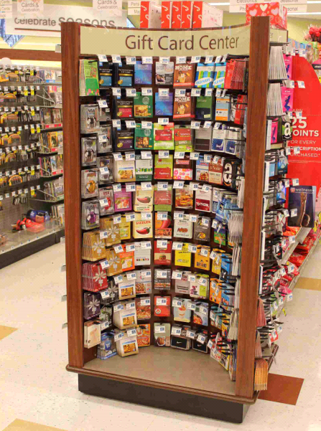
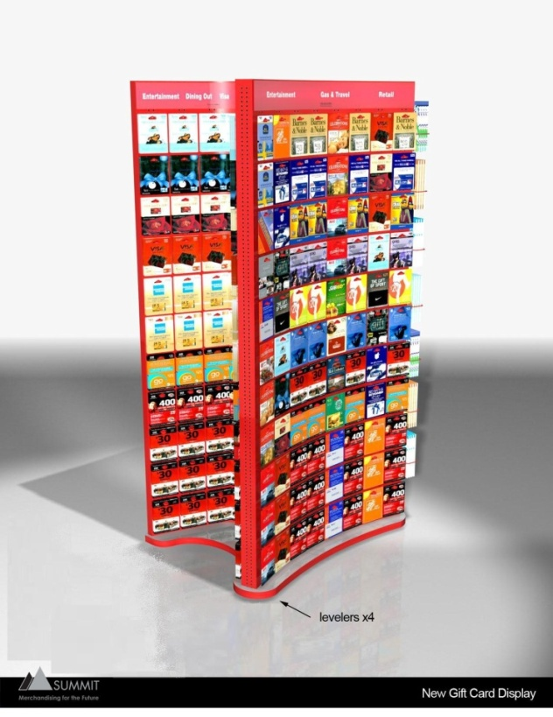
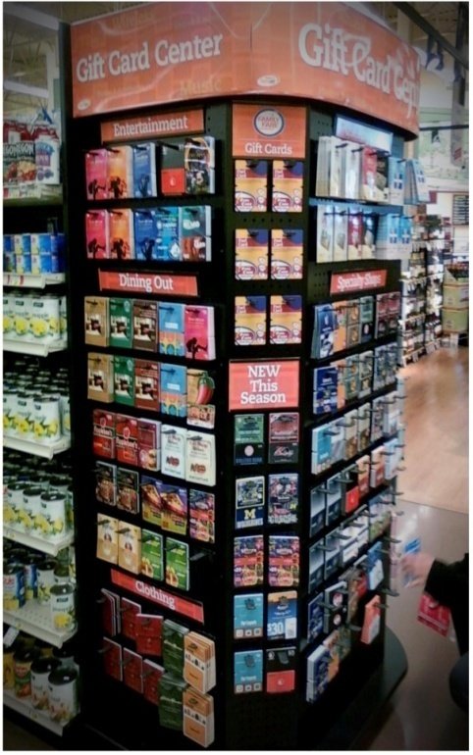
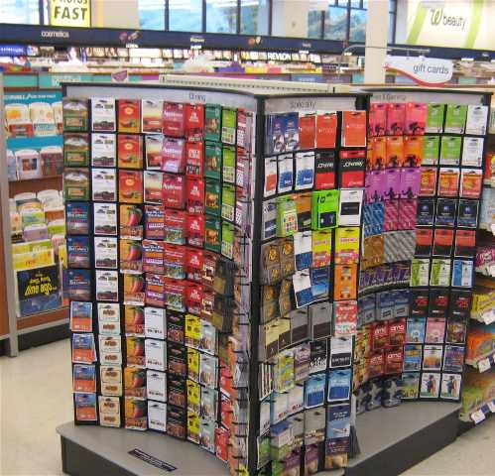







INCOMM RETAIL DISTRIBUTION & MERCHANDISING

Slide 3
Prepaid growth
Aite Group forecasts that prepaid retail transactions will grow to $252 billion dollars market-wide by 2016 *
“Prepaid has gone mainstream,” said Aufseeser. “Twenty-three percent of all consumers have a prepaid card.” *
Overall prepaid financial services market saw an annual compound growth rate of nearly 31 percent from 2003-2012, while debit cards grew at 13 percent and credit cards grew at nearly 4%.*
* “Gift Cards Not Just for Gifting” article from Aite Group analyst Madeline Aufseeser

Slide 4
Did You Know?
51% of all households under age of 25 (aka “millennials”) DO NOT have a credit card
More than 20% of US population uses financial services outside the banking system — typically for reasons of convenience.
Forty-three percent of prepaid debit card users are Gen-Yers.

Slide 5

Paradigm shift
“Starbucks sees 30 percent of its U.S. transactions come via the physical or mobile versions of its stored value Starbucks Card.”*
Prepaid stored value supports:
Convenience
Controlled spend
Driven by loyalty
*Starbucks Corporation (SBUX) Jefferies Global Consumer Conference June 18, 2013 9:30 AM ET

Slide 6
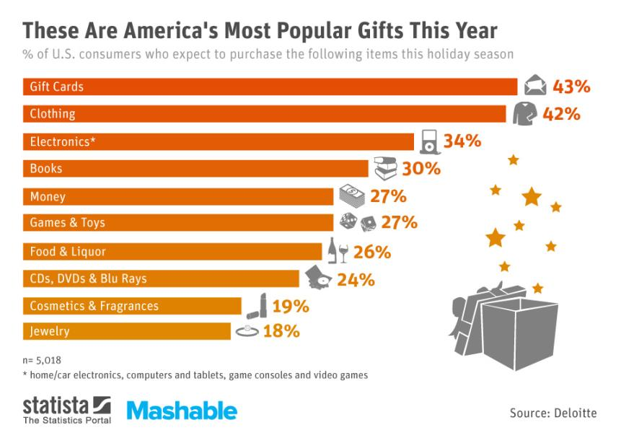

Slide 7
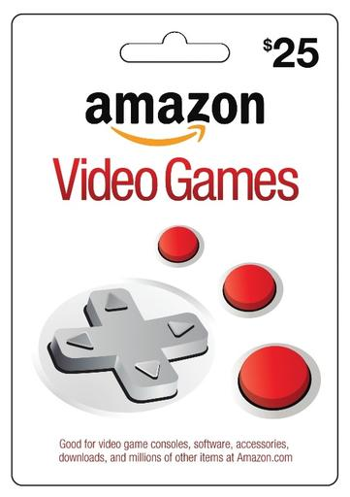
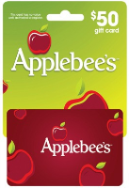
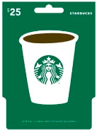

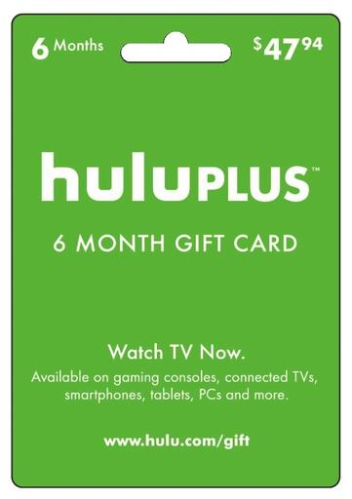
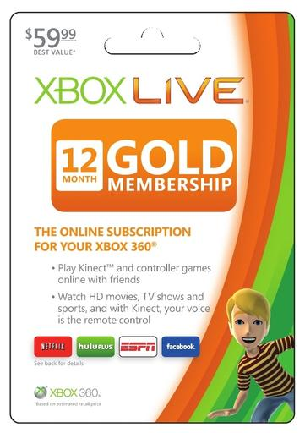
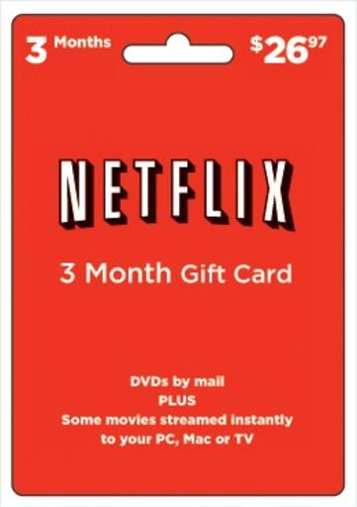
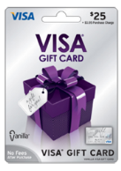
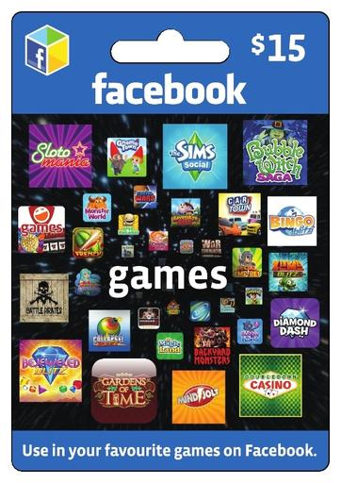


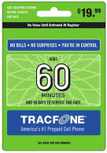
LOTTERY BRANDS in a new context…
InComm retails products in every category:
traditional gift cards for retail, casual dining, movies & entertainment
content & gaming cards for online purchase of games, apps, entertainment
Wireless top up
Financial Services & open loop gift card products
InComm processed $28B in transaction volume in 2013 across all our product categories.

Slide 8

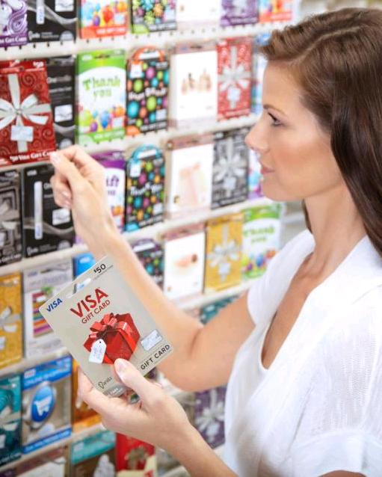
Incomm: gift card solutions
Market lottery as a gifting opportunity:
Lottery is not inherently “gift-able” because picks are personal – prepaid gift cards are a great solution
Leverage retail holiday seasons throughout the year – not just Christmas
Merchandise your brand in a new retail context – where consumers are looking for gifting options
Gift consumers the opportunity to choose a Lottery Gift Card

Slide 9
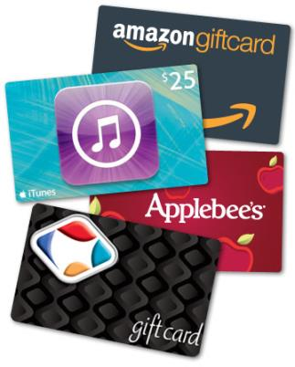
Incomm lottery solutions
NEW retail distribution:
Leverage InComm distribution into non-traditional retailers
Location, location, location – bring lottery out from behind the counter; new retail merchandising
CASH-OUT solutions for retailers:
Give cash-strapped retailers an option to cash-out their customers to a non-reloadable open loop Visa/MC/Discover card

Slide 10
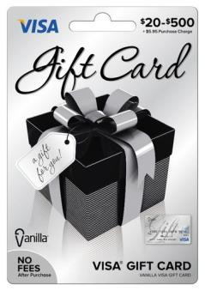
CONTACT information
Tony Fontaine
VP Business Development,
Interactive Gaming and Lottery Solutions
tfontaine@incomm.com
702-429-5959
Karina Grotz
Business Development
Interactive Gaming and Lottery Solutions
kgrotz@incomm.com
213-210-9913

Slide 11


