Slide 1
Instant Tickets:
Redefined

Slide 2


Slide 3
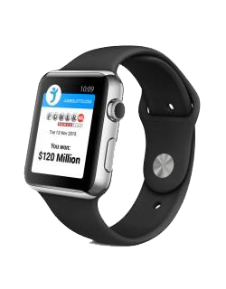
  Lotteries want new and innovative products

Slide 4
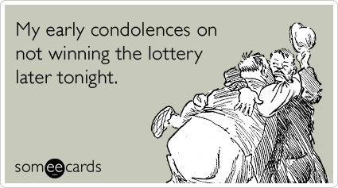
  Draw game sales dependent on jackpot size

Slide 5

  Lottery sales targets consistently increasing

Slide 6

  Limitations on just how innovative you can be

Slide 7
  So where’s the Opportunity?
Notes:
This is where I’d like to introduce myself and my company.

Slide 8
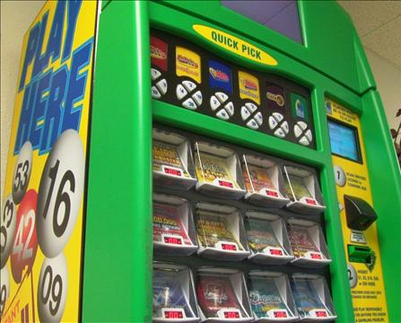
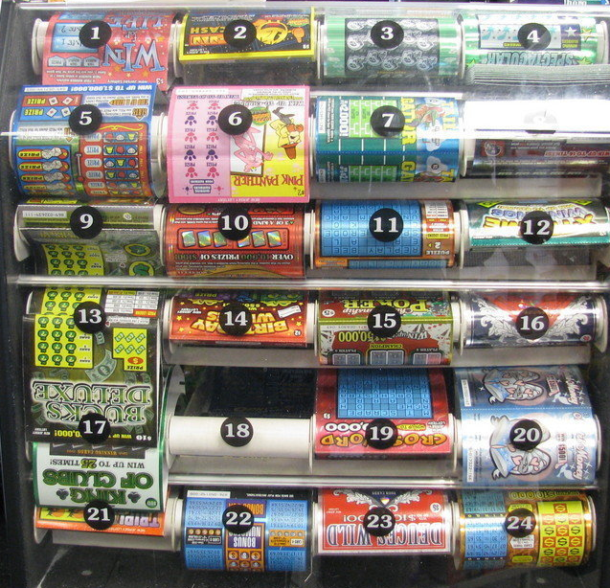

Slide 9
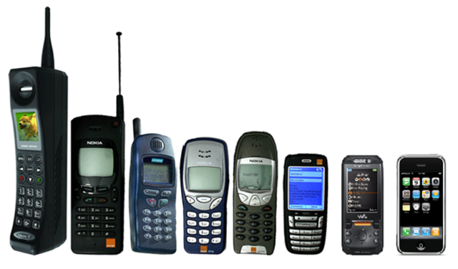
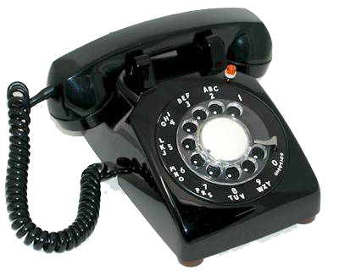

Slide 10

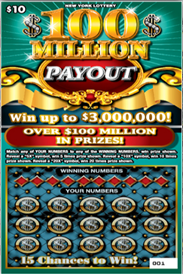
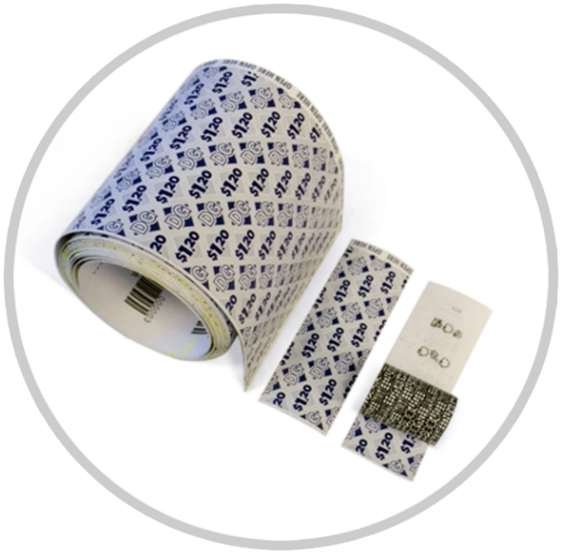



Slide 11
  Who can deliver the opportunity?

Slide 12


Slide 13

+
  Printing instant tickets
  Manufacturing ticket dispensers with video display
  Developing unique games and product lines

Slide 14
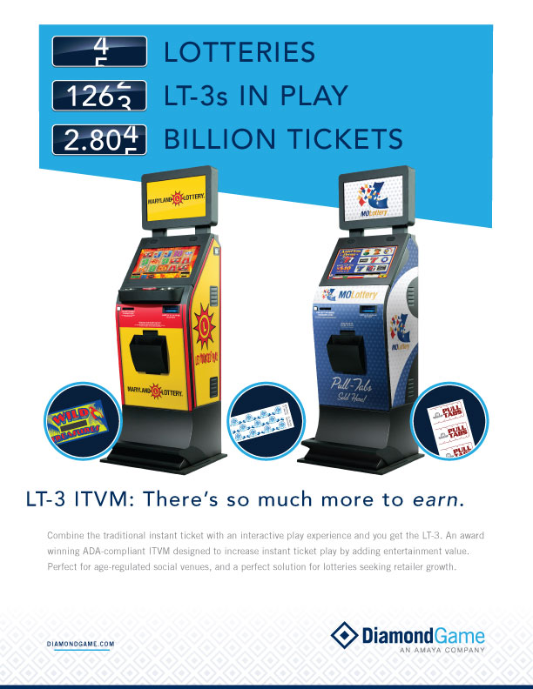

Slide 15


Slide 16
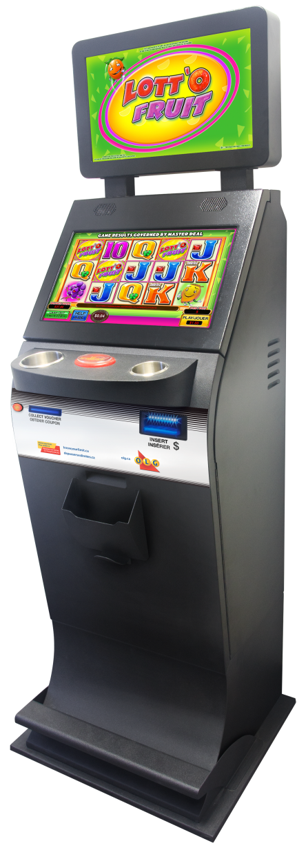
New & innovative, but not really
Consistent sales generation
Incremental sales & retailer expansion

Slide 17



Slide 18

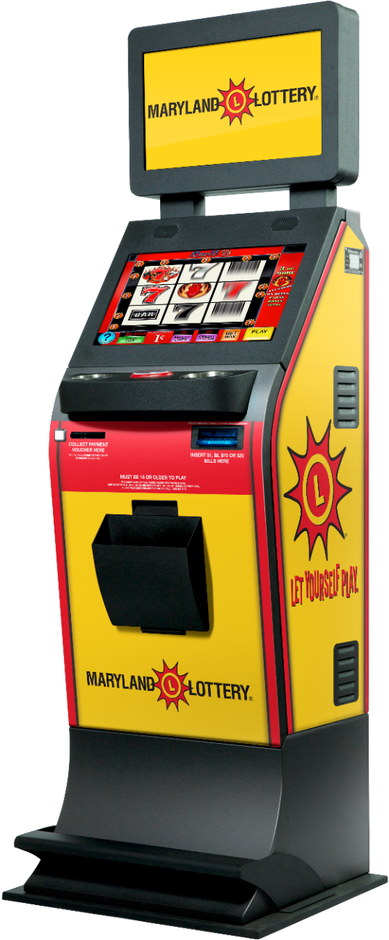
August 2014 deployment
Veteran Halls

Slide 19


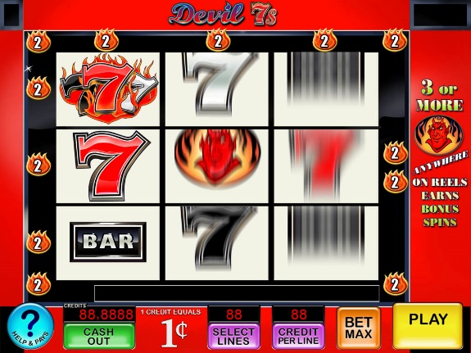
Notes:
Product Configuration

Slide 20
3.8 million tickets/month
Over $22 million in gross sales
$1 million Veteran proceeds

Slide 21
Entertainment value
Higher payout
Longer play experience

Slide 22

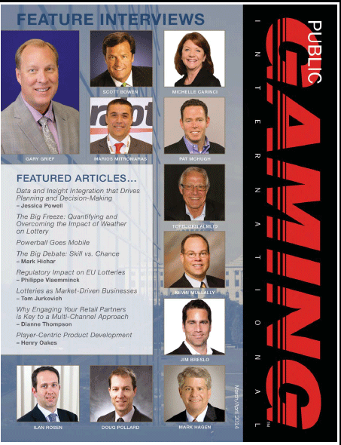

Slide 23


