Slide 1
Maximizing digital for lotteries
Richard Bateson
SVP sales & marketing
March 2015

Slide 2
Agenda
Understanding the opportunity
The challenge and opportunity
Maximizing the opportunity
3 guiding principles
The right enablers
UK case study
5 top tips

Slide 3
Understanding the opportunity

Slide 4
The challenge… the opportunity
“Net revenue returns (and participation) is falling”
Players often don’t play due to convenience or CNBB
Lotteries are mass-market…
…digital is mass-market (mobile making it even more so)
Lottery markets are typically mature
Digital offers an answer to unlocking a younger audience
Lotteries are craving innovation and player relevance
“iLottery done properly will grow net revenue and grow participation”
Notes:
Lotteries are well-suited to digital. The nature of lottery products themselves, as an impulse product and a secure electronic transaction, is particularly well-suited to digital and mobile. Furthermore, it enables lotteries to expand distribution at low marginal cost to increase participation and importantly across traditionally hard to engage demographics.
Lotteries are mass-market. Lottery, as a mass-market product, must also reflect broader consumer behavior. Lotteries must ensure that their product and distribution ‘offering’ is aligned with an increasingly digital consumer, including an increasing propensity to transact on their mobile device – 43% of US citizens completed at least one transaction on their smartphone in 2013
Lottery markets are typically mature. In almost all jurisdictions, lottery is a mature product, often with falling levels of player participation coupled with a challenge in recruiting and retaining the younger demographic. Mobile presents an opportunity for lotteries to maintain their relevance to consumers, and attract this younger demographic, who have grown up with mobile.
Established digital and mobile lottery channels have proved successful in the UK and Europe. In the UK, consumers have been able to make lottery purchases through digital and mobile transactions since 2003 under established responsible gaming best practices. A selection of European lotteries that have an established digital channel include: La Française des Jeux, the Irish National Lottery, Lottomatica, Norsk Tipping and Danske Spil to name a few.
Adjacent industries have gathered significant value through mobile. Indeed PaddyPower through its multi-channel (digital, mobile and retail) approach achieved a 17% increase in its net revenue in 2013 with 79% of its profits coming from digital. In its 2013 annual report it predicts double digit annual growth for mobile betting over the next five years with this growth representing up to 90% of total industry growth.
Mobile market data is based on 2013 nVision Research, based on a sample of 5,000 consumers

Slide 5
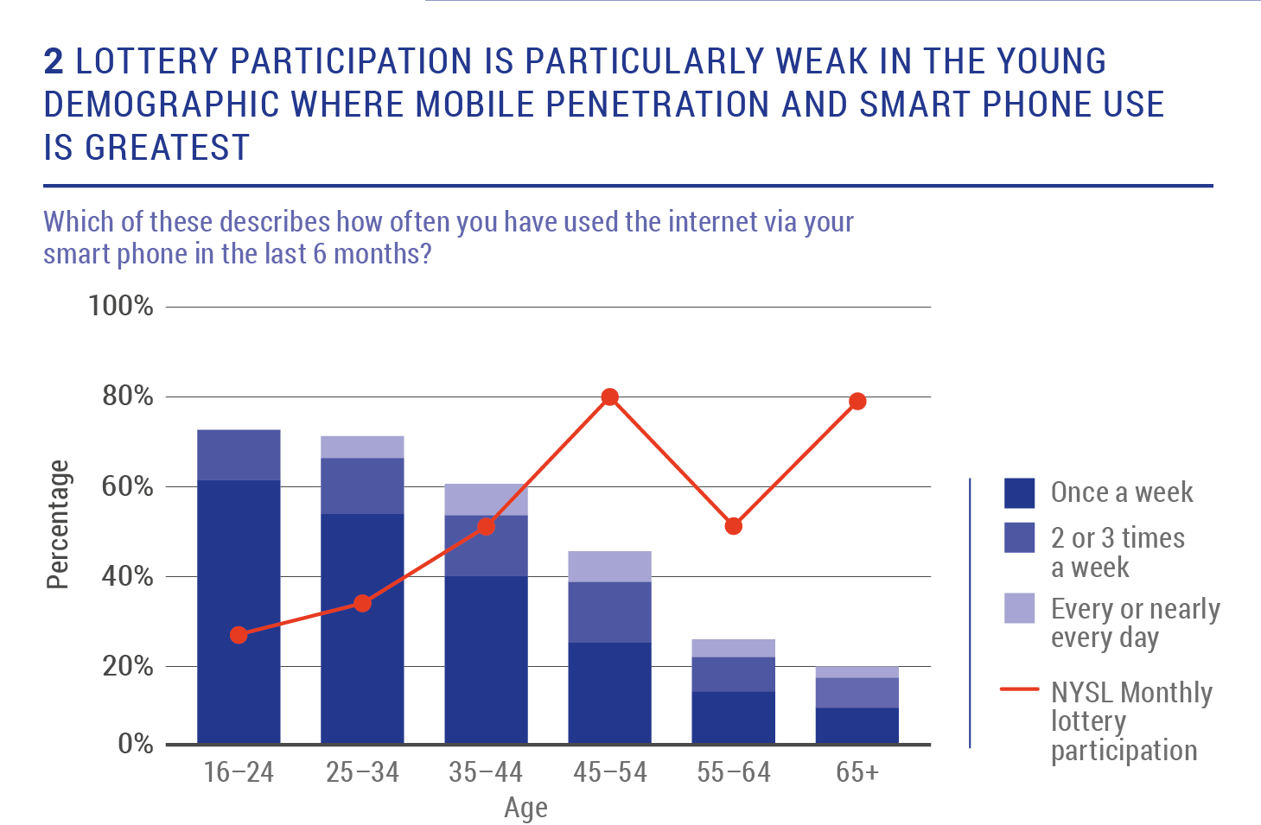
Understanding the opportunity
Lottery participation is weak with younger segments… yet internet usage via a mobile phone is higher with these segments.
Once a week
2 or 3 times
a week
Every or nearly every day
Lottery participation
Notes:
Lotteries are well-suited to digital. The nature of lottery products themselves, as an impulse product and a secure electronic transaction, is particularly well-suited to digital and mobile. Furthermore, it enables lotteries to expand distribution at low marginal cost to increase participation and importantly across traditionally hard to engage demographics.
Lotteries are mass-market. Lottery, as a mass-market product, must also reflect broader consumer behavior. Lotteries must ensure that their product and distribution ‘offering’ is aligned with an increasingly digital consumer, including an increasing propensity to transact on their mobile device – 43% of US citizens completed at least one transaction on their smartphone in 2013
Lottery markets are typically mature. In almost all jurisdictions, lottery is a mature product, often with falling levels of player participation coupled with a challenge in recruiting and retaining the younger demographic. Mobile presents an opportunity for lotteries to maintain their relevance to consumers, and attract this younger demographic, who have grown up with mobile.
Established digital and mobile lottery channels have proved successful in the UK and Europe. In the UK, consumers have been able to make lottery purchases through digital and mobile transactions since 2003 under established responsible gaming best practices. A selection of European lotteries that have an established digital channel include: La Française des Jeux, the Irish National Lottery, Lottomatica, Norsk Tipping and Danske Spil to name a few.
Adjacent industries have gathered significant value through mobile. Indeed PaddyPower through its multi-channel (digital, mobile and retail) approach achieved a 17% increase in its net revenue in 2013 with 79% of its profits coming from digital. In its 2013 annual report it predicts double digit annual growth for mobile betting over the next five years with this growth representing up to 90% of total industry growth.
Mobile market data is based on 2013 nVision Research, based on a sample of 5,000 consumers

Slide 6
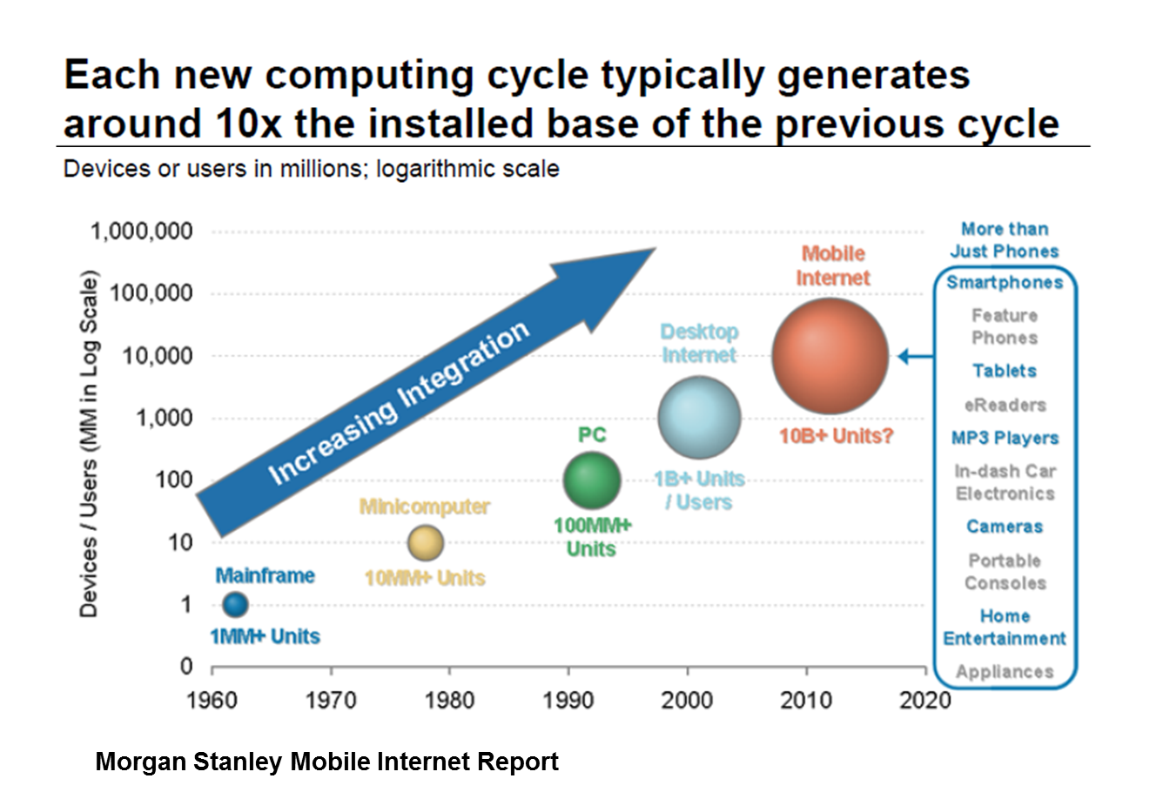
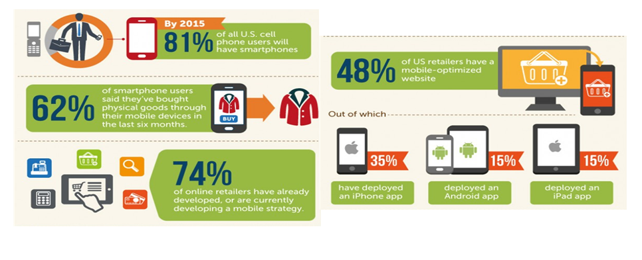
The digital agenda is being driven harder by mobile

Slide 7
A few factoids…
“More people have mobiles in the world
than have toothbrushes”
“There are 5 times as many mobiles
in the world as there are PCs”
“Time spent on mobile apps is
Dominated by gaming and social”
“Mobile internet access in 2014
exceeded PC internet”
“3/4 of people will leave a mobile website
if it doesn’t load within 5 seconds”
Notes:
Lotteries are well-suited to digital. The nature of lottery products themselves, as an impulse product and a secure electronic transaction, is particularly well-suited to digital and mobile. Furthermore, it enables lotteries to expand distribution at low marginal cost to increase participation and importantly across traditionally hard to engage demographics.
Lotteries are mass-market. Lottery, as a mass-market product, must also reflect broader consumer behavior. Lotteries must ensure that their product and distribution ‘offering’ is aligned with an increasingly digital consumer, including an increasing propensity to transact on their mobile device – 43% of US citizens completed at least one transaction on their smartphone in 2013
Lottery markets are typically mature. In almost all jurisdictions, lottery is a mature product, often with falling levels of player participation coupled with a challenge in recruiting and retaining the younger demographic. Mobile presents an opportunity for lotteries to maintain their relevance to consumers, and attract this younger demographic, who have grown up with mobile.
Established digital and mobile lottery channels have proved successful in the UK and Europe. In the UK, consumers have been able to make lottery purchases through digital and mobile transactions since 2003 under established responsible gaming best practices. A selection of European lotteries that have an established digital channel include: La Française des Jeux, the Irish National Lottery, Lottomatica, Norsk Tipping and Danske Spil to name a few.
Adjacent industries have gathered significant value through mobile. Indeed PaddyPower through its multi-channel (digital, mobile and retail) approach achieved a 17% increase in its net revenue in 2013 with 79% of its profits coming from digital. In its 2013 annual report it predicts double digit annual growth for mobile betting over the next five years with this growth representing up to 90% of total industry growth.
Mobile market data is based on 2013 nVision Research, based on a sample of 5,000 consumers

Slide 8
Maximizing the opportunity

Slide 9
3 guiding principles to maximizing the opportunity
Change in mind-set for the lottery
Focused player management
Need the right enablers

Slide 10
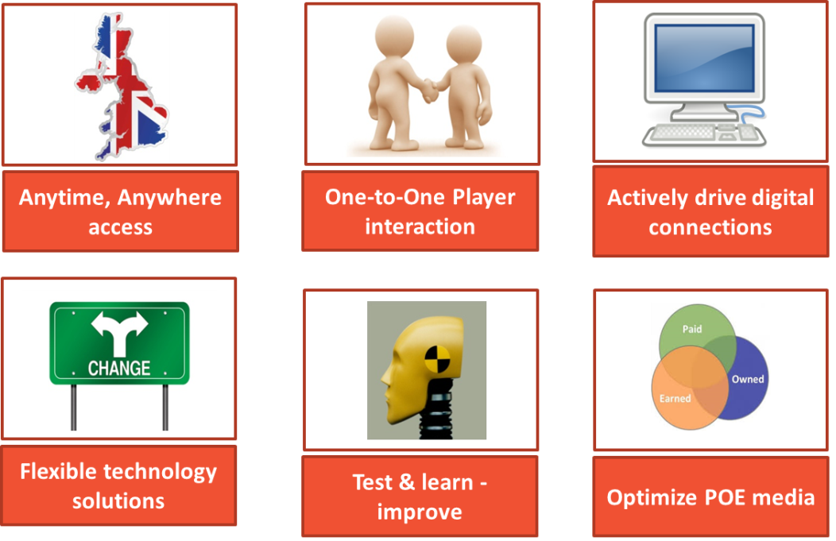
Change of mind-set…
… requires the channel to be traded like a digital retailer
… need to invest in convenience and multi-channel thinking
… digital affords new relationships with players, new demands on the business and new ways of working

Slide 11
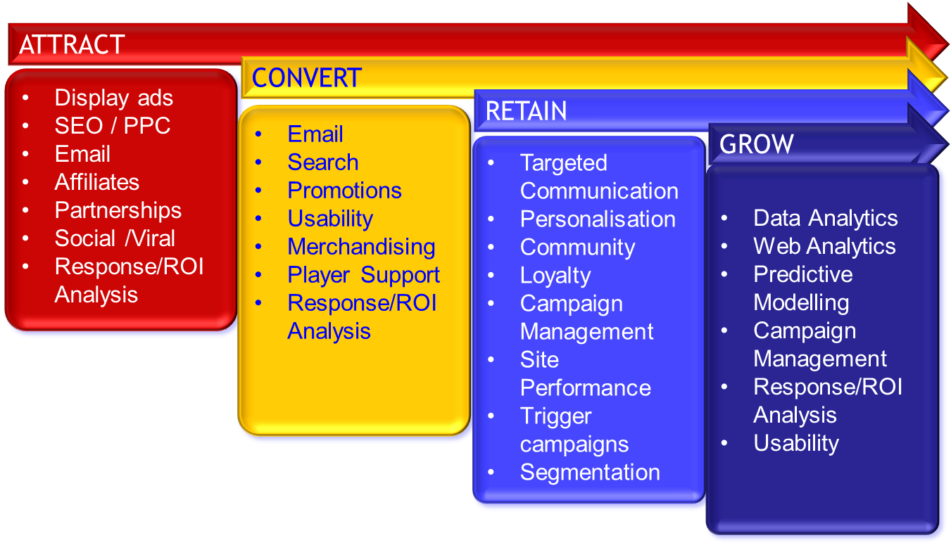
Focused player management…
…invest and focus on player ‘life-cycle’ management… need to focus on targeting the right players and their Life Time Value
…the aim is to attract latent demand, and not to cannibalize retail

Slide 12
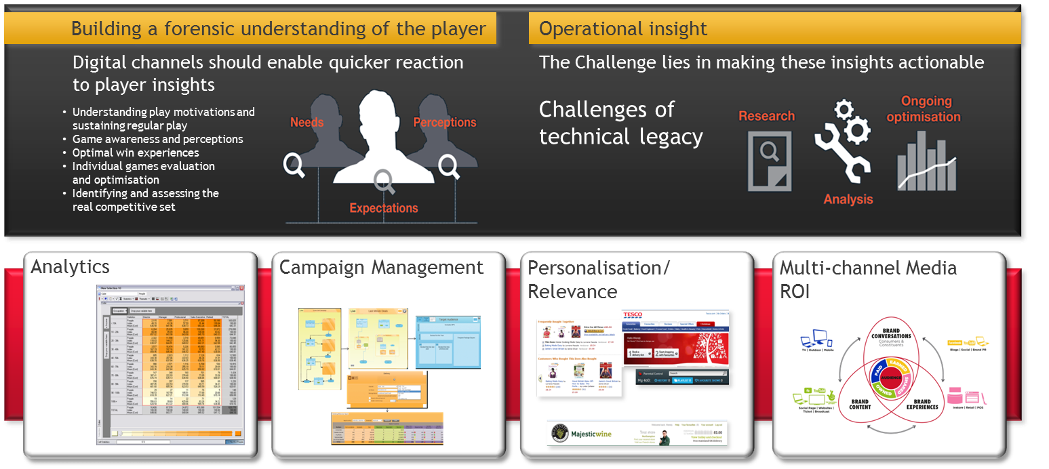
Need the right ‘enablers’
…key to achieving the first two objectives is having the right ‘enablers’ of people, processes and technology
…requires a transformation of expertise understanding and technology
…specialist know-how is required to maximize the opportunity, as is the technology require to enable the sales & marketing plan

Slide 13




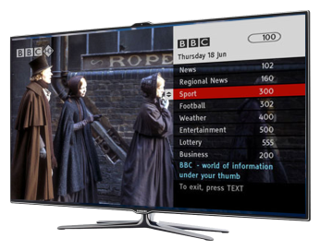

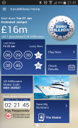

Case study UK:
New iLottery platform

Slide 14
In 2014 Camelot launched its own iLottery platform in the UK… why?
The old platform could not provide the technical agility needed to under-pin future growth plans
Limited ability to optimise site engagement and path to purchase
No adequate mobile capability
Often the longest lead time in game development and commercial planning
Dependent on vendor roadmap, rather than of lottery operator requirements/future needs
2 or 3 releases a year, requiring the business to work in waterfall methodology
Difficult to integrate with third party tools and systems
Expensive to run and test
Notes:
See comment

Slide 15
What did the new UK platform offer the lottery that the old platform could not.
An open, service-orientated web platform
Designed and built using latest methods and technologies
Approach allows re-use of components and infrastructure where necessary
Web services platform can be integrated with any host lottery system; designed to be multi-language, multi-currency and multi-jurisdictional
Responsive web application allows easy access across mobile, tablet and desktop
Supports both draw-based and instant games
New platform went live in September 2014 with 6 million live player records and a new PC, mobile and tablet rendered iLottery channel.
Notes:
See comment

Slide 16
Need the right ‘enablers’
Sales at record levels for both PC and mobile…
Digital sales are currently tracking c.15% up year-on-year with new registrations up 21% year-on-year.
IWG sales have set new records since the new website went live - recently recorded $11m in one week.
Total IWG sales are up an average 56% per week since launch
Mobile sales are up 68% year on year and Mobile (smartphone only) and now accounts for 20% of all digital sales
The range of 17 new MIWGs has seen IWG penetration of interactive players rise from 17% pre iLottery to 25% post iLottery
29% of MIWG players are completely new to the category
Notes:
See comment

Slide 17
Top five tips

Slide 18
Top five tips:
Mobile – you must have an optimized mobile offer
Content – draw-based games, IWG and invest in R&D important to drive footfall & spend
Data & segment – get close to your data and target your activities
People – you need people who understand digital and how to ‘trade’ your platform
Technology – you need technology that allows for agile development of the platform. Need to test & learn / fail fast

