Slide 1
MOBILE:
CHANNELING SUCCESS IN ILOTTERY

Slide 2
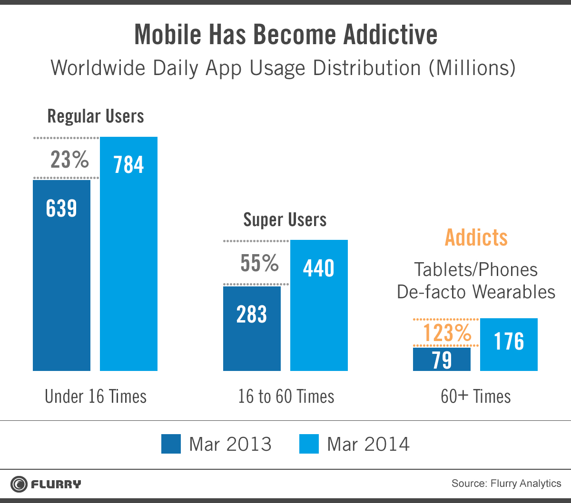
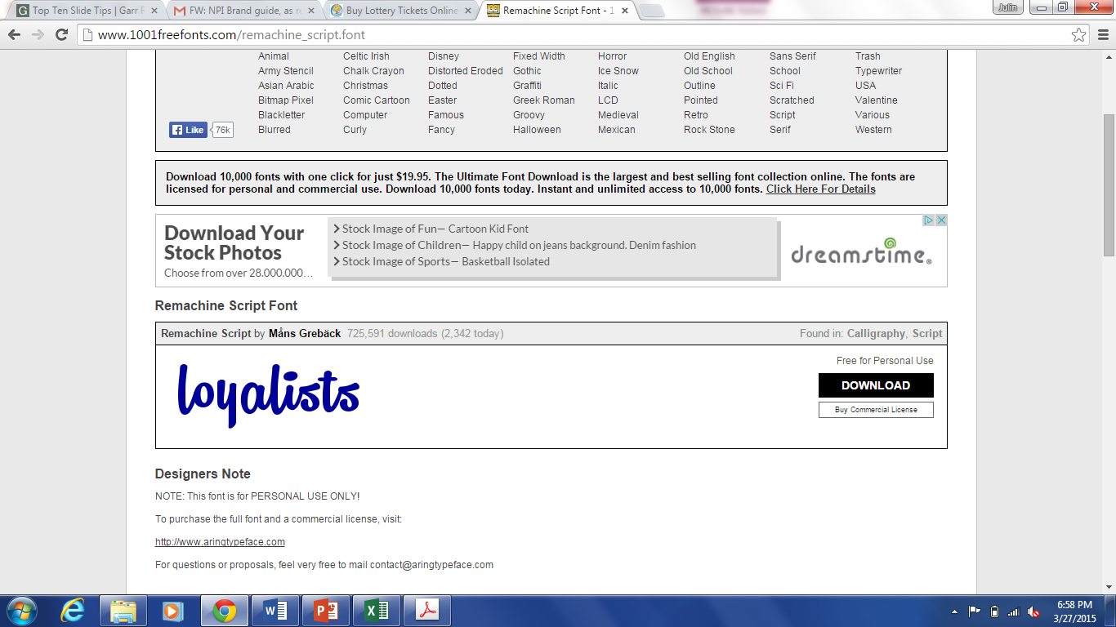

*!@?#
6x
higher usage

Slide 3


LATEST TREND IN MOBILE
BUY ONLINE

Slide 4

simplify.
44%

Slide 5
TRUE
FALSE
iLottery attracts younger players.

Slide 6

#
T
R
U
T
H
66%

Slide 7
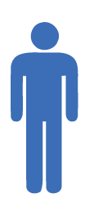



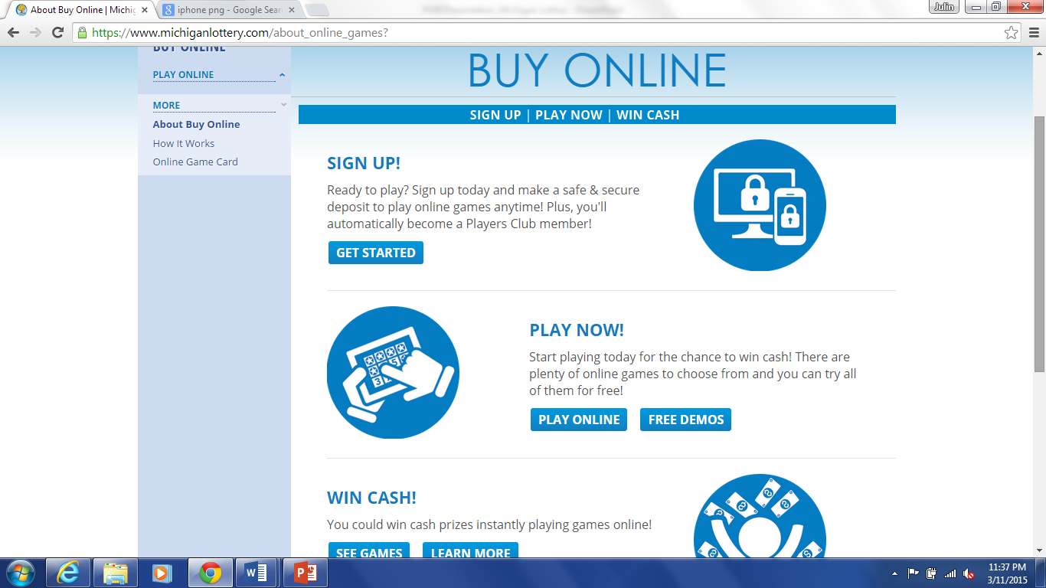
in fact...
50
38

Slide 8
so what?
the rise of the mobile player.

Slide 9

MOBILE USAGE RATES
growth of mobile depositors outpacing web.
48
20
W
M

Slide 10
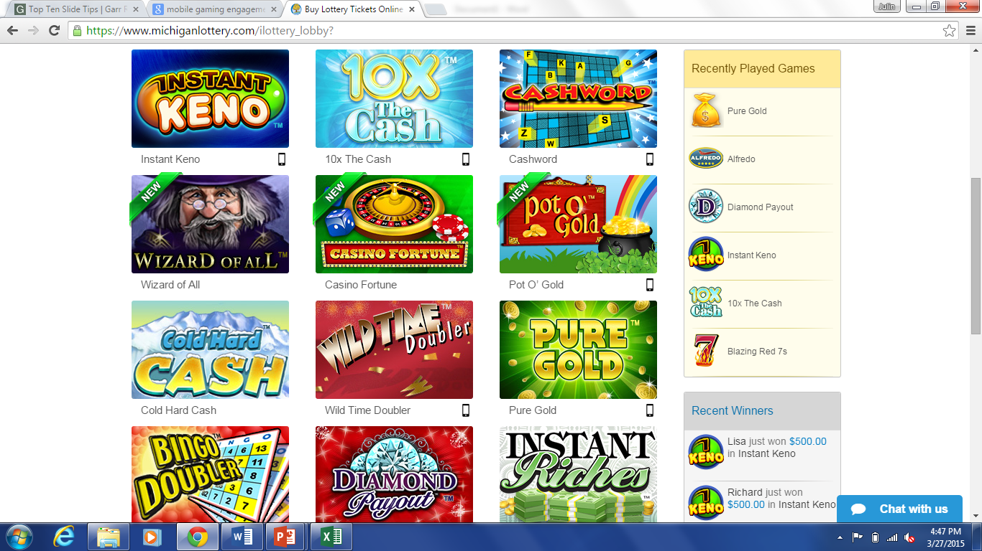

7%
MOBILE ENGAGEMENT

Slide 11


MOBILE PLAYER VALUE
83%

Slide 12
MOBILE SALES CHANNEL
40%
of iLottery sales

Slide 13

mobile matters
JULIN SHAW | MANAGER, INTERACTIVE SALES AND MARKETING | JSHAW@PBL.CA

