Slide 1

PGRI SMART-Tech 2015

Slide 2
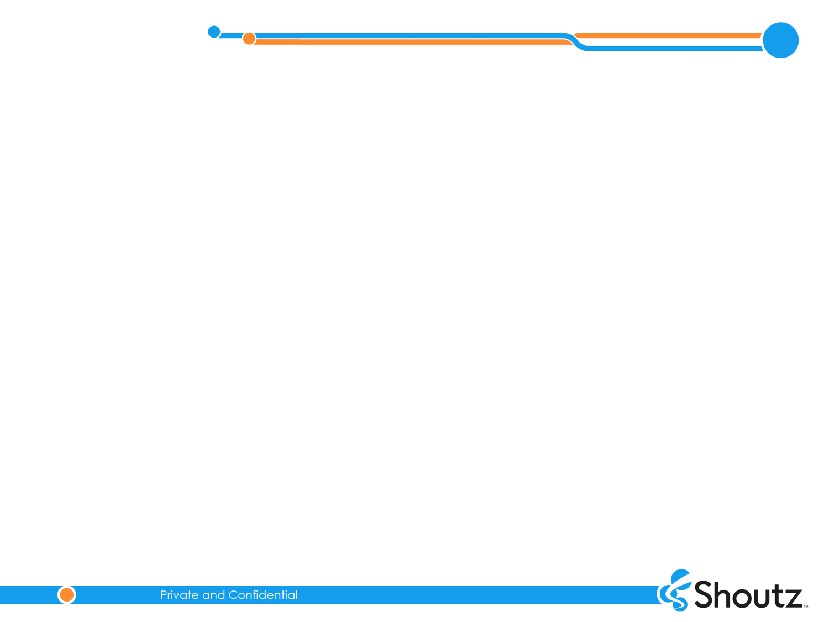




About Shoutz
2
We bring together the rewarding and fun experiences of mobile gaming with consumer engagement and loyalty programs
With our innovative use of digital media, we give lotteries the power to better engage their players, accurately measure their marketing efforts, and optimize their fundraising abilities
Shoutz is an associate member of the World Lottery Association and recently completed a comprehensive vetting process conducted by the Texas State Lottery Commission
Shoutz has been an active supporter of the Multi-State Lottery Association since debuting its LotteryHUB™ mobile application in May 2013
• Shoutz, Inc. is an
award winning gaming, marketing and technology company that brings together the rewarding and fun experiences of mobile gaming with consumer engagement and loyalty programs within the retail, media & entertainment industries
• LotteryHUB is an official app of both Powerball and Mega
Millions, and has become the lottery player’s ‘go-to’ source
for winning numbers, information and news

Slide 3

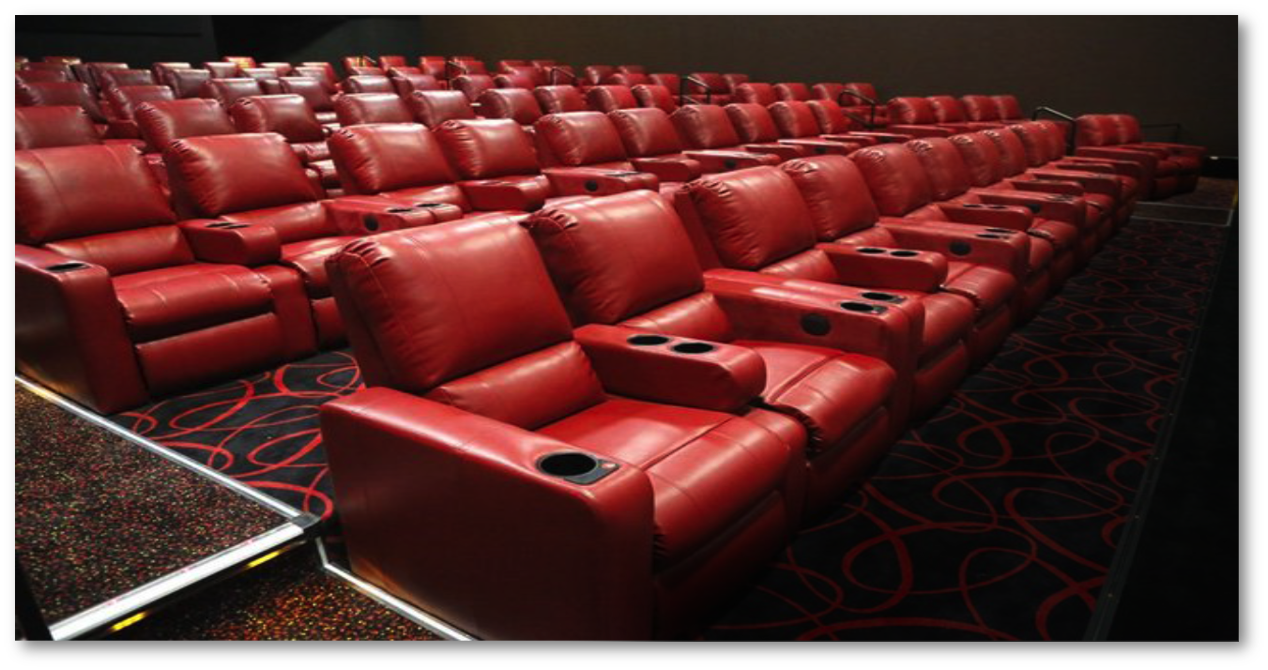
3
• With so many emerging options and technologies battling for
the consumer’s entertainment and leisure dollars, how do you
remain a relevant experience, particularly within the coveted
millennial demographic
•Relevance is found
through engagement
• Engagement comes through
offering value, not discounts,
and compelling content

Slide 4
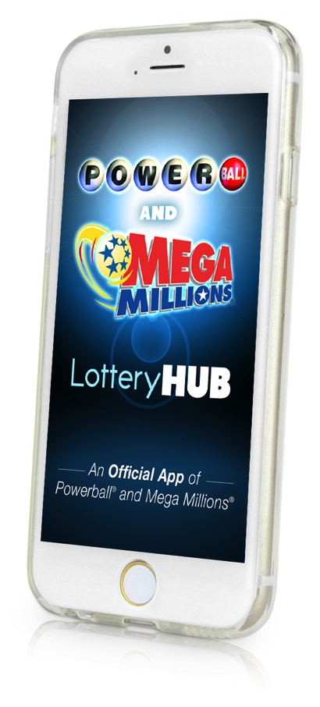
LotteryHUB
4
LotteryHUB is our flagship product
LotteryHUB is an official mobile application of Powerball and Mega Millions
Provides lottery players a convenient, engaging and rewarding mobile experience that includes video and news content, jackpot and drawing information, and a loyalty rewards program
Players can also use the app to save their tickets, either by entering numbers manually or scanning tickets with a smartphone camera
LotteryHUB has twice been named the Best Mobile App by the American Gaming Association (AGA) and has won AGA Awards in the Best Direct Digital Marketing and Best Mobile Marketing categories

Slide 5

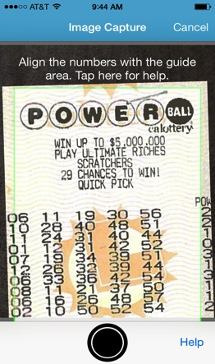
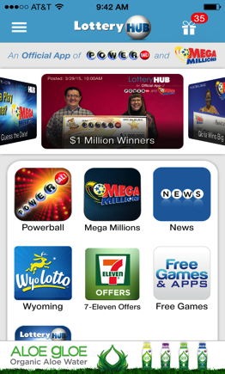
LotteryHUB
5
1,800
APPROX.
1.0M
9.0M+
25M
5.5M
AVG. DAILY
DOWNLOADS
DOWNLOADS
USER SESSIONS
SCREEN VIEWS
VIDEO PLAYS
Year to date, we are delivering an average of 1.5 million messages a week, totaling 46.0 million since launch
LotteryHUB has also generated almost $500,000 in third-party advertising revenue for Multi-State Lottery Association members and the charitable causes they support
During the February Powerball jackpot run-up, LotteryHUB jumped to the #1 free News app in the iTunes

Slide 6

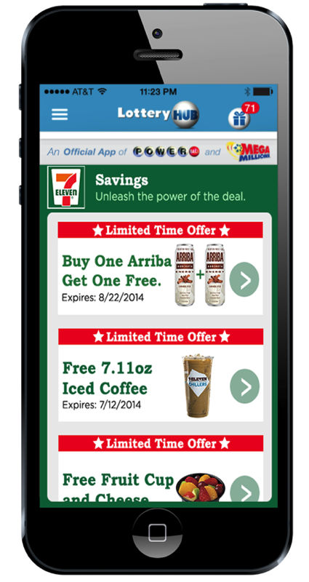
6
LotteryHUB teamed with 7-Eleven in a national campaign offering buy-one-get-one-free coupons for Arriba energy drinks
7-Eleven stores make up the largest network of lottery retailers in the nation and by combining forces with Lottery-HUB’s digital couponing and communications platform, our goal is to further reinforce lottery player engagement through compelling content
7800
Redeemable in
7-Eleven
Stores
62%
buy tickets at convenience stores
Of Lottery
Players
65%
And spend
than non-lottery players
More

Slide 7
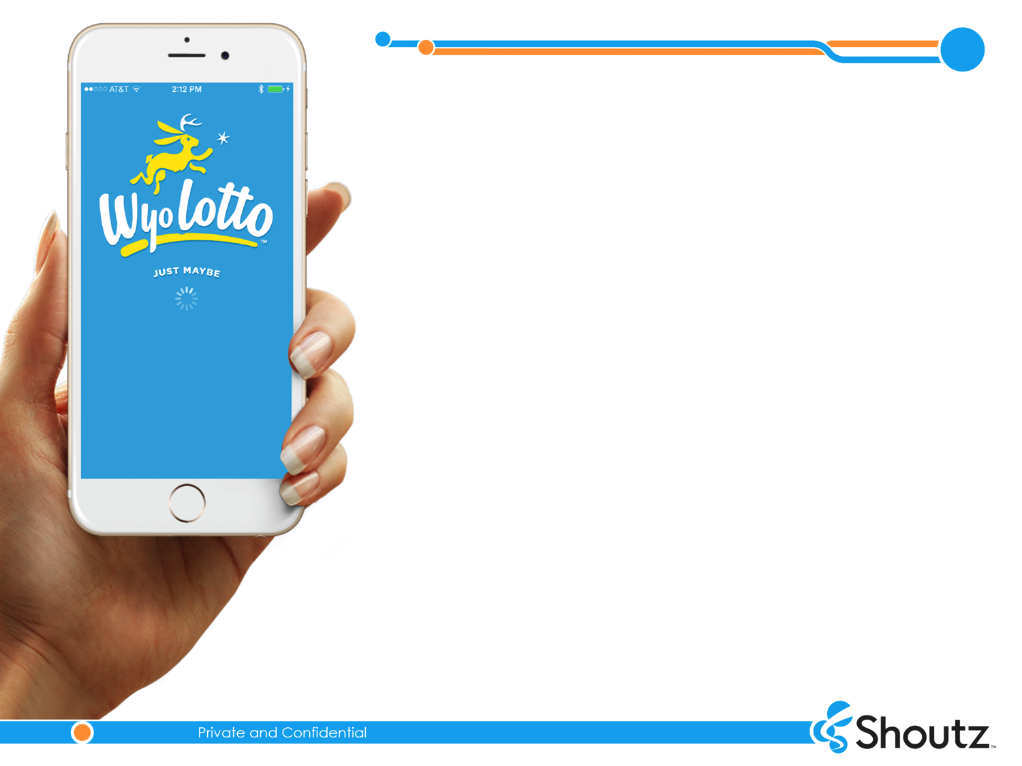


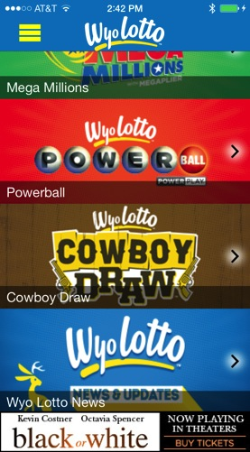
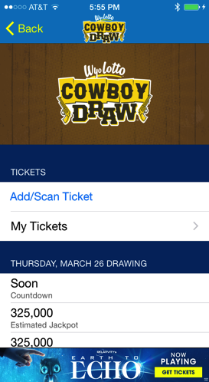
7
Leveraging the LotteryHUB architecture and launching a customized mobile app for the Wyoming Lottery in April
The app will allow the lottery to provide its players with
unique content and customized brand experience for Mega Millions, Powerball and their unique Cowboy Draw game

Slide 8

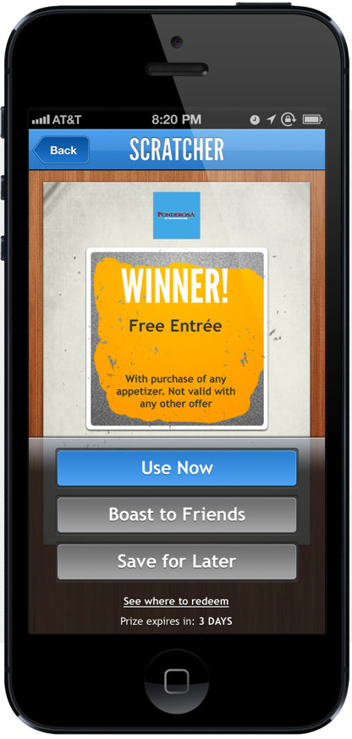
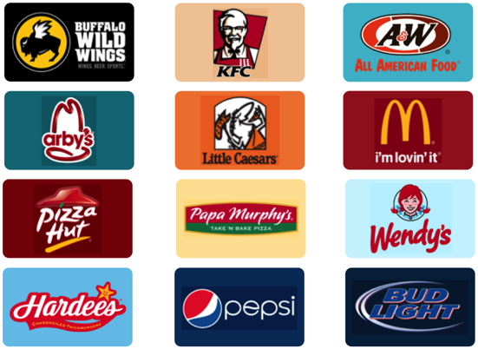
8
Front Flip allows users to sign up for multiple loyalty programs, receive gifts, earned reward programs, interact with social media, and share their experience and gifts with friends
Front Flip’s mobile scratch-off format adds a fun “gaming” element to prize delivery and overall consumer engagement
1.4M
DOWNLOADS
7.0M
SCANS
16%
REDEMPTION
RATE

Slide 9

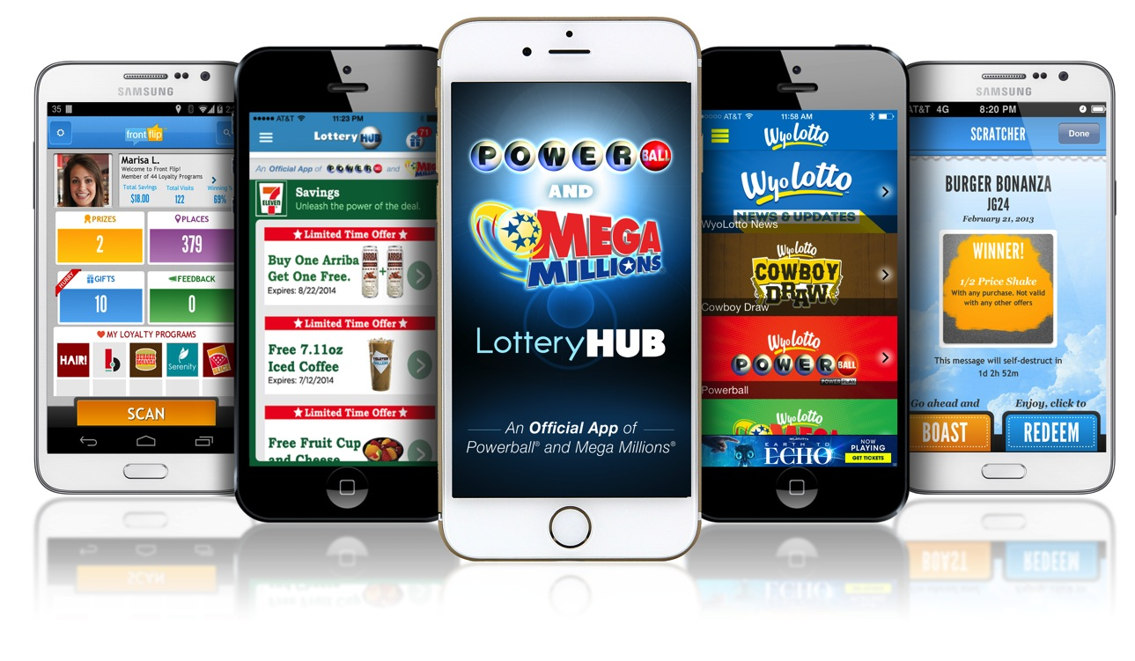
9
THANK YOU!

