Slide 1
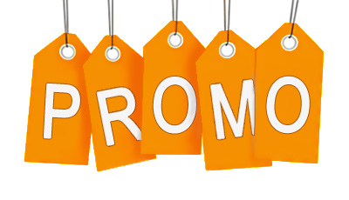
The psychology of promotions
PGRI, NYC 2015
Fivi Rondiri

Slide 2
Significance
Promotion is an essential element in the corporate marketing mix.
Promotion allows businesses to reach out to consumers using various forms of media, techniques and strategies to capture their attention.
Promotion delivers a brand marketing message to consumers' television screens and radios; in the stores where they shop; online; and in magazines.
Goal: inform, persuade and remind customers about the products and services we have to offer.
  Increase sales
  Attract new customers
  Retain current customers
  Educate

Slide 3
Types & Strategies
Promotion can be broken down into three categories:
  Advertising (e.g. print advertisements in magazines, banner advertisements on the Internet or commercials)
  Sales promotion (e.g. discounts, special events, contests, customer loyalty programs)
  Public relations (e.g. articles, press releases)
Push
POS Displays
Emails
Pull
Coupons
Loyalty Programs
Special Events
Vs.

Slide 4
Considerations
The key is deciding on the right type of promotion to run and clearly defining the parameters of the promotion.
Plan
  What is the Objective?
  Short Term (e.g. trial) vs. Long Term (e.g. loyalty)
Determine the Details
  Who is eligible to enter?
  How many entries per person will be allowed?
  What is the contest duration?

Slide 5
Define Success
Cold metrics
  Numbers help justify decisions, remove some risk.
  Sales, Tickets, Frequency
Warm metrics
  Marketers can be skeptical of warm metrics, because they defy easy math.
  Engagement levels, Viral factors, Sentiment analysis
Combination is the best solution:
  Traditional ROI
  When it is difficult to tie directly to sales:
    Return on Influence (especially for social media- value per follower/fan)
    Return on Objective (common marketing objectives include increasing factors like awareness, brand favorability and purchase intent)

Slide 6
Psychology
Here are a few things to keep in mind that can help generate a great promotion.
Create a great promotion name.
  Something catchy that fits within the promotion theme.
  The visual appearance of a promotional message is often more influential than the deal itself.
Have a clear call-to-action.
  Keep it simple or it could result in fewer – and possible lower quality entries.
Communicate it as a Special Offer.
  Special offers with restrictions ‘limit two per customer’ or ‘offer valid only until a certain date’ lead to higher sales than the same deals without restrictions.

Slide 7
Psychology
Here are a few things to keep in mind that can help generate a great promotion.
Use the biggest number.
  When looking at % off or save 50 cents, shoppers will find the one with the biggest number disproportionately appealing.
  Shoppers look at the ‘%’ without paying attention to the number to which the ‘%’ applies.
Offer something for FREE.
  The word FREE is processed as no risk (no way of losing).
Make the promotion shareable.
  Include prominent social media share buttons so consumers can easily post to their Facebook and Twitter feeds.
  Be creative!

Slide 8
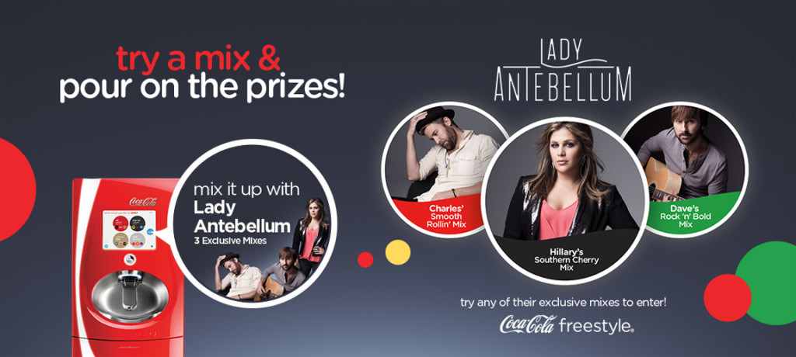
Examples
Encourage Trial
When fans visit participating restaurants with Coca-Cola Freestyle, they can choose from three Lady Antebellum mixes for a chance to mix it up backstage with the award-winning country group.
Each time fans pour an exclusive mix using Coca-Cola Freestyle, they can receive a code which will allow them to enter for a chance to win a grand prize trip for two to a Lady Antebellum concert.

Slide 9
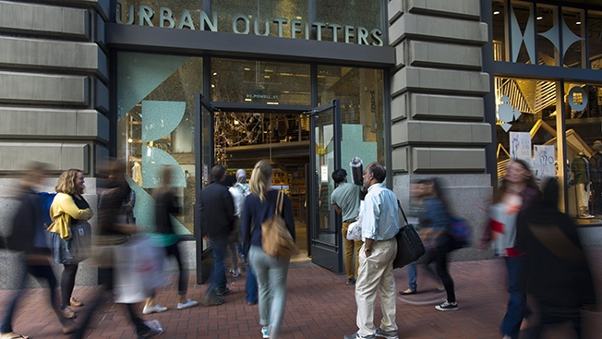
Examples
Use newest technology
Beacons- small devices that marketers place around stores that ping messages at shoppers who have downloaded the retailer's app.
When shoppers first enter the store, a push notification prompts users to check-in via social media to unlock an offer.
Then in the fitting room, beacons are being used to churn out user-generated content about products. Shoppers are prompted to take selfies and post them to Instagram with the hashtag #UOonYou for a chance to be featured on Urban Outfitters' website.
At the register, shoppers may get a push notification promoting them to shake their phone to show the Urban ID—a loyalty card—and earn a digital badge.

Slide 10
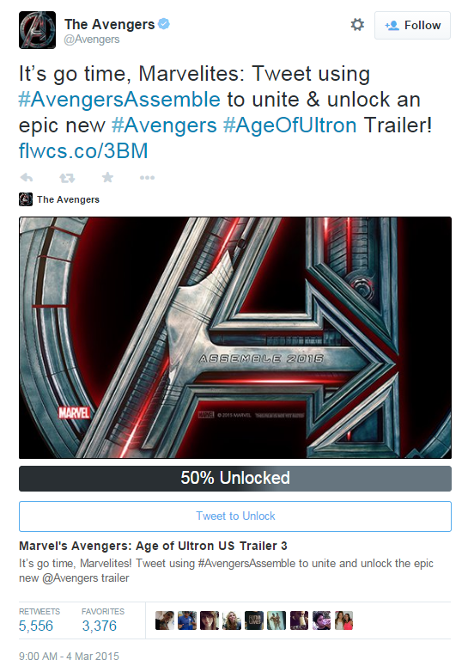
Examples
Create Excitement

Slide 11
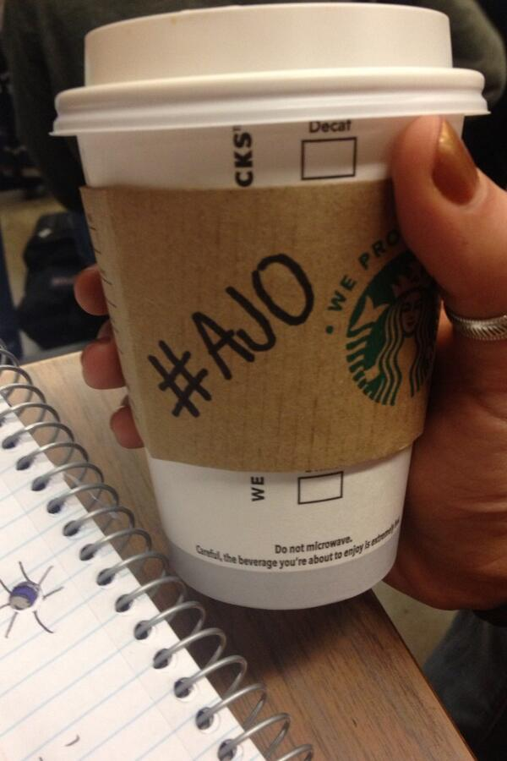
Examples
Cause Marketing
Pay it Forward movement: a worldwide effort by do-gooders to help others. It often helps the needy, but not always. Sometimes it’s just a stranger helping the person behind them by buying them coffee or paying a toll.
#AJO
  Thanks to social media, paying it forward with the #AJO hashtag has spread around the world and has gone well beyond coffee.

Slide 12
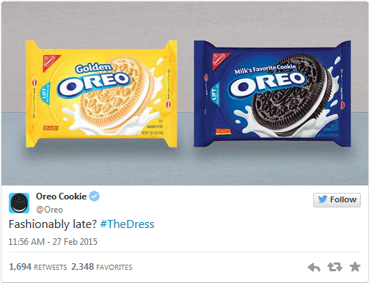
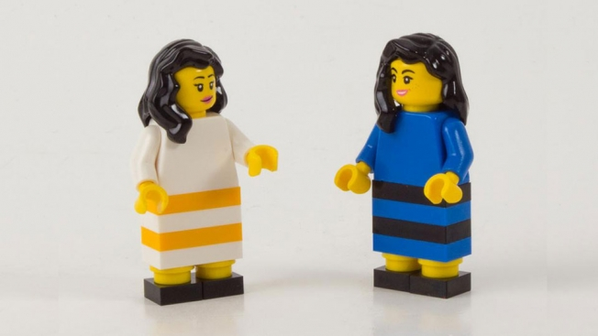
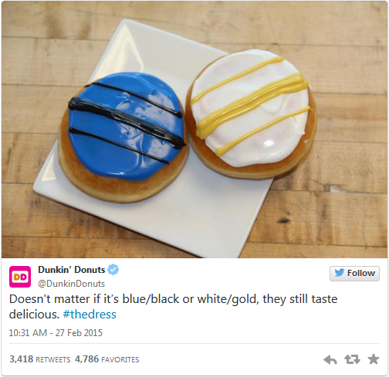
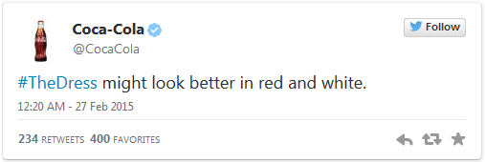
Examples
Take Piece of the Action

Slide 13
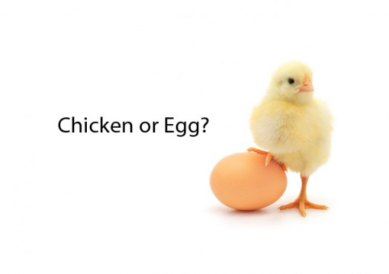
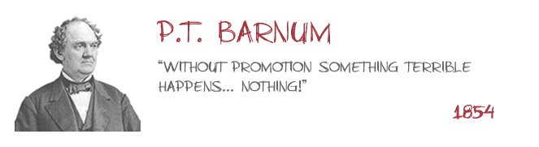
conclusion

Slide 14
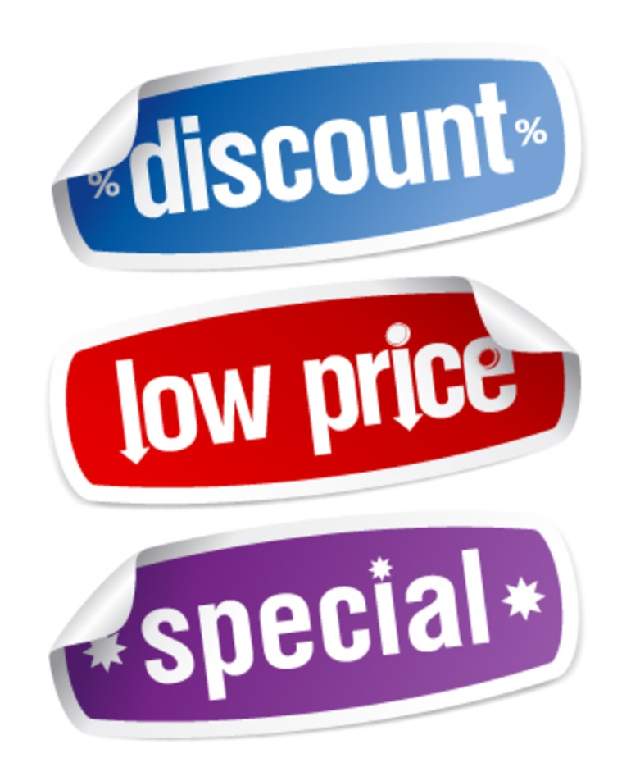
Thank You!
Fivi Rondiri
Corporate Marketing Coordinator
Fivi.rondiri@intralot.us

