Slide 1
Lotteries on Facebook, taking it to the next level
Yariv Sarig
Director of Sales

Slide 2

Do you feel that you’re making the most of Facebook?
Notes:
The total number of FB users in United States is 155,786,480

Slide 3
Did you know?
There are 163,071,460 users in the US
45.4% of them are male and 56.6% Female
46% are above 35 and 69.7% are above 25
Notes:
46% = 75,012,871
69.7% = 113,660,080

Slide 4
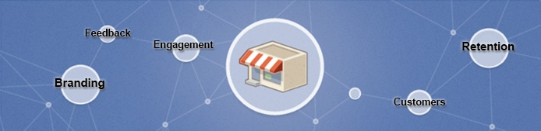
What can businesses achieve by using Facebook?

Slide 5
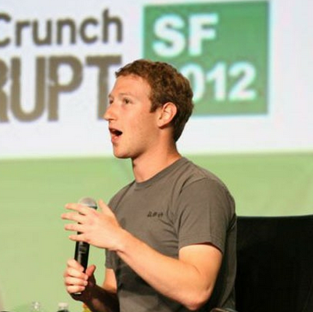
A gaming platform
Facebook CEO Mark Zuckerberg says 235 million people are playing games on Facebook each month, proving the platform is a new home for gamers

Slide 6
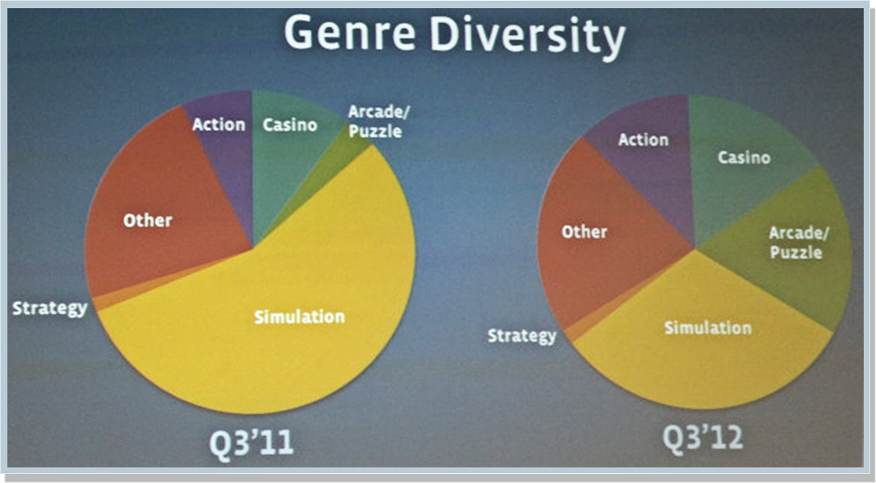
Increase in Casino oriented games

Slide 7
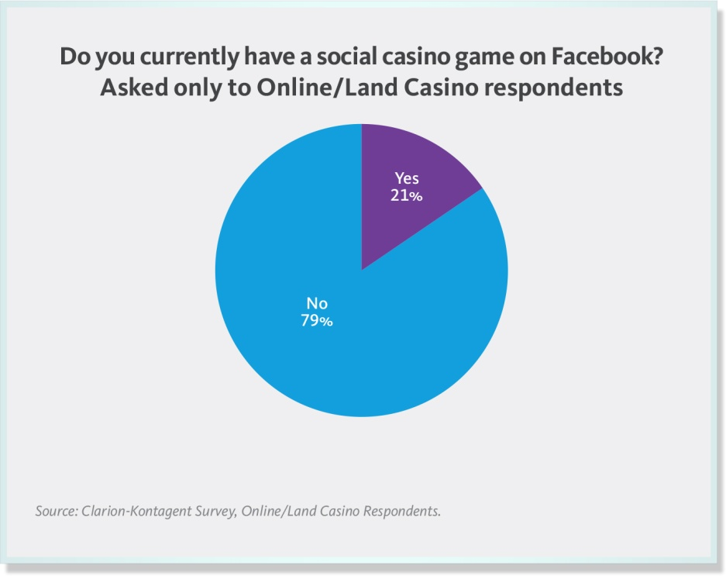
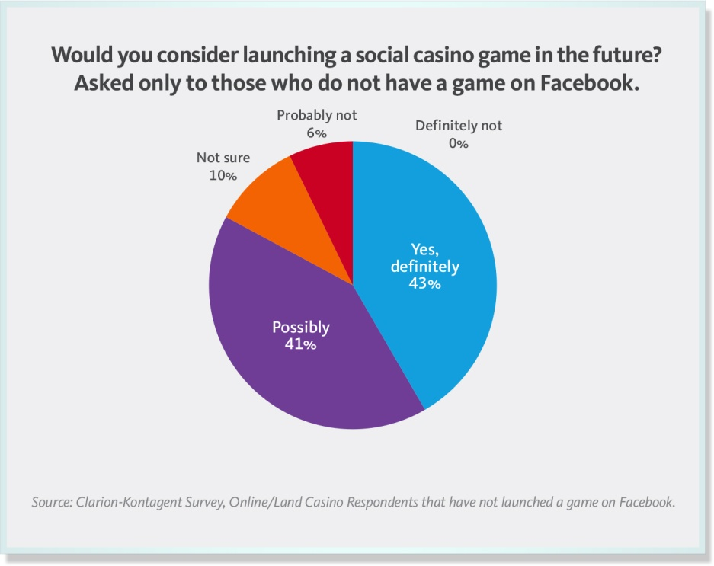
20+ US casino’s have already announced their plans to launch social casino games

Slide 8
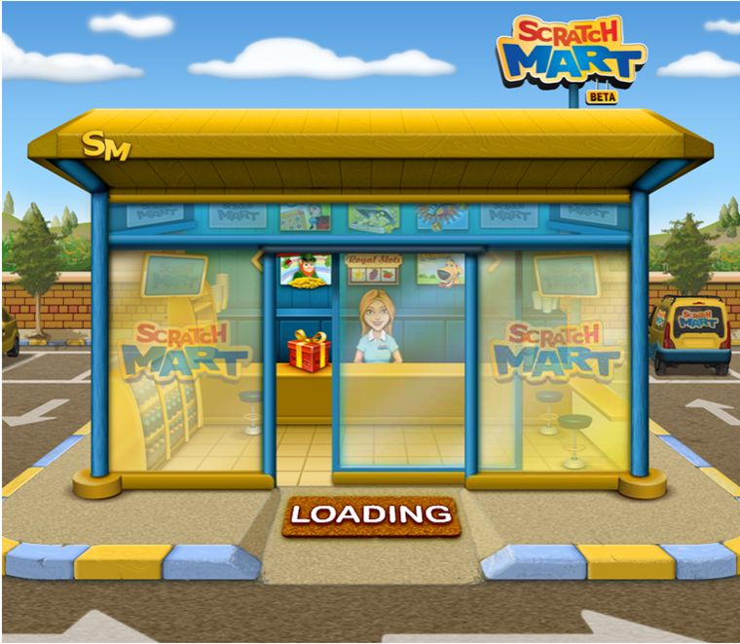
Welcome to the 1st Instant Game on Facebook
Notes:
http://apps.facebook.com/scratchmart/?fb_source=search&ref=ts&fref=ts

Slide 9
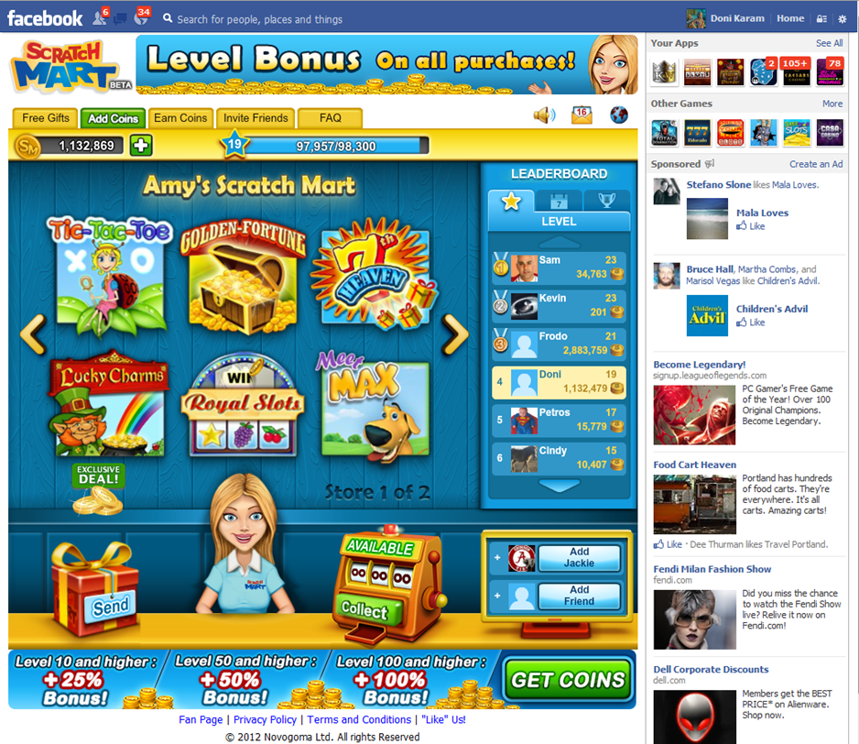
Lobby display and features
Free play, moving up by gaining points
Player information – optional
Sharing Mechanics such as Gifts & Leaderboard
Monitoring & Analysis tools
Fully customizable

Slide 10
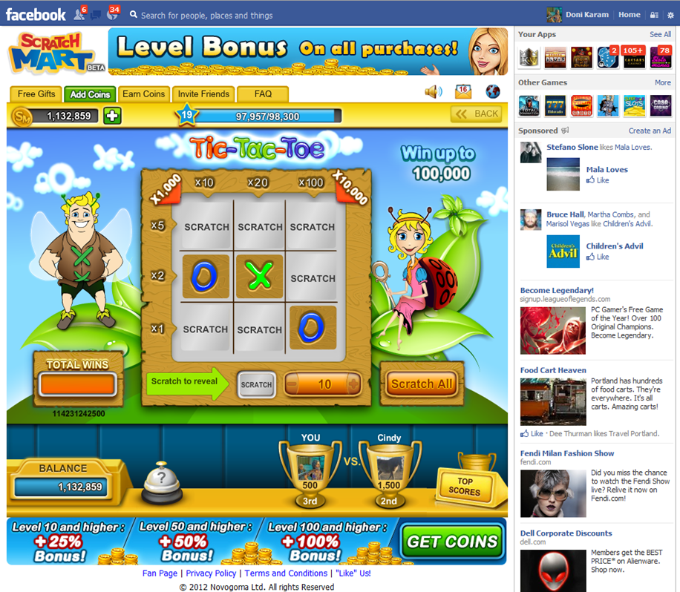
Game Display

Slide 11
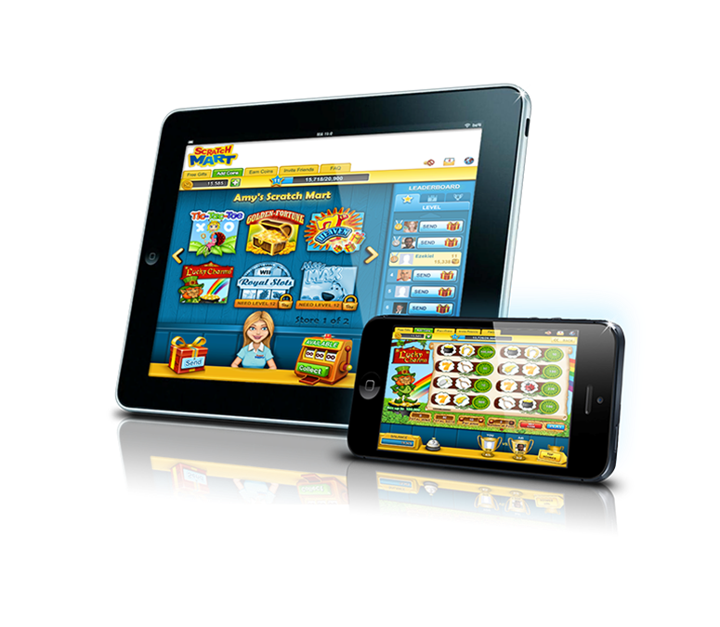
What’s next?
App stores
Apple app store – iPhone, iPad
Google play – Android, Android HD
Windows store
Additional games
Cashword Instant Games
Bingo Instant Games
Keno
Draw Games

Slide 12
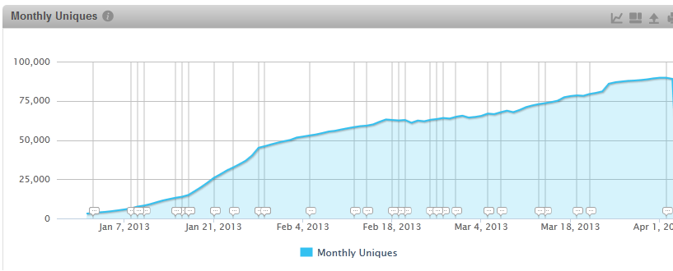
0 - 102,505 players in 4 months

Slide 13
So, what can a lottery do with this?
Engaged in discussion with several European & North American Lotteries to understand how can this help their business
Connectivity to loyalty programs
Enhancement of the user engagement on the fan page
Introducing new games before sending them to the retail stores (feedback)
Second chance draw games

Slide 14
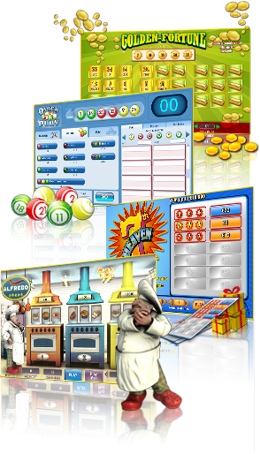
About us…
Industry pioneer of interactive Instants and lottery games with over 8 years of experience
Providing the widest, market proven, portfolio of interactive Instant Win and lottery games
Cross channel offering
Worldwide customer base
Serving our network of partners with over 200M tickets and games every month
Associate Members of WLA, NASPL, CIBLAE and certified by leading industry laboratories

Slide 15



Thank you!!
yarivs@neogames.com

