Slide 1

In 8 episodes the Michigan Lottery
paid out over $27,000,000 in prizes to 96 different contestants!

Slide 2
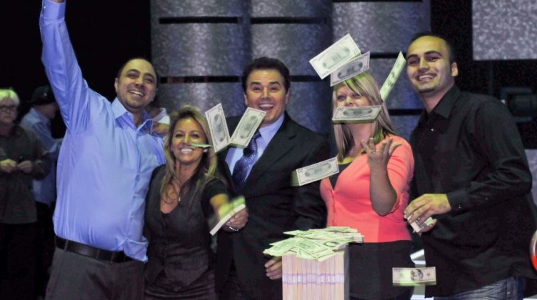
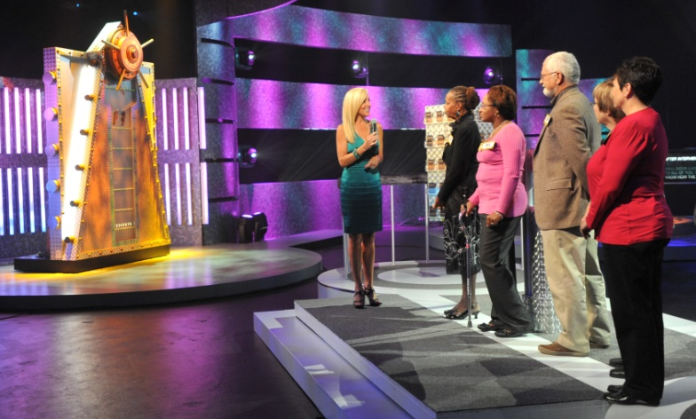
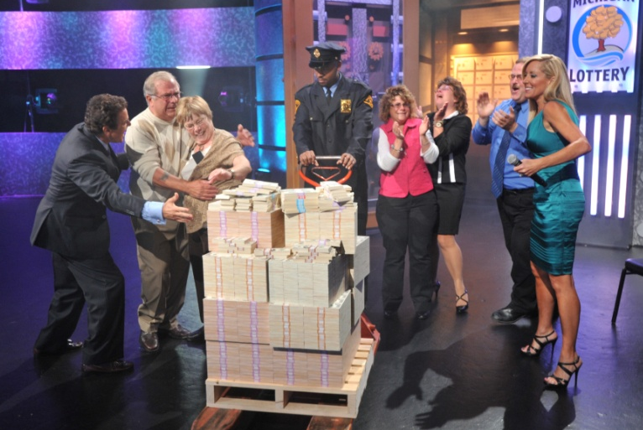
Winner Awareness!
Contestants were each awarded a $5,000 appearance fee and waived their anonymity.
The show aired statewide giving millions of people the opportunity to see actual lottery winners!

Slide 3

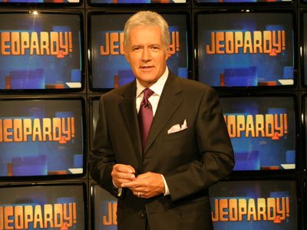
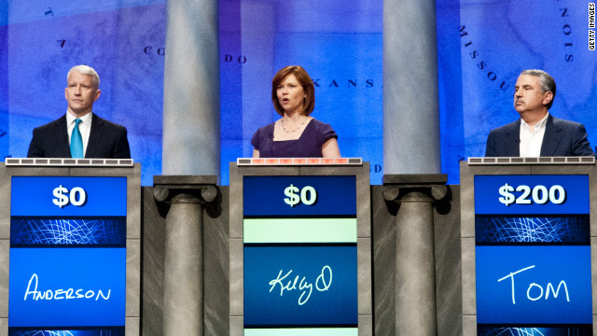
The highest episode total payout - $77,000

Slide 4
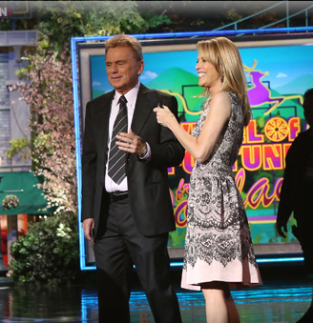

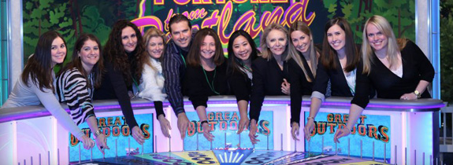
The highest episode total payout - $1,026,080

Slide 5
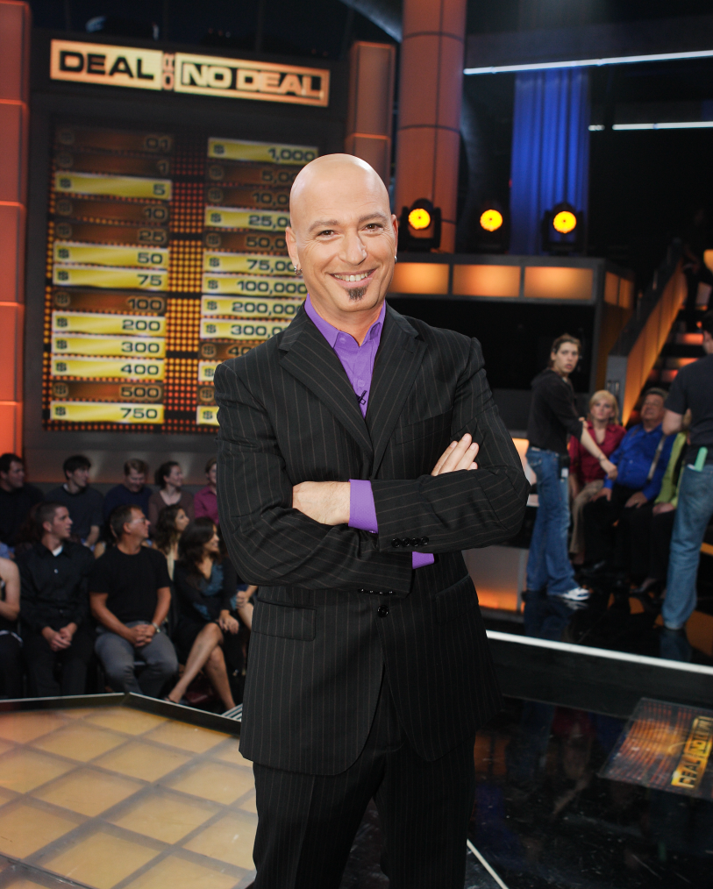

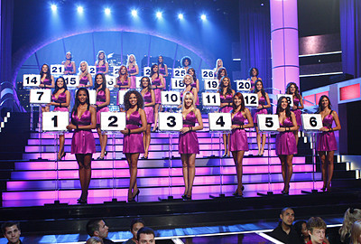
Offers $1,000,000 top prizes -not guaranteed.

Slide 6

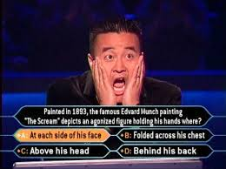
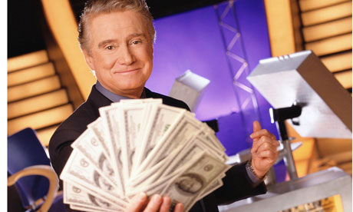
On the ABC Primetime version (1999 – 2002) only seven contestants correctly answered all 15 questions and won the top prize of $1,000,000!

Slide 7


Slide 8
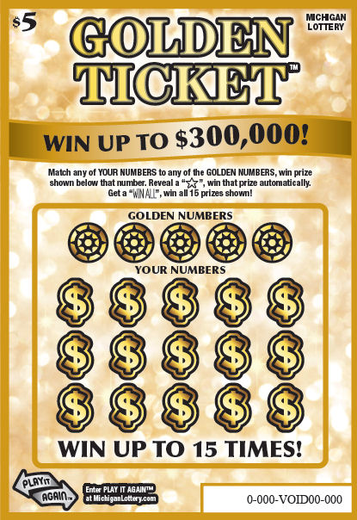
Play the “Golden Ticket” for your chance to get on the
National Lottery Game Show!
$10
Entry Mechanism:
Contestant drawings from $1,000 winners on the “Golden Ticket” instant game
$1,000 prizes require claim center validation
Easy way to collect required contestant information

Slide 9
$10 Golden Ticket Prize Structure
26 Million Tickets Funding 13 Episodes
PRIZE | COST | % GROSS SALES
$10 | $9,490,000 | 5.00%
$15 | $18,980,000 | 10.00%
$20 | $23,725,000 | 12.50%
$30 | $14,614,600 | 7.70%
$50 | $11,577,800 | 6.10%
$75 | $5,694,000 | 3.00%
$100 | $6,263,400 | 3.30%
$200 | $569,400 | 0.30%
$1,000 | $190,000 | 0.10%
Game Show (13 Prizes) | $47,775,000 | 25.00%
Total Prizes | $189,800,000 | 73%
T

Slide 10
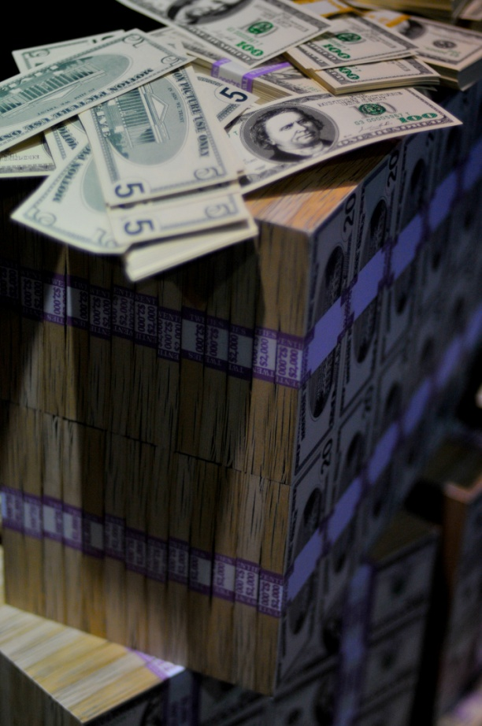
$5,000,000 A WEEK!
This is how we do it….
$10 “Golden Ticket” instant game
$5,000,000 guaranteed grand prize per episode (Cost of annuity = $3,675,000)
13 episodes designed to promote lottery winners
Approximately 2 million tickets a week sold nationally covers a $5,000,000 annuitized prize .

Slide 11
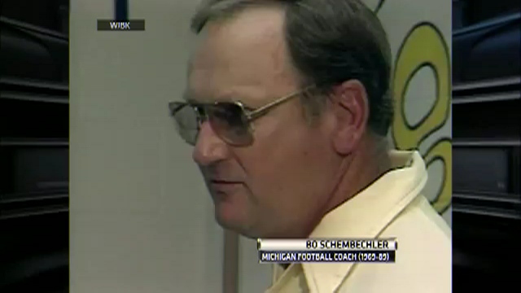
THANK YOU!

