Slide 1

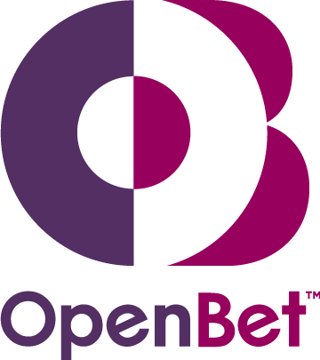
OpenBet
Peter Miles
Commercial Director

Slide 2


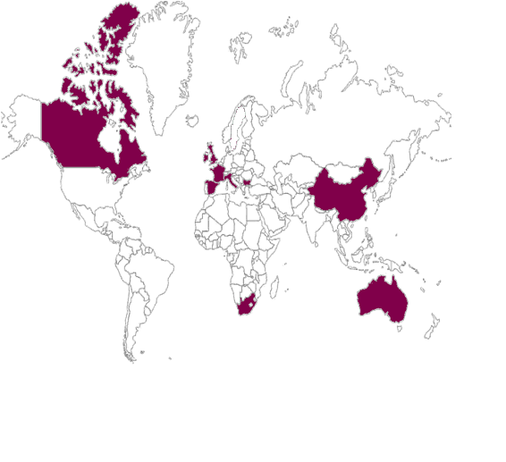


UK
Canada
Australia
Hong Kong
Local teams work better with operators
Follow the sun support
Company Profile
OpenBet Offices
1996: Founded as Orbis Technologies
1998: First sportsbook live with Rank Interactive
2000: Purchased by NDS - News Corp company
2003: OpenBet casino launches with BlueSquare
2006: OpenBet Poker launches with SkyBet
2010: OpenBet launches first North American casino
Currently Status: 690 Employees
UK
Gibraltar
Alderney
Isle of Man
Macau
Canada
France
Italy
China
Spain
Malta
South Africa
Australia
Denmark
Vitruvian Partners is an independent private equity firm that specialises in middle-market buyouts, growth buyouts and growth capital investments in the UK and elsewhere in Northern Europe
Vitruvian
Operator Jurisdictions
100%
100%
Provides land-based gaming products, principally to high street licensed betting shops, bingo operators and casinos. They also operate UK amusement arcades.
Inspired Gaming Group
OpenBet Technologies Ltd

Slide 3
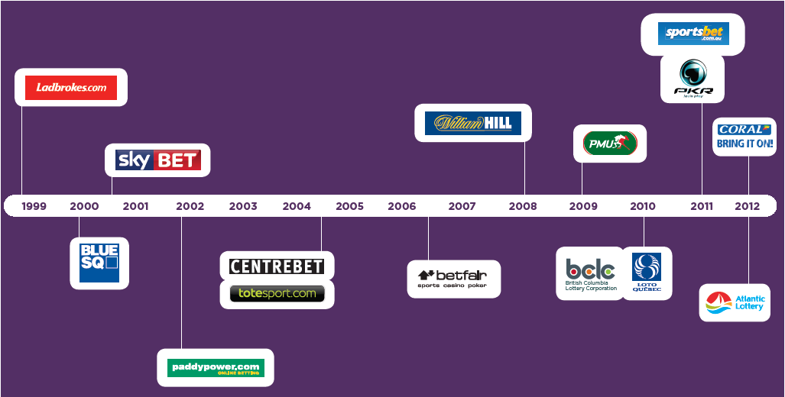

























OpenBet Online Operators
Proven internet platform since 1998
Our products are developed with 20 of the world’s leading gaming operators
A future-proof platform allowing lotteries to expand their product offering and channels
The technical expertise to build new products and services specifically for lotteries
Open platform focused on a central account providing operators a single view of all player activity
Probity - never allowed customers to take bets from USA
Notes:
OpenBet provides a wealth of modules however operators are free to take the modules they feel they need and integrate in house or third party solutions as needed. An overview of some of the customers the are currently running on OpenBet follow.
Ladbrokes (www.ladbrokes.com)
Main additional Sportsbook modules:
Betting in running
Asian handicap
Pari-mutuel betting (Tote and TRNI)
Integration with odds checking sites
Promotions
OpenBet Games
Fixed Odds Lotteries
Live racing feeds integration
Seamless integration to multiple third party informational services
OpenBet Backgammon
Mobile betting
Highlights:
The Ladbrokes site is a good example of a site which handles significant loads.
It has a modern betslip which floats above the main site, anchored to the top title frame. The betslip automatically calculates any multiple bets possible with the individual selections added.
The site is fully multi-lingual (with multi-byte character sets used) and also adjusts the interface to the customer based on the language – see English compared to Greek (or ASEAN is the same style but in English). This functionality can also be used when white labelling to offer a different experience (which can also include bet types) to some or all of the white label site.
The site has seamless integrations into a number of third parties to add additional betting services (such as Bingo and Poker) but also informational services (such as results, form, and live video feeds). Ladbrokes have chosen to follow the multiple wallet account route for the third party systems.
BlueSq (www.bluesq.com)
Main additional Sportsbook modules:
Betting in running
Asian handicap
Pari-mutuel betting (Tote and TRNI)
Integration with odds checking sites
Promotions
OpenBet Games
Fixed Odds Lotteries
Live racing feeds integration
Mobile betting
Highlights:
BlueSq is an example of a nice, clean site with functionality that effectively mirrors that of Ladbrokes.
Paddy Power (www.paddypower.com)
Main additional Sportsbook modules:
Betting in running
Asian handicap
Pari-mutuel betting (Tote)
Integration with odds checking sites
Promotions
OpenBet Games
Live racing feeds integration
Seamless integration to multiple third party informational services
Mobile betting
Text-only internet site
White labelling
Highlights:
Paddy Power make good use of the flexibility of the event hierarchy with a large number of so-called novelty bets (e.g. date that Tony Blair will stand down).
Paddy Power also have a number of white label sites (e.g. www.liverpoolfc.tv) that make use of the ability to reskin the site but still use the same base code and database.
SkyBet (www.skybet.com)
Main additional Sportsbook modules:
Betting in running
Asian handicap
Pari-mutuel betting (Tote and TRNI)
Integration with odds checking sites
Promotions
OpenBet Games
Live racing feeds integration
Seamless integration to multiple third party informational services
Mobile betting
OpenBet Poker
Highlights:
SkyBet have designed a fully accessible site. This means that if you turn off style sheets on your browser or are using a screen reader or basic browser the site still works perfectly.
The SkyBet betslip has also been designed around this and works more as a ‘shopping basket’ of selections than a betslip. Once a user is happy with their selections they are directed to a betting page which shows the betting opportunities for the selections chosen.
Slot (www.macau-slot.com)
Main additional Sportsbook modules:
Betting in running
Asian handicap
Promotions
Seamless integration to multiple third party informational services
Highlights:
Macau Slot is a good example of an Asian facing Sportsbook.
Macau Jockey Club (www.macauhorsebet.com)
Main additional Sportsbook modules:
Pools betting (Macau)
Highlights:
The MJC Sportsbook is purely for betting into the Macau Jockey Club pools.
Tote (www.totesport.com)
Main additional Sportsbook modules:
Betting in running
Asian handicap
Pari-mutuel betting (Tote and TRNI)
Integration with odds checking sites
Promotions
OpenBet Games
Fixed Odds Lotteries
Live racing feeds integration
Seamless integration to multiple third party informational services
Highlights:
The Tote site makes good use of the OpenBet Display Manager with the site changing its canvases at various times during the day. This gives an interesting and varied site with full control of this given to the operator and so not requiring continual involvement of Orbis developers.
Centrebet (www.centrebet.com)
Main additional Sportsbook modules:
Betting in running
Asian handicap
Promotions
OpenBet Games
Highlights:
Centrebet have a number of unique features: a very different betslip methodology, different bet types and markets unique to Centrebet.
Betfair(www.betfair.com)
Highlights:
Betfair have ustilised a games portal developed by orbis as well as deploying a very successful games only OpenBet implementation

Slide 4
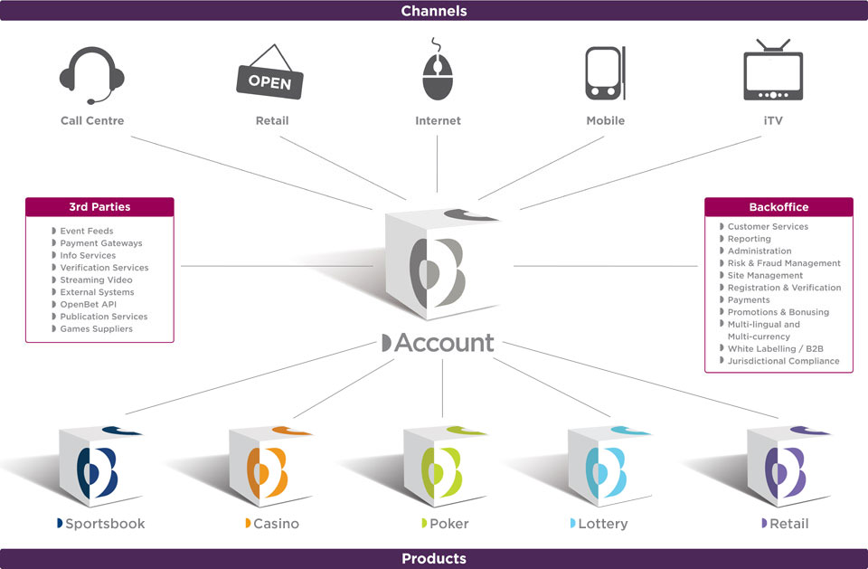
Integration Specialists
Notes:
The OpenBet solution provides a centralised platform onto which many modules and third party products can be attached. The transactional engine ensure data integrity whilst scaling to accommodate the demands of our large multinational customers.
From an operators perspective the a single point for reporting and customer management considerably eases the problems of operating with multiple suppliers. Orbis’s open policy to operator database access means that existing data warehousing and reporting tools can be run directly of the OpenBet database.
Because the backend logic of the system is effectively decoupled from the front end display it is possible to extend the same trusted code base to support multiple channels. For example your digital tv offering will use exactly the same bet placement logic and the same database as your internet offering.

Slide 5









































OpenBet Account
PAM
Payments
Authentication
Promotions
API’s
E-Wallet
Verification
Responsible Gaming
Identification
Professional Services
Responsible Gaming
Self Exclusion
Play breaks
Self imposed deposit limits
Loss limits
Session Limits
Reality Checks
Geo-location
Locate customer to within state boundaries
Different site access depending on location
Per product and per game rules
Centralised service for all third party products

Slide 6



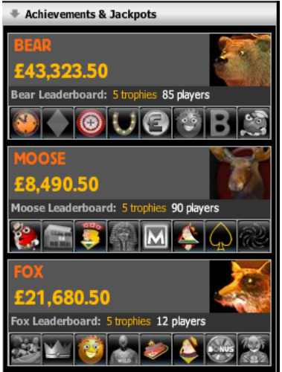




Promotional Tools Engine
Online and off
Flexible rules based engine allows Operators to innovate
Real time awards enable short highly focused promotions
NO FIXED RULES – market your product how you want, don’t follow the herd
Engine support both online and offline promotions
Single user friendly interface to manage your entire promotional suite
Drives acquisition
Powers retention
Qualification
Complete Tasks
Rewards
Currency
Customer Group
Channel
Entry date
Language
Country
Place Bets
Refer a Friend
Promo Codes
Customer Groups
Introductory Source
Cumulative Spend
External Bet
Voucher code
FreeBets
Cash / Non-withdrawable Cash
Ad Hoc
Manual Claims

Slide 7








Casino and Games
Games Partners
Dynamite Idea
IGT
WMS*
NextGen
Ash Gaming
Endemol Realistic
Next Gen
Mazooma / Bell Fruit
Betsoft
Football 1x2
Cryptologic
Blueprint
Novomatic / Astra
Fremantle media
Betball Bingo
Probability
Zukido
Genesis Gaming
World Mobile Gaming
Badda Media
Viaden
Evolution Gaming
Scratchino
Games Marketing
Million-21
Playtech
Cozy Games*
Net Ent
Chartwell/Amaya
Virtue Fusion*
Dragonfish*
Game Account*
Evo Gaming*
Party Poker*
Viaden
Microgaming*
NeoGames*
Shuffle Master
Pasoca
Lianda
Truly open platform
Brings the major land based game online
Content from over 35 Partner providers
Massive portfolio 1000+ games
All OpenBet games are Alderney compliant
* Integration pending
Notes:
Mazooma Community Games – Sky bet doing very well with these
Barcrest / Million-21 – Elvis, cashino
Crypto – Street fighters 2 , Millionaries club
Blueprint – vizz, chuzzle

Slide 8

Case Study: BCLC
Key
PAM
OpenBet
Paddy Power
R
O
O
O
O
O
O
IGT
Lottery
Payment Handling
KYC Rules engine
Sports
Casino
Bingo
OB-G2 middleware
GTech
Lottery
Hub
OpenBet
Content
Partner
Content
Betware
Pan-Canada
Lottery
Moneris & Beanstream
equifax
RAMP
Poker
O:Internet
M:Mobile
R:Retail
OpenBet are a platform provider and integration specialists
Most development or adaptation for an integrations is performed by OpenBet
Payments & KYC
Lottery & Bingo
Poker
Both Betware systems contact the standard OpenBet PAM API via web services calls to retrieve funds and player details. Transaction details are stored in OpenBet
Single sign on is achieved by passing a login token between the sites. All login is performed against the OpenBet PAM
G2 (Gtech) were unable to adapt their poker system to make direct calls to the OpenBet PAM API and so as part of the deployment OpenBet has built a middleware to translate G2 messages to the corresponding OpenBet messages
OpenBet has performed an integration onto the API’s of each of these service providers. These range from file transfer to on demand web services calls with both batch and consolidation scripts running as background processes.

