Slide 2
The WLA membership
The WLA has 143 regular members
71 - 50% Europe
21 - 15% North America & Caribbean
25 - 17% Asia & Pacific
13 - 9% Latin America
13 - 9% Africa Associates: 57 of which 6 are contributors

Slide 3
WLA Members in North America
Canada (5) | Atlantic Lottery Corporation BCLC (British Columbia Lottery Corporation) Loto-Québec Ontario Lottery and Gaming Corporation Western Canada Lottery Corporation
United States (14) | California State Lottery Connecticut Lottery Corporation (CLC) Illinois Lottery Iowa Lottery Kentucky Lottery Corporation Louisiana Lottery Corporation Minnesota State Lottery Missouri Lottery Nebraska Lottery New Jersey Lottery New York State Lottery North Carolina Education Lottery Pennsylvania State Lottery Tennessee Education Lottery Corporation

Slide 4

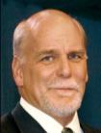

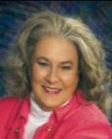
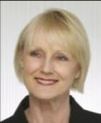

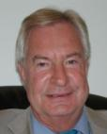
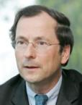


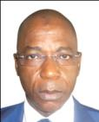

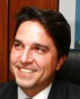
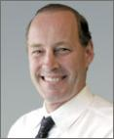
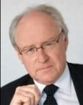
The WLA Executive Committee
President
Immediate Past Presidents
Jean-Luc Moner-Banet
Loterie Romande
Switzerland
Senior Vice President
Vice President
Arthur L. Gleason, Jr.
Kentucky Lottery Corporation - USA
Risto Nieminen
Veikkaus Oy - Finland
Eight Elected
Members
Rebecca Paul Hargrove
Tennessee Education Lottery
USA
June Roache
SA Lotteries
Australia
Dianne Thompson
Camelot Group
United Kingdom
Dr. Rolf Stypmann
Toto-Lotto Niedersachsen GmbH
Germany
Christophe Blanchard-Dignac
La Française des Jeux
France
José Miguel Martínez Martínez
Sociedad Estatal Loterías y
Apuestas del Estado, Spain
Jorge Rodriguez, President
Asociación de Loterías,
Quinielas y Casinos Estatales de Argentina
Five
Regional
Representatives
AALE: Fofana Issiaka
Loterie Nationale de la Côte d‘Ivoire
Ivory Coast
APLA, Soo Nan Tan
CEO, Singapore Pools
CIBELAE: Fabio Cleto
Caixa Econômica Federal
Brazil
NASPL: David N. Loeb
Western Canada Lottery Corporation
Canada
EL: Ivan Pittevils
Loterie Nationale
Belgium

Slide 5
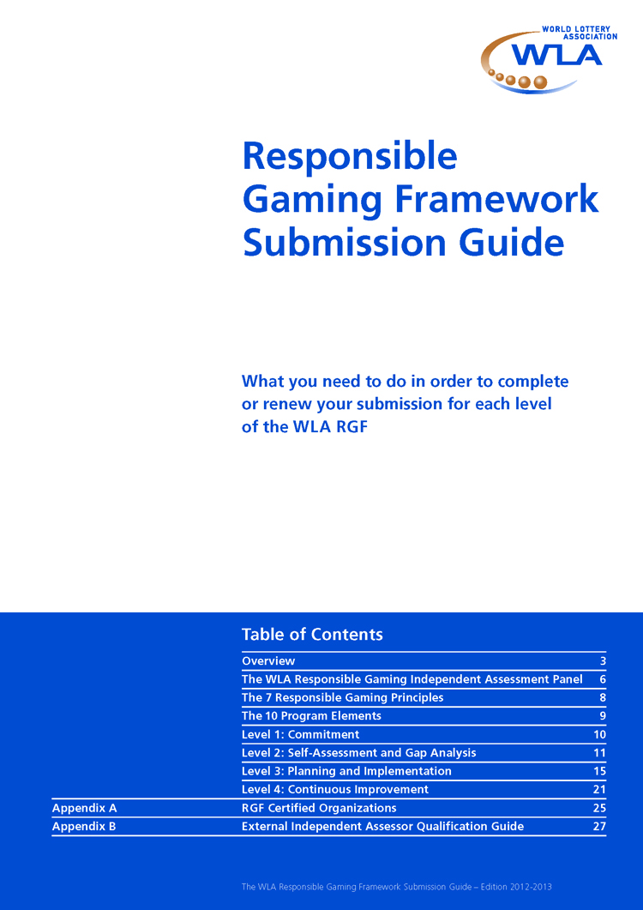
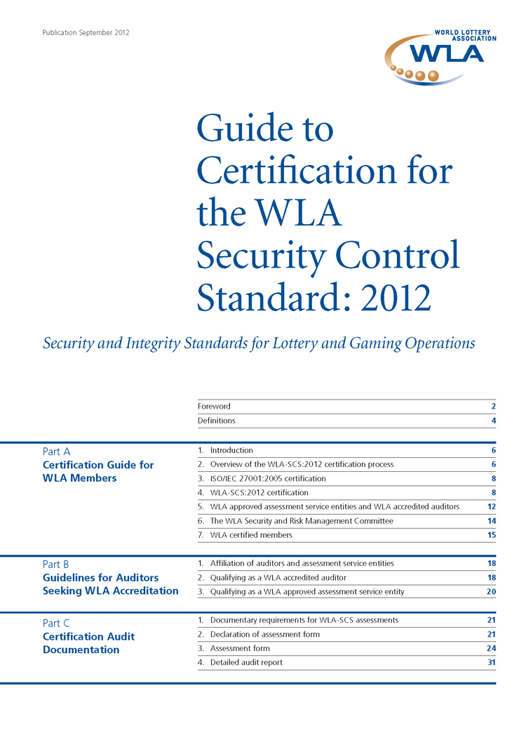
WLA Best Industry Practice Standards

Slide 6
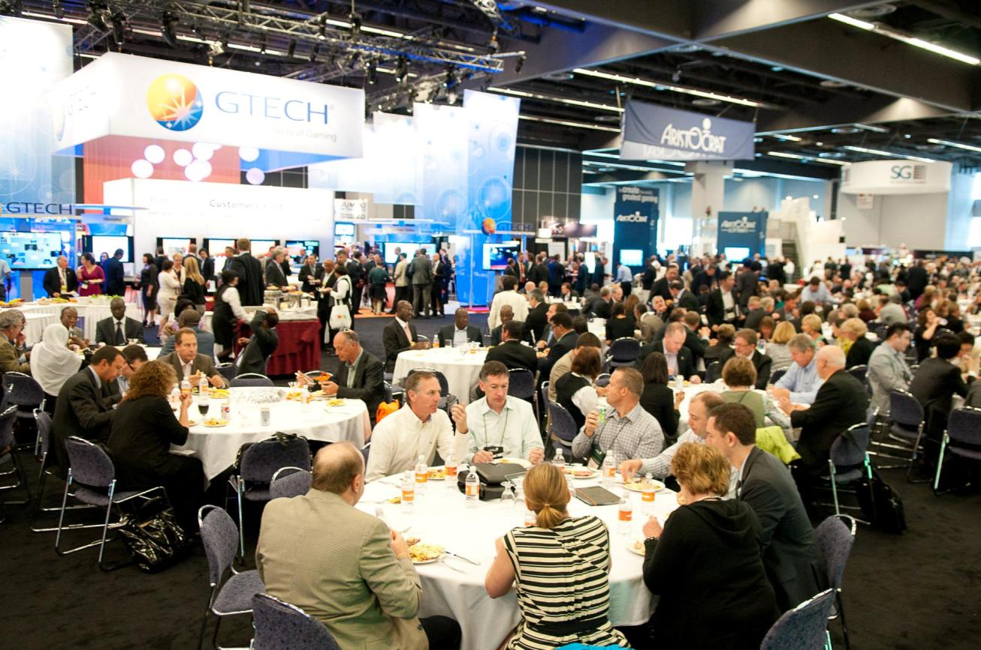
Tradeshow Montréal 2012

Slide 7

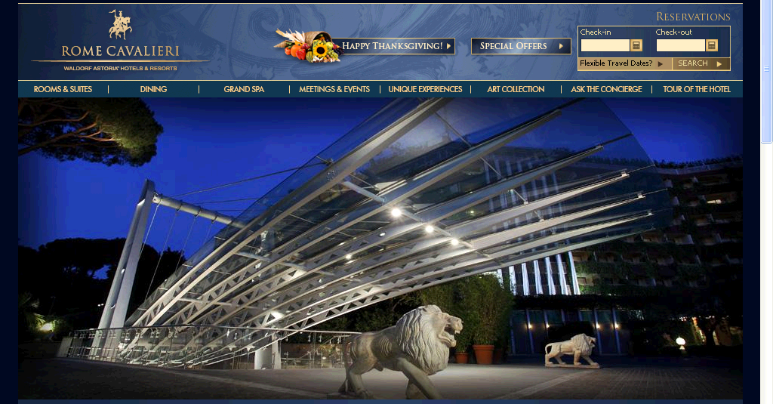
Rome Cavalieri 2-5 November 2014
http://www.romecavalieri.com/

