Slide 1
The Lottery’s Answer
to the Appeal of Daily Fantasy?

Slide 2

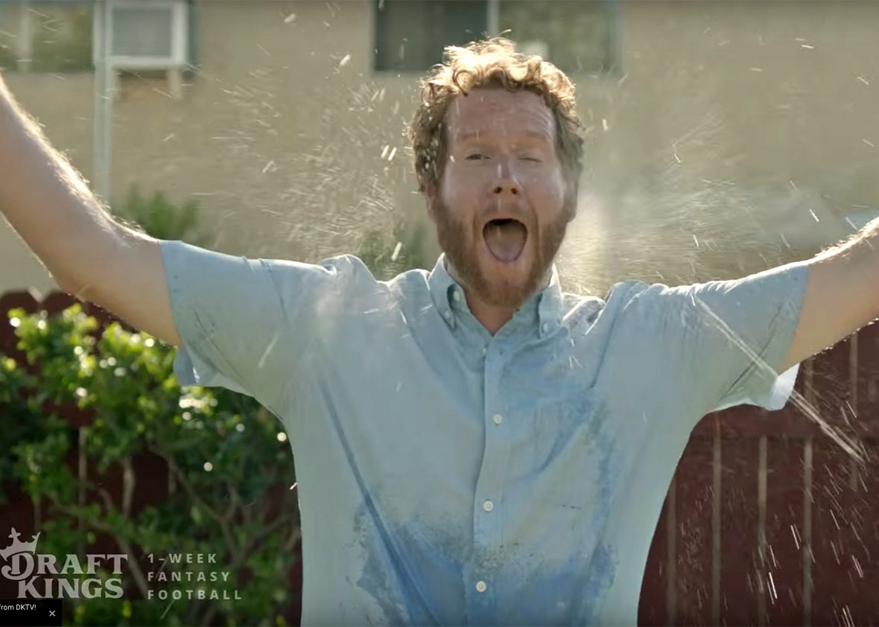

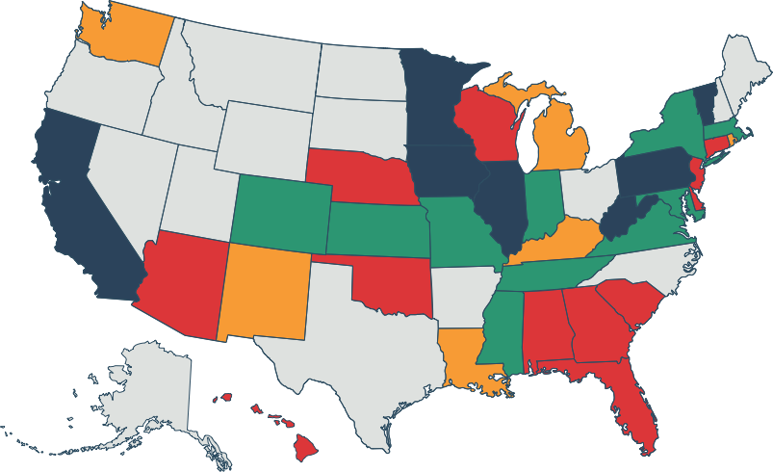




The Rise of Daily Fantasy Sports
Legislative
Status
Signed into Law
Passed One Chamber
Passed Committee(s)
Introduced

Slide 3

DFS
Live sports excitement.
Unpredictable event
determines future winnings.
Simple and easy to play.
Mobile app integration.
Strong Millennial appeal.

Slide 4
How can lottery build on this narrative?
What can lottery offer
that DFS can’t or won’t?

Slide 5


DFS
Lottery
Simple and easy to play.
Mobile app integration.
Unpredictable event
determines future winnings.
Live sports excitement.
Strong Millennial appeal.
Enhancement to
local businesses.
Vehicle for social good.

Slide 6
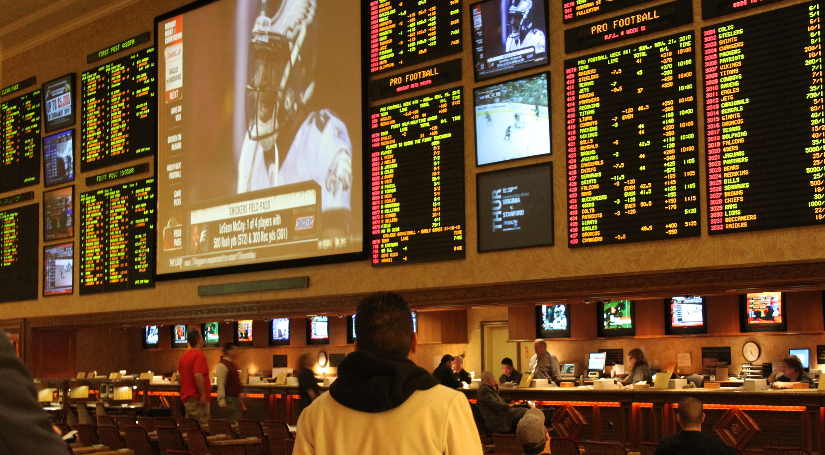

Conventional wisdom says sports gaming is a game of skill.
Should we challenge such wisdom?

Slide 7
Why not sports gaming as a game
of chance?
Are lottery players inherently not
sports fans?

Slide 8
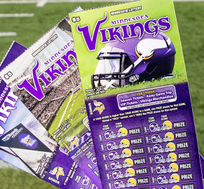
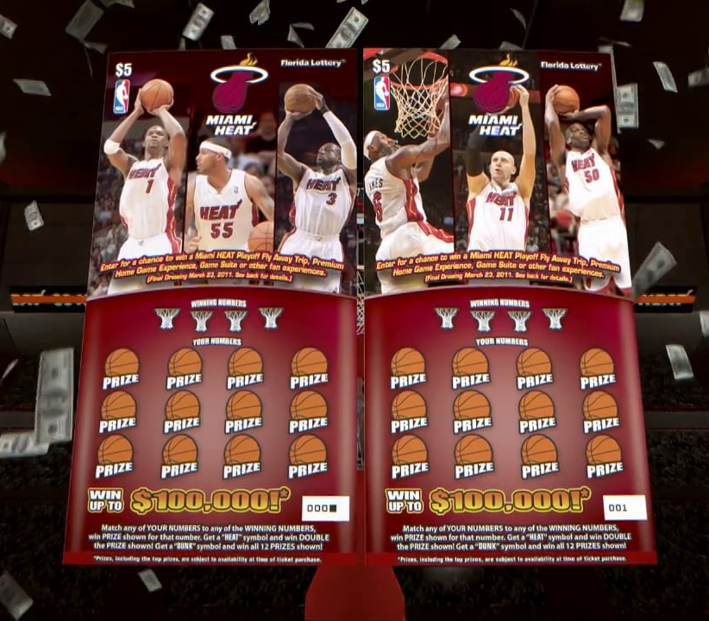


Lotteries across the country already prove their players are.

Slide 9
Since lottery players love sports too,
how can we capitalize on this?
Is there an opportunity for a new game category in lottery?

Slide 11
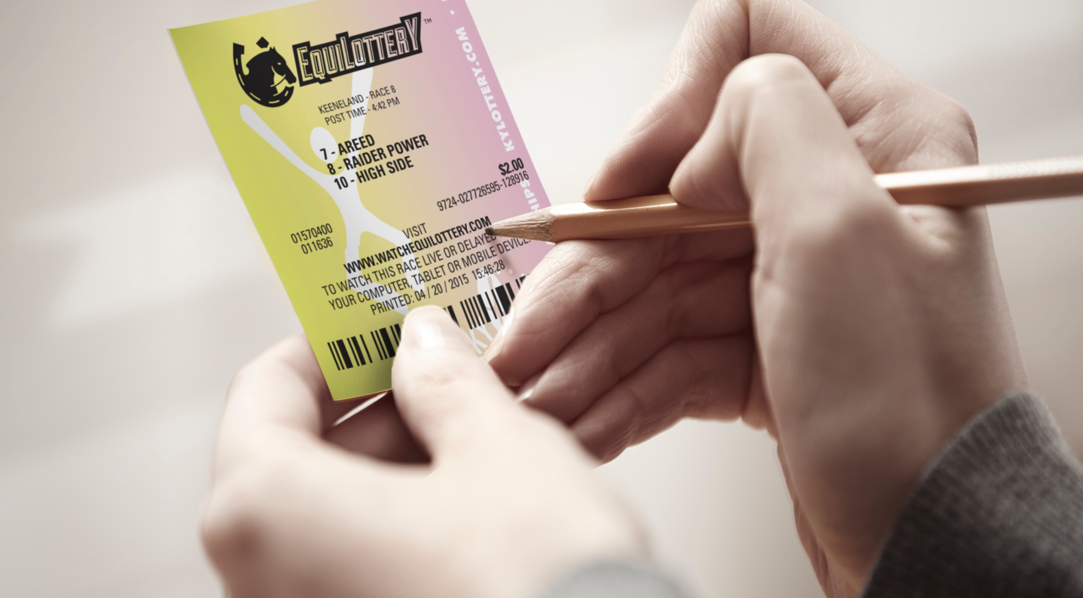

Brief Overview
of EquiLottery
Daily $2 draw style game based on
the results of live horse racing.
Quick pick only gameplay.
Each ticket represents three numbers
and horses.
Daily race video delivered through
mobile app and website.

Slide 12

Prize
Opportunities
Top Prize
$300 - $1,700
Box Prize
$5 - $40
Exact Match Two
Free Ticket
Scratched Horse/Cancelled Race
Future Play
Second Chance Raffle
Every Ticket Is A Winner

Slide 13


Systems
Providers
Lottery Systems
Provider
Tote Systems
Provider
Mechanics of how game works can be found on
www.EquiLottery.com

Slide 14


Have Your
Tickets Ready

Slide 15

Hold All Tickets

Slide 17
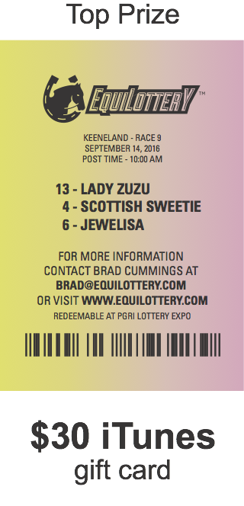
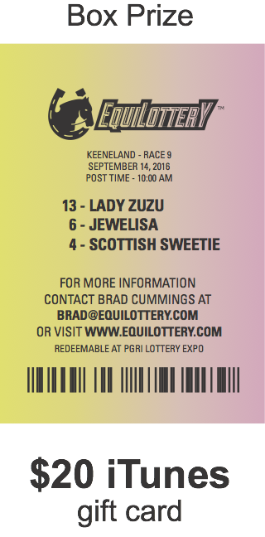
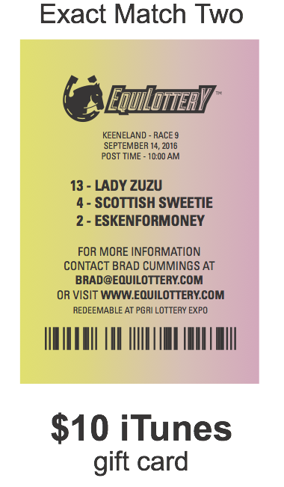
Winning
Horses
13 - Lady Zuzu
4 - Scottish Sweetie
6 - Jewelisa

Slide 18


Qualitative
Data
Qualitative Study
Findings:
Players loved the excitement and authenticity of a 2 minute horse race.
Shorter event time seen as positive.
Retailers loved quick pick only approach without play slips.
Mobile app appealing especially
among Millennials.

Slide 19
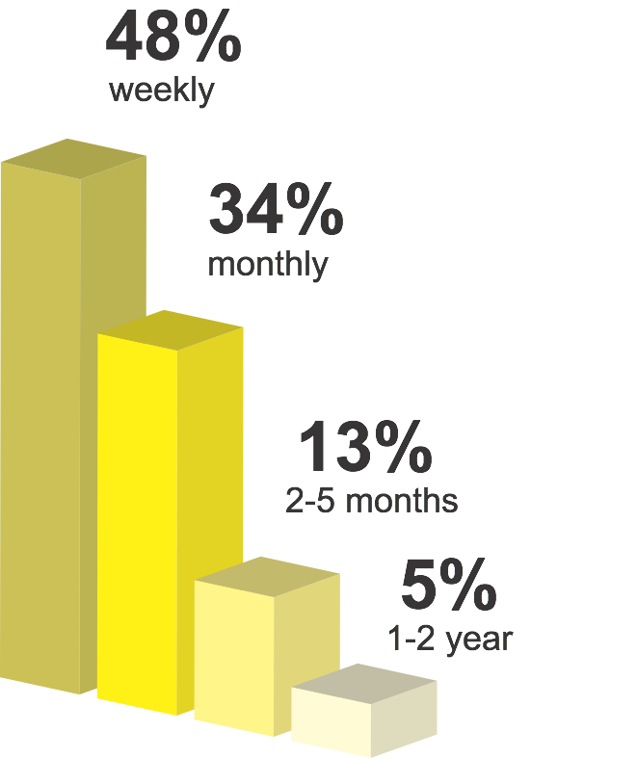
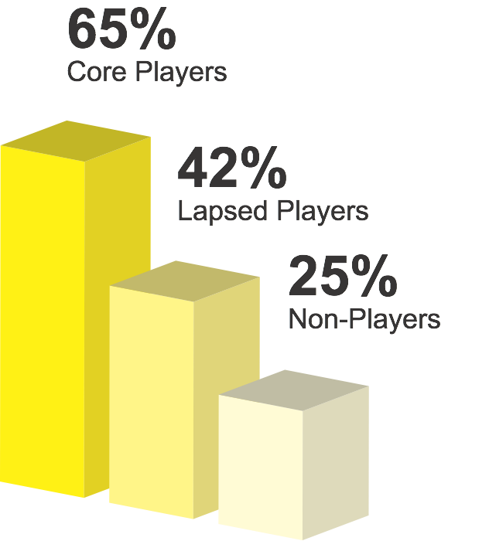
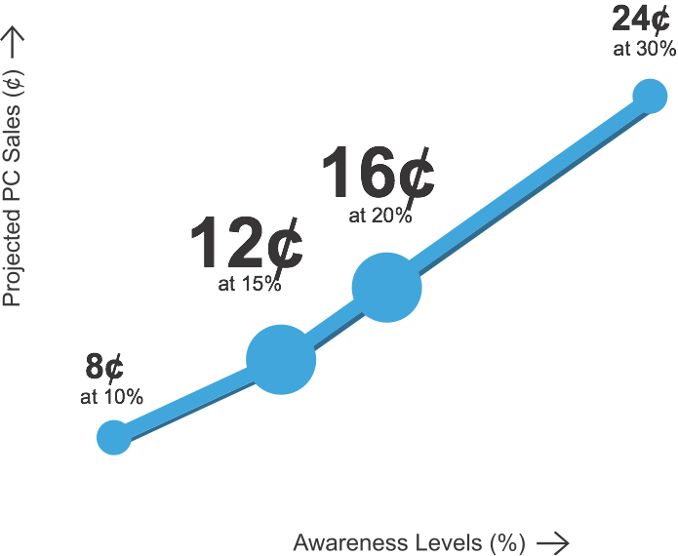
Quantitative
Study Findings:
Player Spend
Weekly Per Capita
Player Stickiness
Adds 300,000+ lottery players to state of 4.4 million.
Cannibalization rate between
0.55% and 1.64%.
Average player would purchases
2.2 tickets per race.

Slide 20

Quantitative
Study Findings:
Demographics
There was no discernible difference
in regional, gender or age player interest.
+19%
“I like the idea of using a mobile
app to find out whether I won.”
+16%
Impression of the game if races were offered from outside the state.
Millennials found many of the game features more appealing than the general population.
+11%
“I would purchase more tickets until I
got the horses I like.”
+11%
“Having some of the proceeds of the
game directed to the Kentucky horse
racing industry is appealing.”

Slide 21
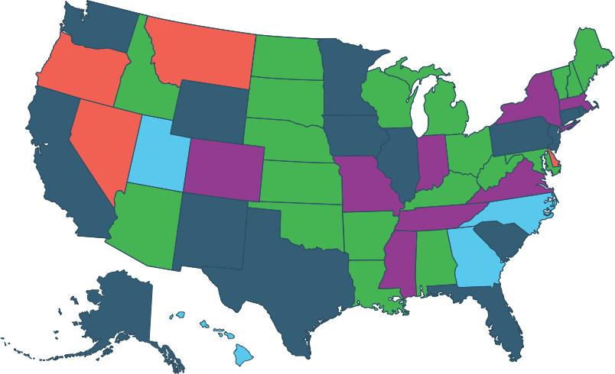
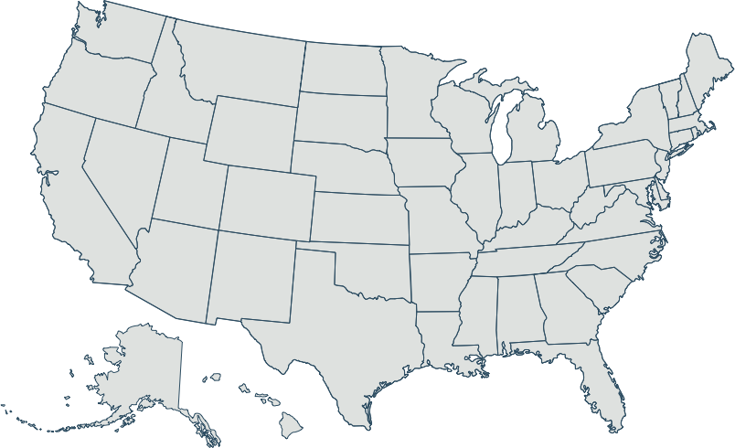





Sports Gaming Momentum in
the U.S.
Sports and
pari-mutuel wagering
Sports wagering pursued
since 2010
Daily Fantasy legislation
passed
Pari-mutuel wagering,
no sports wagering
No sports or
pari-mutuel wagering

Slide 22
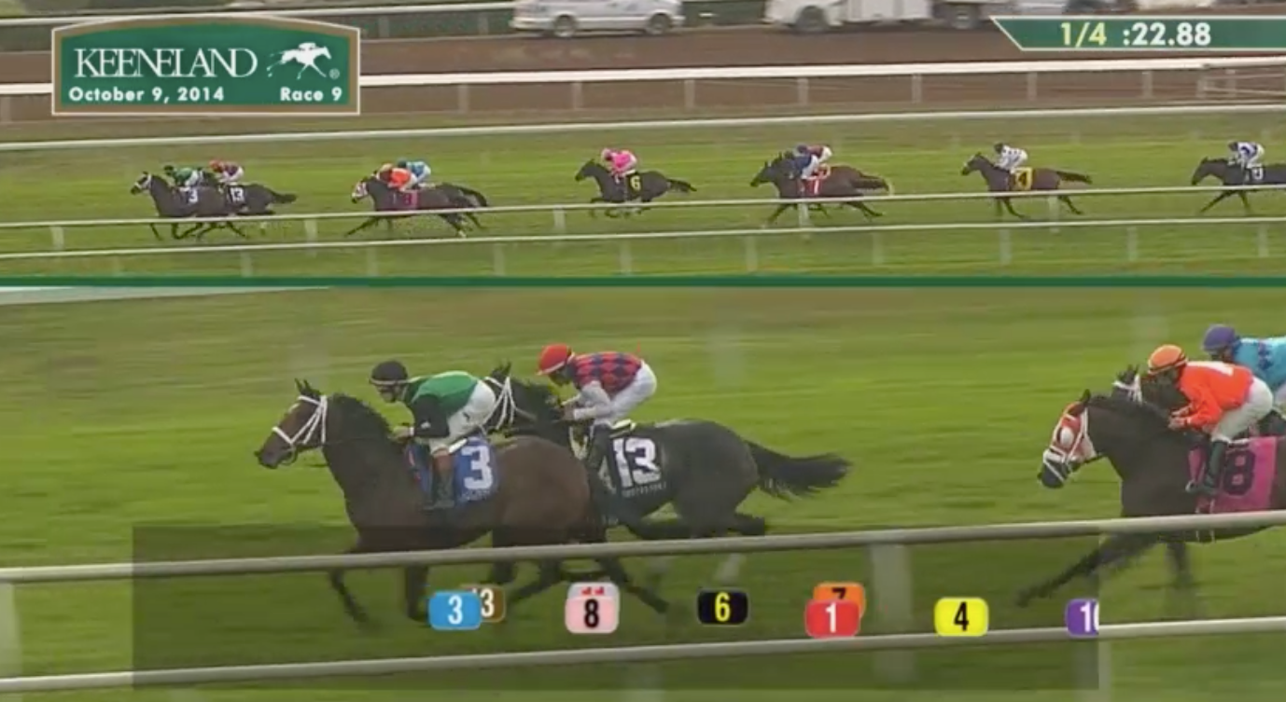
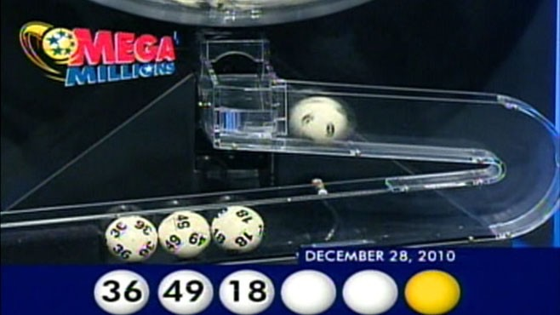

Slide 23
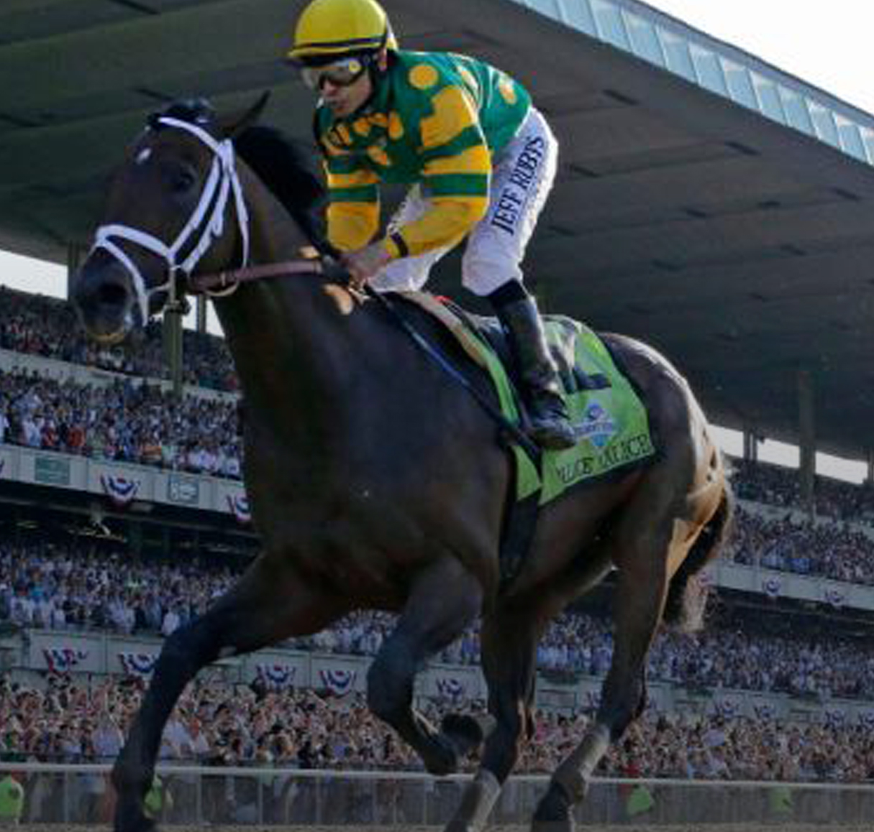

Build now for the future.
Capitalize on the DFS wave.
Let’s play EquiLottery.
For more information,
please visit www.EquiLottery.com
or email brad@equilottery.com.

