Slide 1
WYOMING LOTTERY CORPORATION
PGRI Conference
September 13, 2016
Presented by:
Jon Clontz, CEO

Slide 2
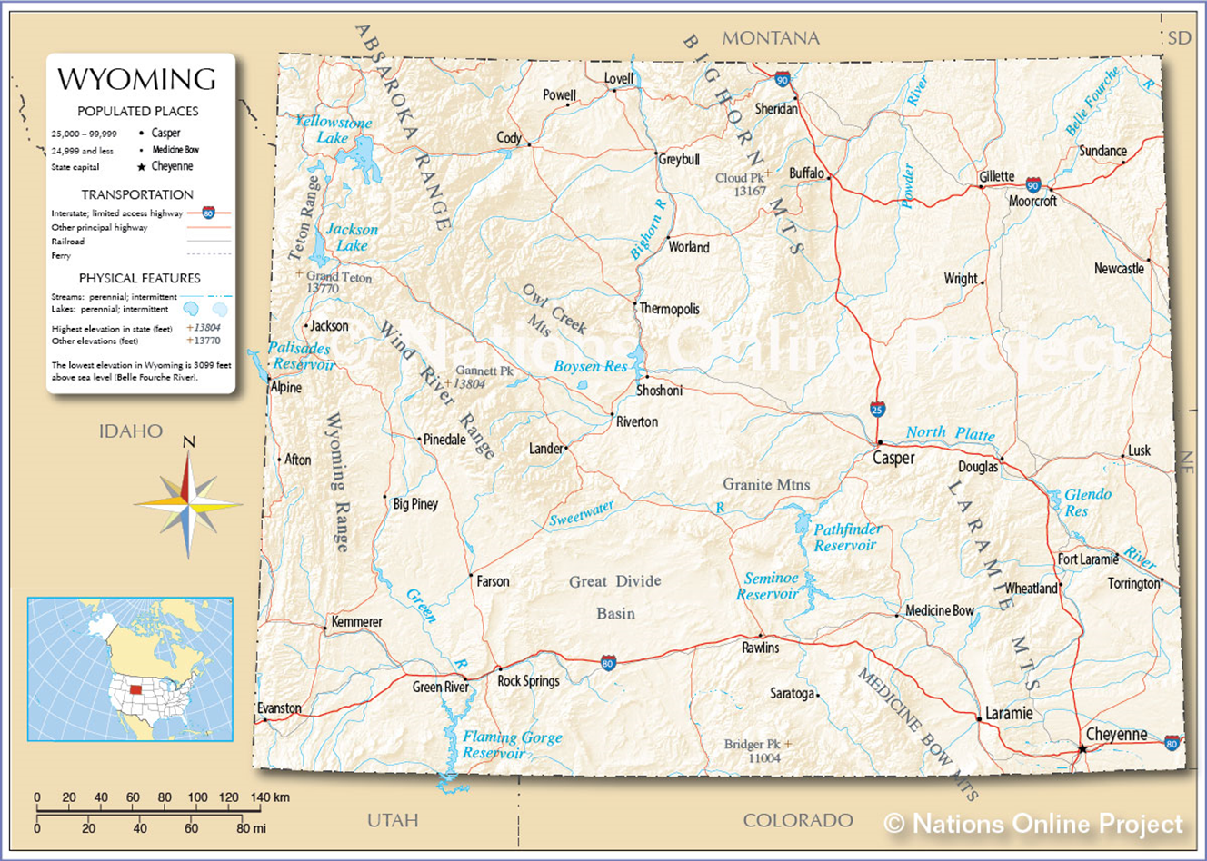
Wyoming is bordered by Montana, South Dakota, Nebraska, Colorado, Utah, and Idaho. It is the tenth largest state in the United States with a total area of 97,818 square miles. Wyoming's population rank is 50th, with about 586,000 inhabitants (in 2015 est.), making it the least populated state in the US. Wyoming is made up of 23 counties.

Slide 3

Obstacles
Geographical
Lowest population in the nation
*Only 5 cities larger than 20,000 people
48% of land owned by US Government; 6% by State
Average distance between cities is 54 miles
Demographic
Persons under 5: 6.6%
Persons under 18: 23.7%
Persons over 65: 14.5%
Median household income (2010-2014): $58,252
Legislation
Statute change required to permit lottery sales at start-up
Stakeholder relationship development initially difficult

Slide 4
Stakeholder Relations
Engaging State Legislators
Managing Expectations of Board Members
Realistic Time Frame to Start Up
Defusing Negative Press/Opposition
Importance of Branding & Building Networks
Addressing the Problem Gambling Issue

Slide 5
Starting the Wyoming Lottery
Founding legislation passed in the 2013 General Session
Governor appointed a nine member board of directors
Board of Directions began the search for a CEO (hired in October of 2013)
In the fall of 2013, a line of credit was established with a local bank to fund start-up operations (no State or tax payer money is used to fund the Wyoming Lottery)
After the CEO was hired, other staff members were hired
All staff members were hired by April of 2014

Slide 6
Starting the Wyoming Lottery
The RFP for a lottery vendor was released in early December 2013
The contract for the lottery vendor was signed and enacted in May 2014
The Wyoming Lottery began selling (Powerball and Mega Millions) on August 24, 2014
The Wyoming Lottery launched and began selling its own in-state game (Cowboy Draw) on March 15, 2015
On April 5, 2016, the Wyoming Lottery made their first transfer to the State of Wyoming in the amount of $1,120,000

Slide 7
Stakeholder Relations – Problem Gambling
W.S. 9-17-119(g) Unclaimed prize money shall not constitute net lottery proceeds. A portion of unclaimed prize money, not to exceed two hundred thousand dollars ($200,000.00) annually, shall be used by the corporation to develop, in consultation with the department of health programs for the treatment of compulsive gambling disorder and educational programs related to the disorder. In addition, unclaimed prize money may be added to the pool from which future prizes are to be awarded or used for special prize promotions.
Wyoming Lottery Corporation and Wyoming Department of Health

Slide 8
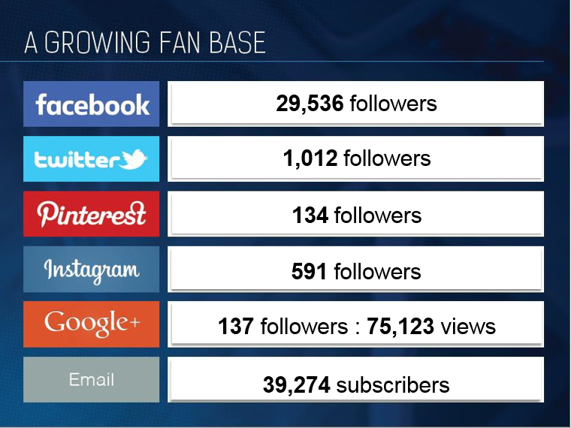
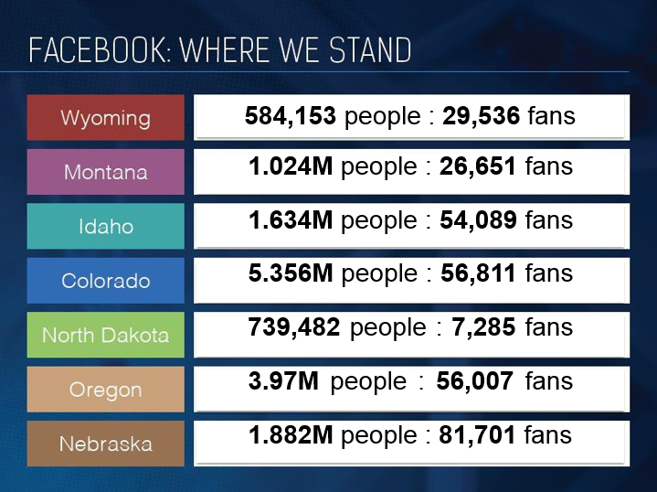
Building a Lottery in the Social Media Era
Marketing and Promotions

Slide 9
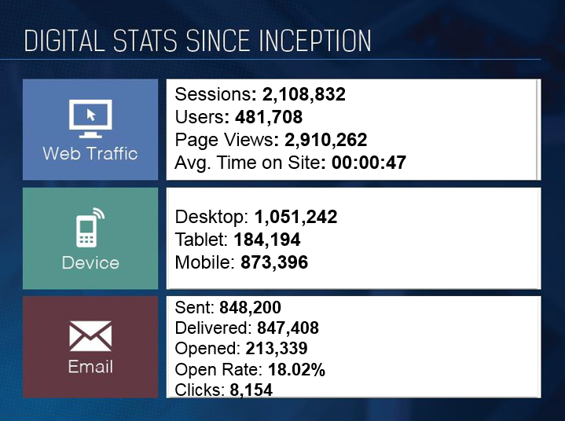
Building a Lottery in the Social Media Era
Marketing and Promotions

Slide 10
Questions?

