Slide 1
Tom Delacenserie
Secretary

Slide 2
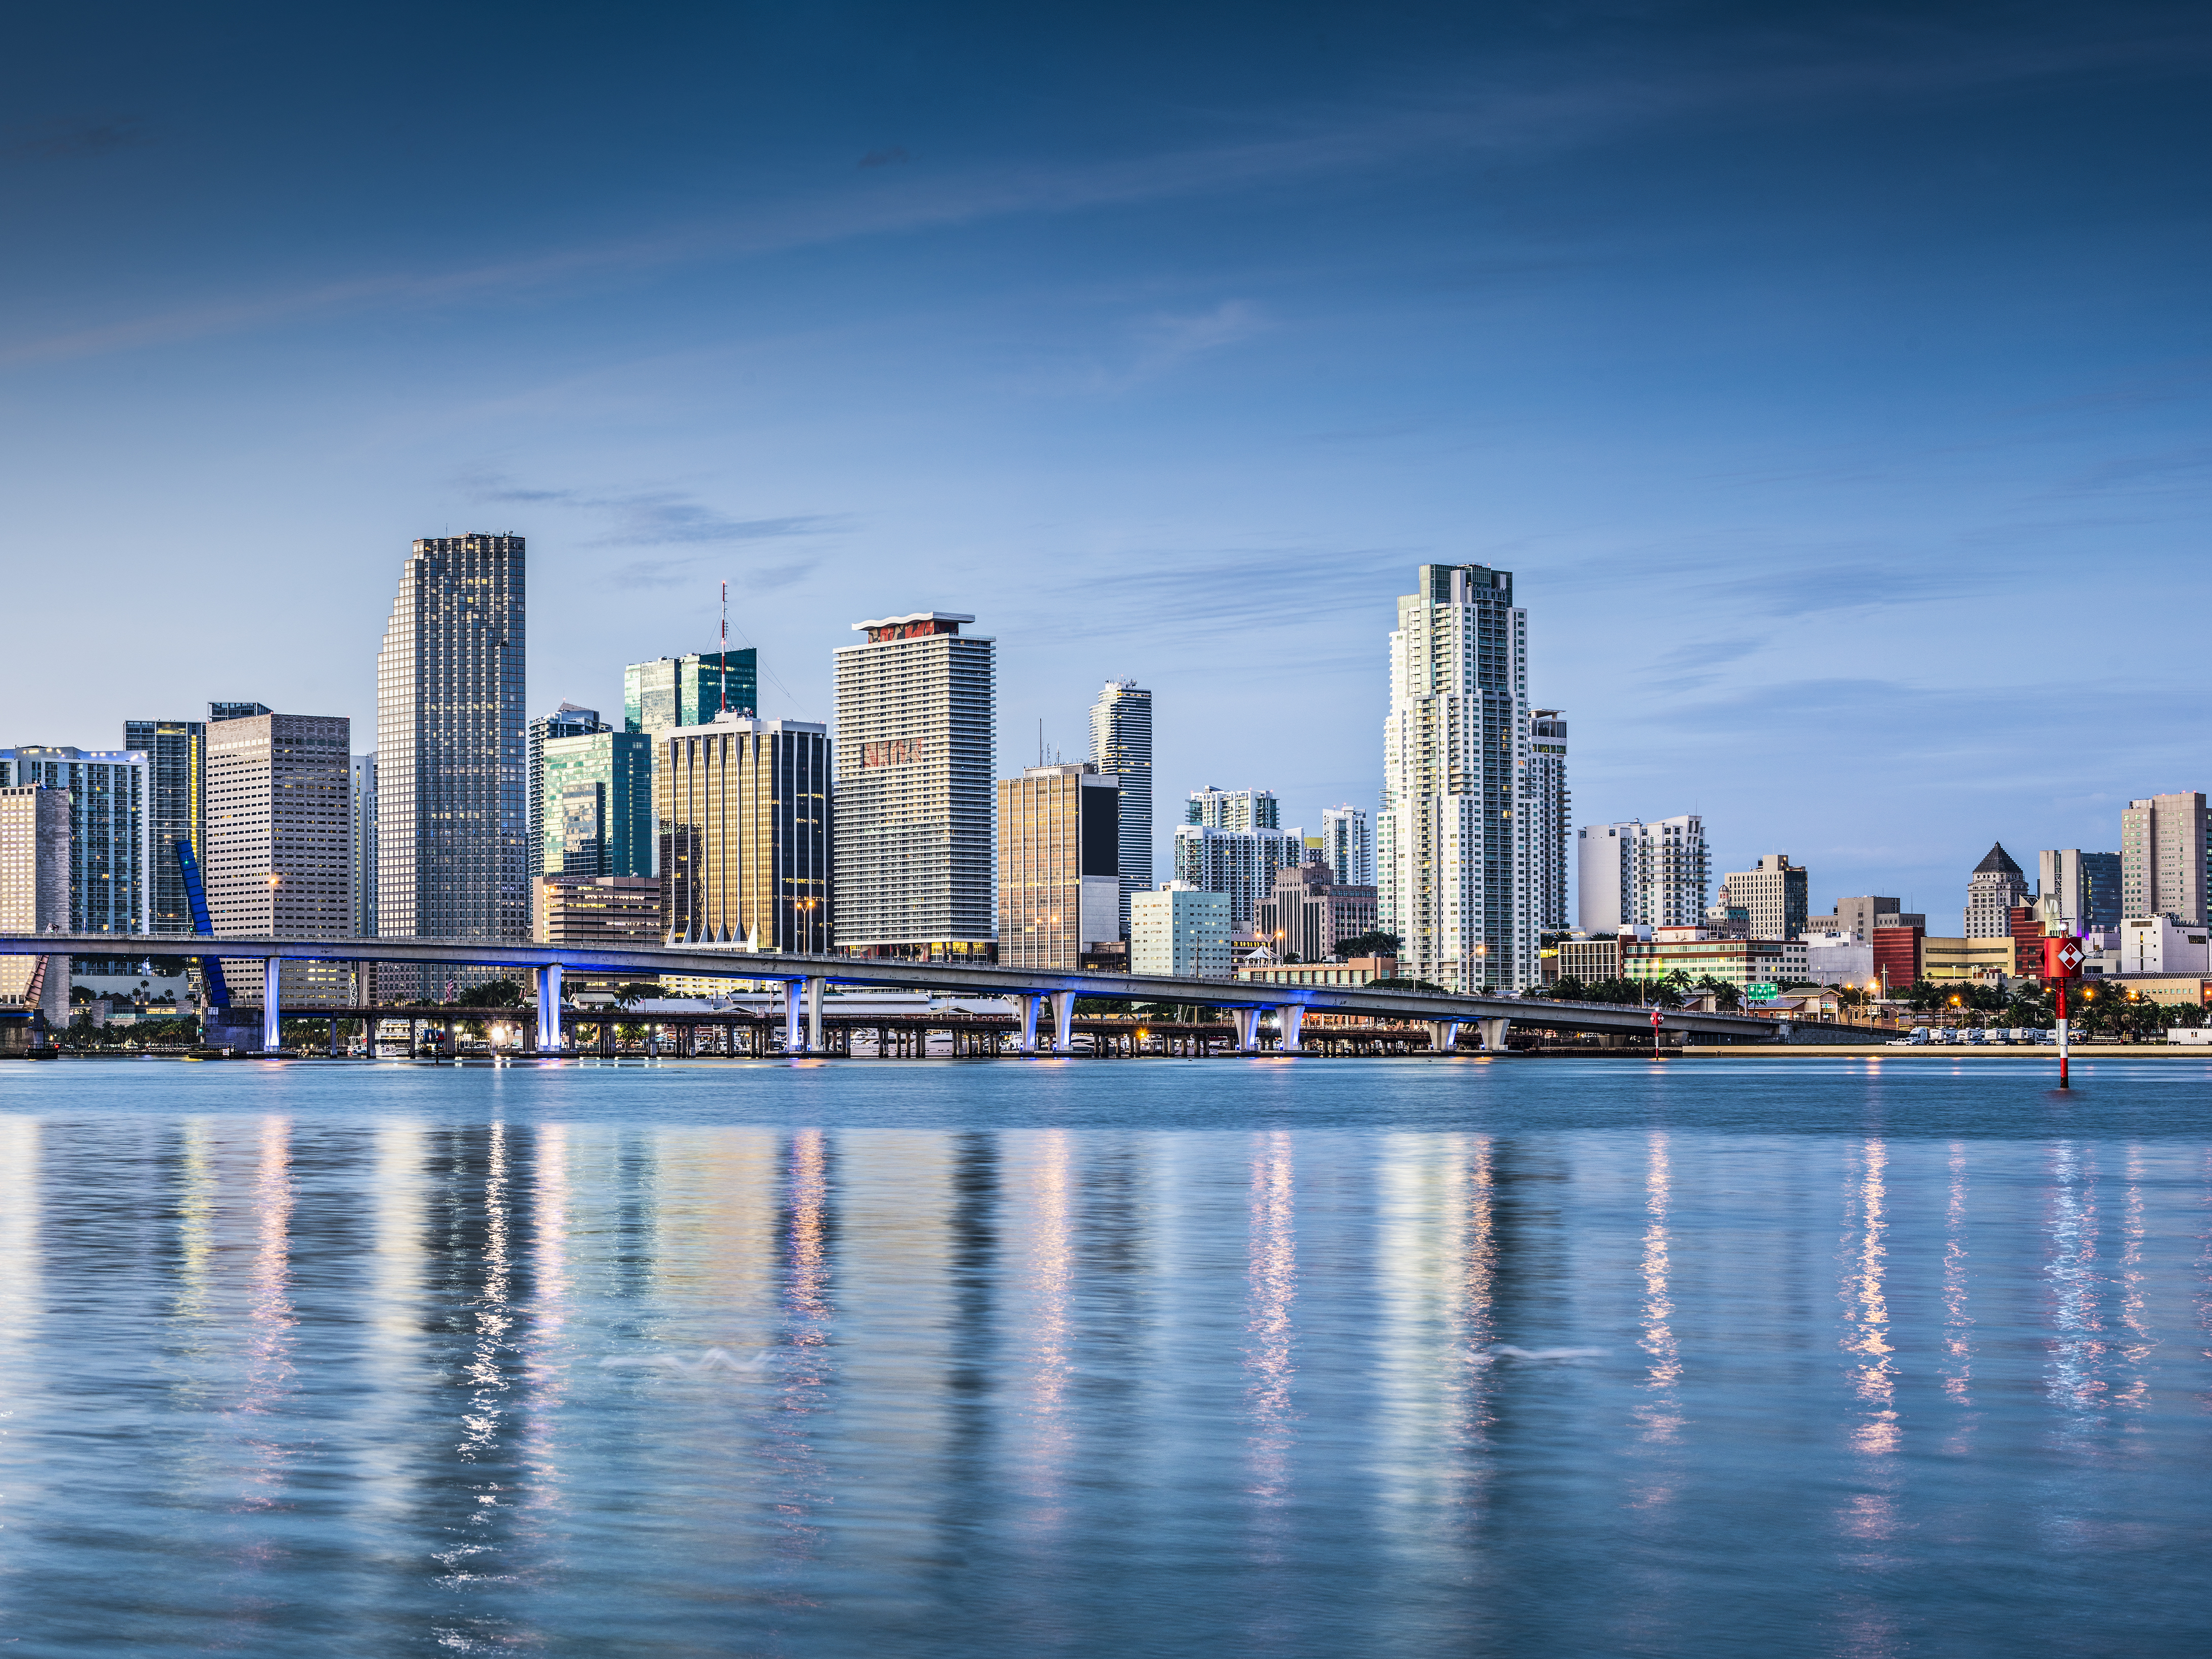

Slide 3


Slide 4
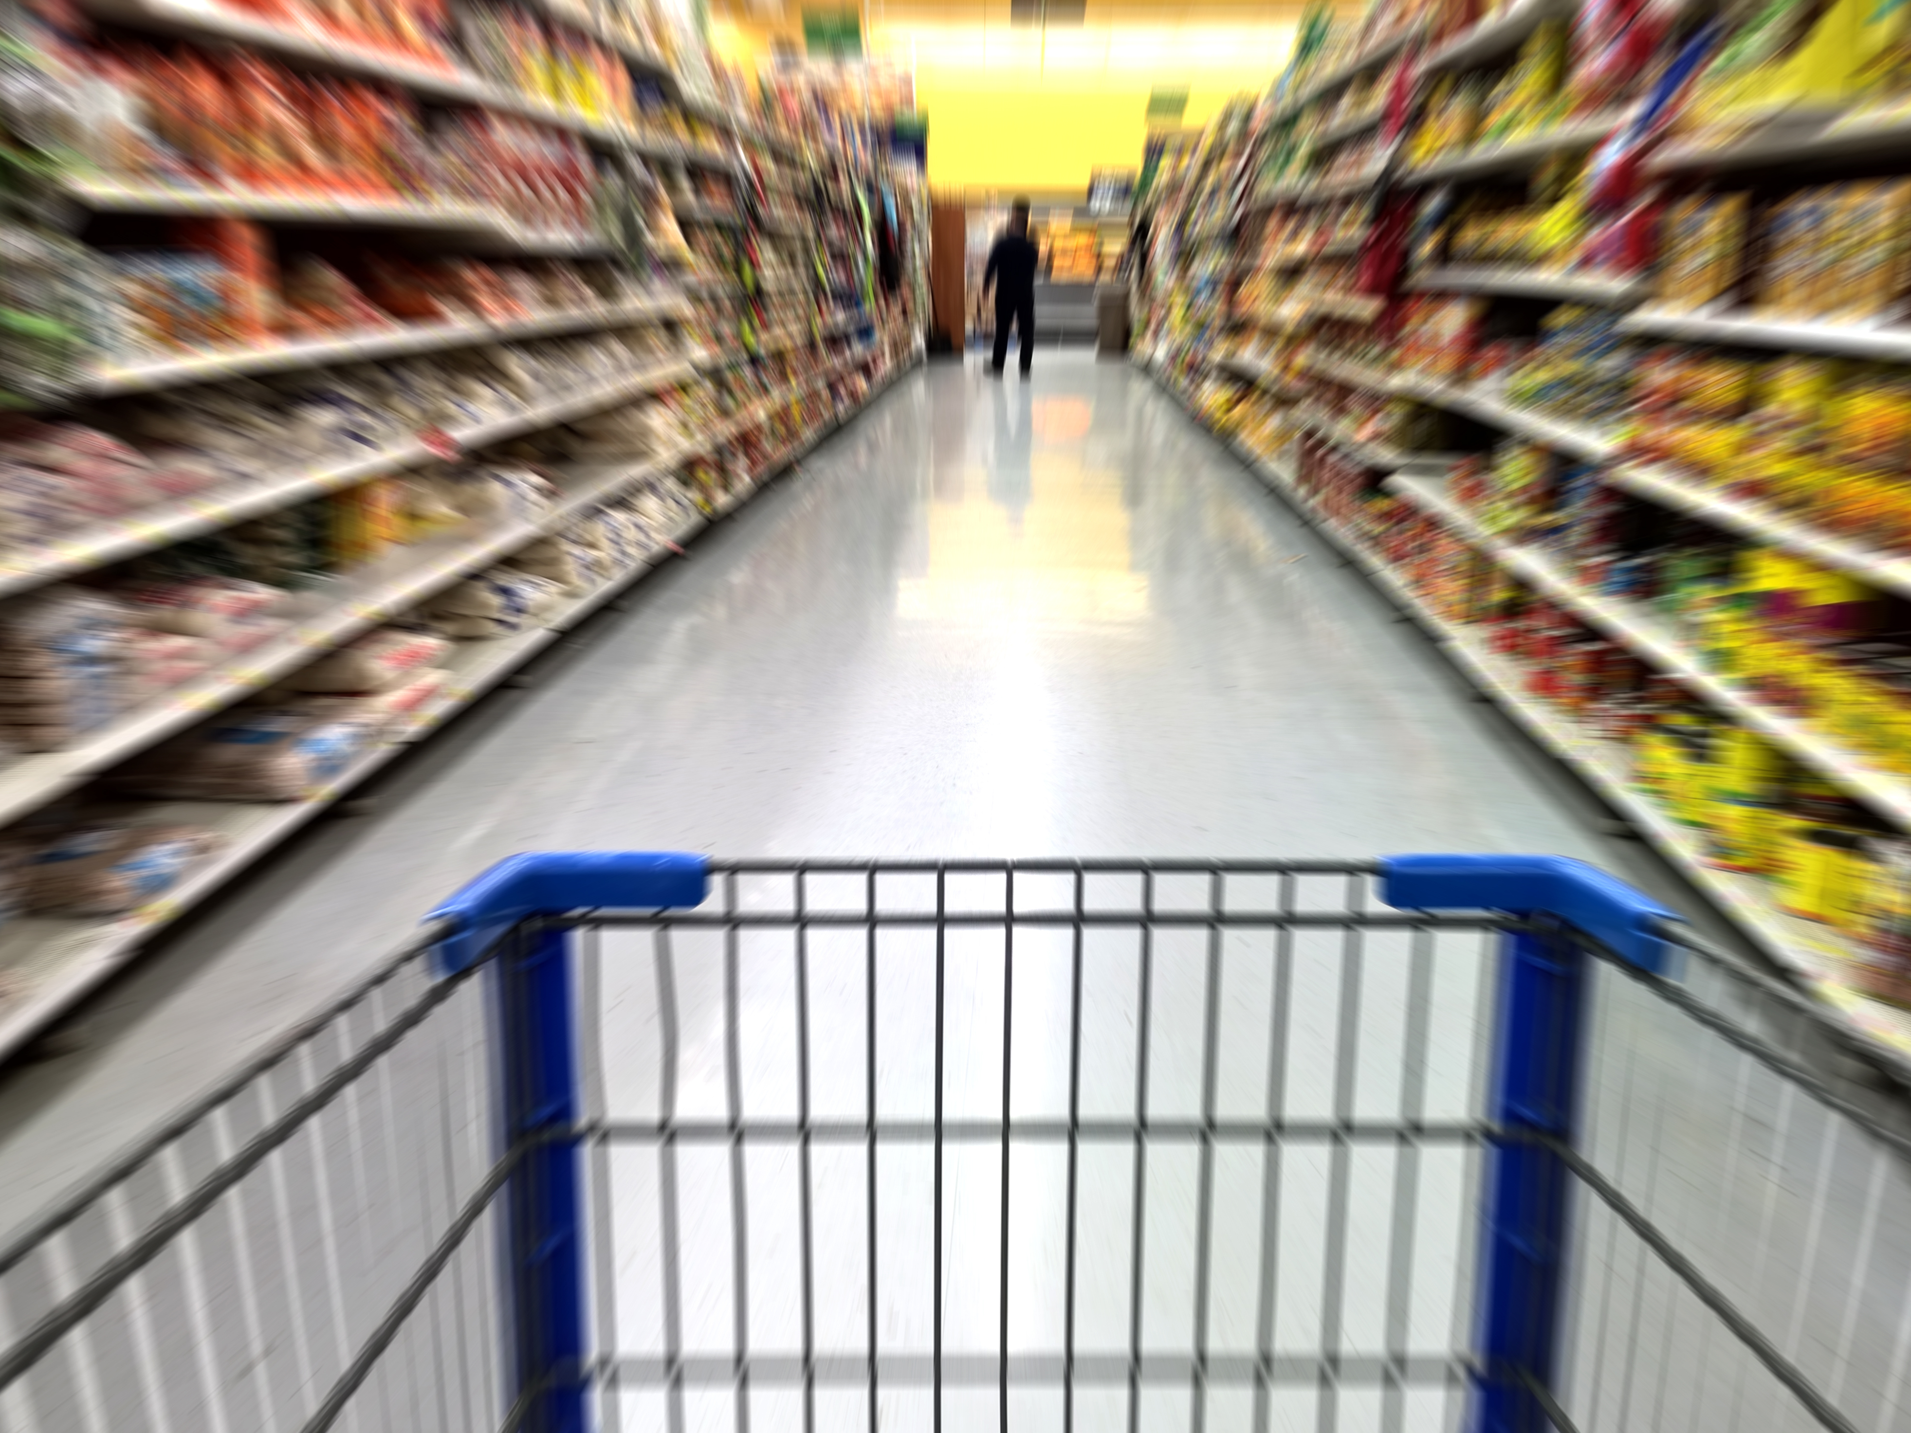
Challenges to
Growing a
$70 Billion Category

Slide 5
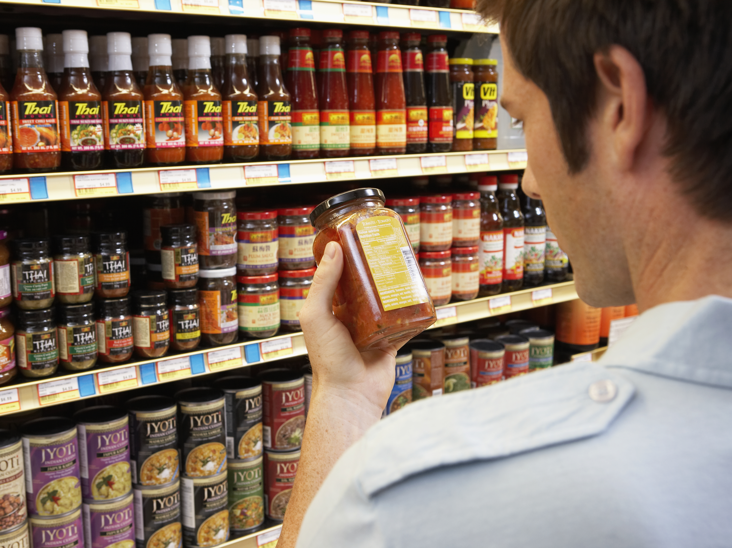
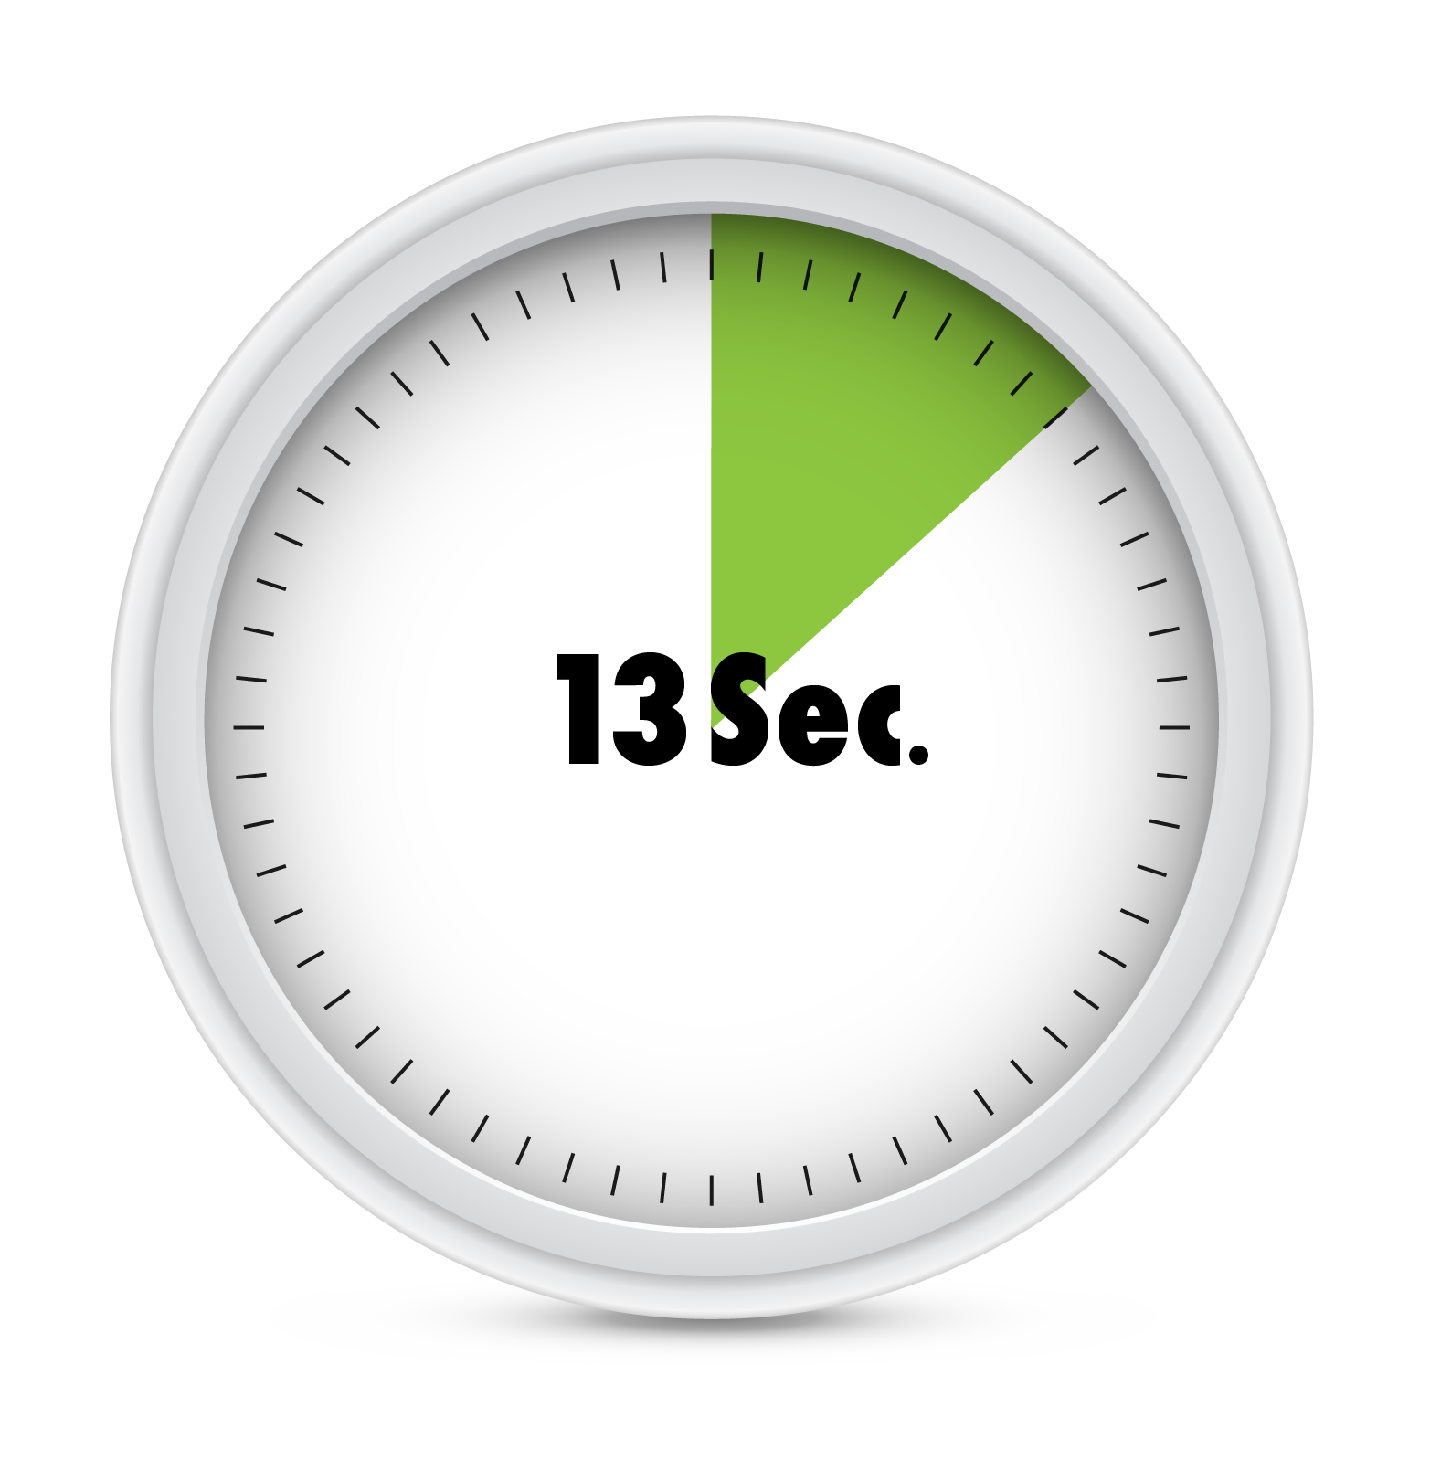
The Average Consumer Spends Around 13 Seconds Making an In-Store Brand Purchase Decision.

Slide 6
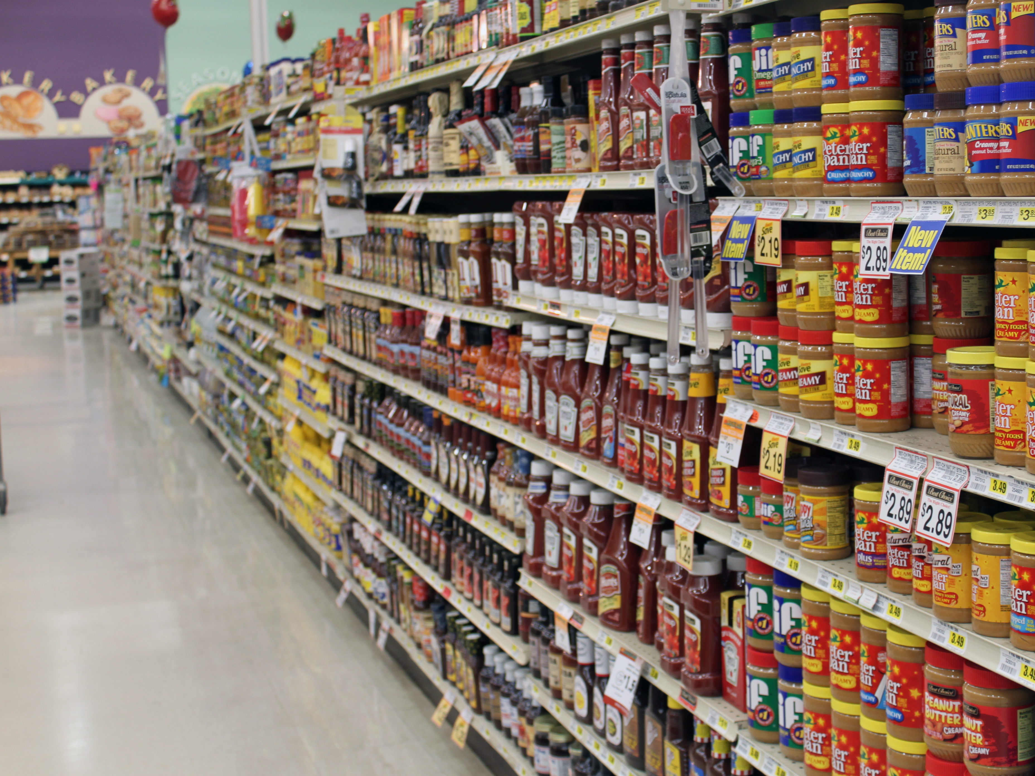
So Many Choices

Slide 7
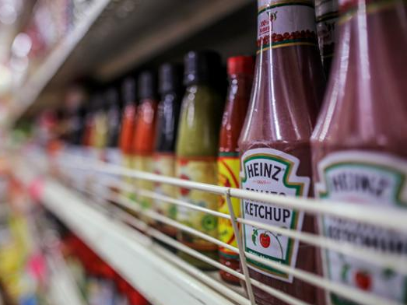
Decision Made

Slide 8
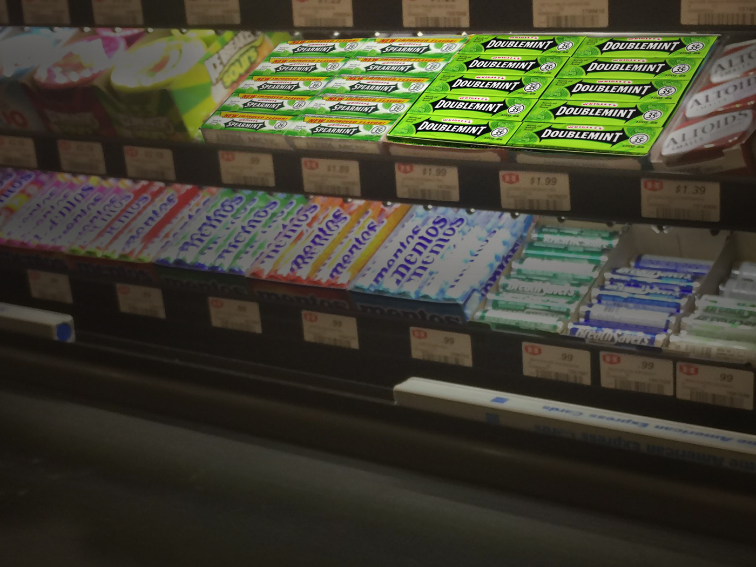
Impulse Purchase Decision

Slide 9
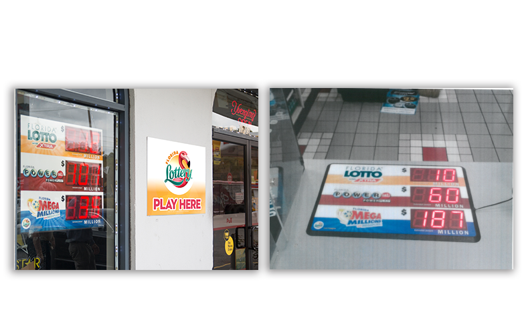
Focused Purchase

Slide 10
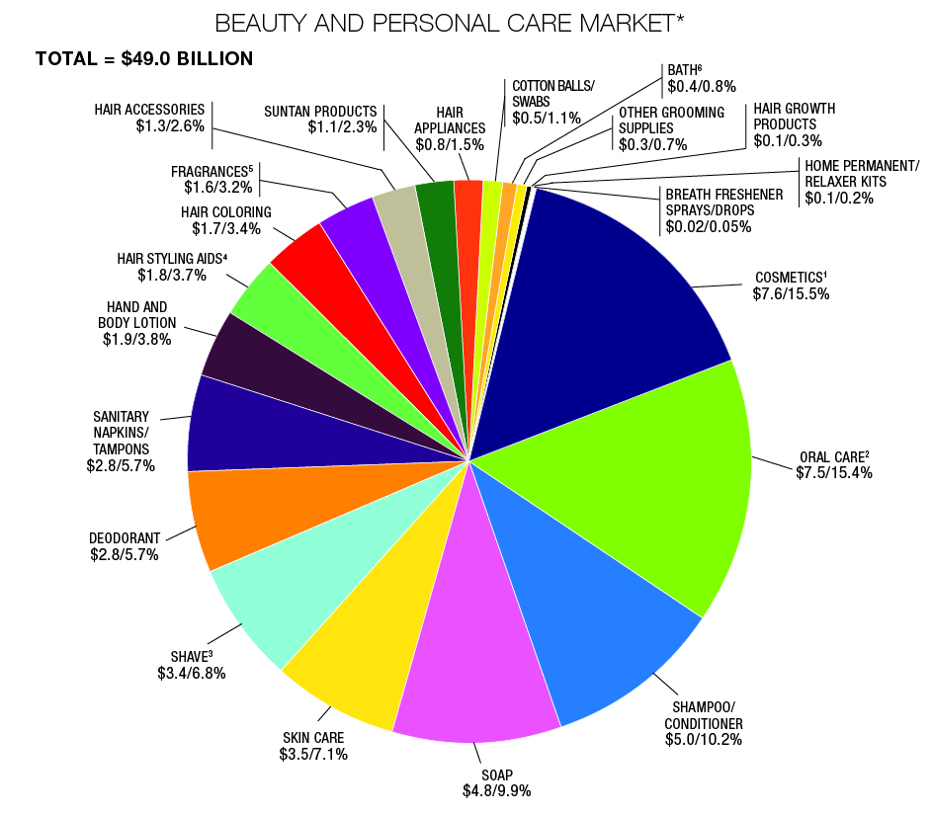
BEAUTY AND PERSONAL CARE MARKET*
*In billions; percent reflects share of total beauty segments
Reference Source “Beauty Care Trending”, August 2016 • drugstorenews.com

Slide 11
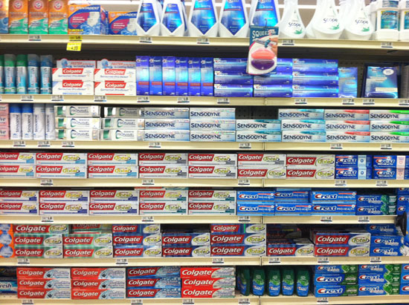
Category Trends

Slide 12
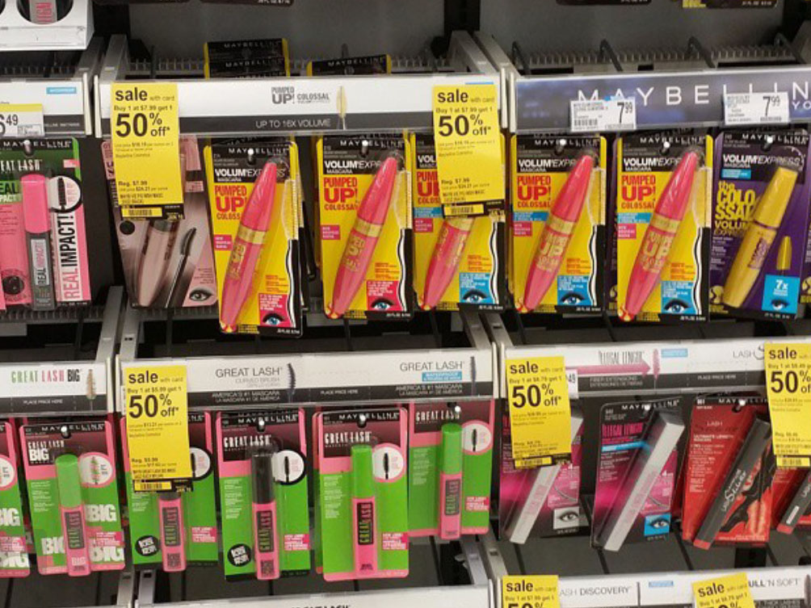
Category Trends

Slide 13
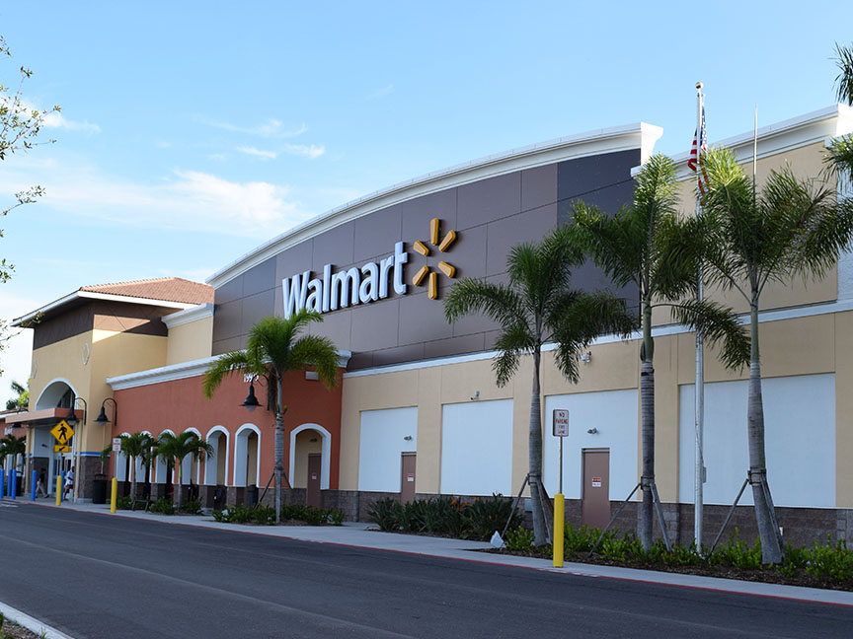


Slide 14
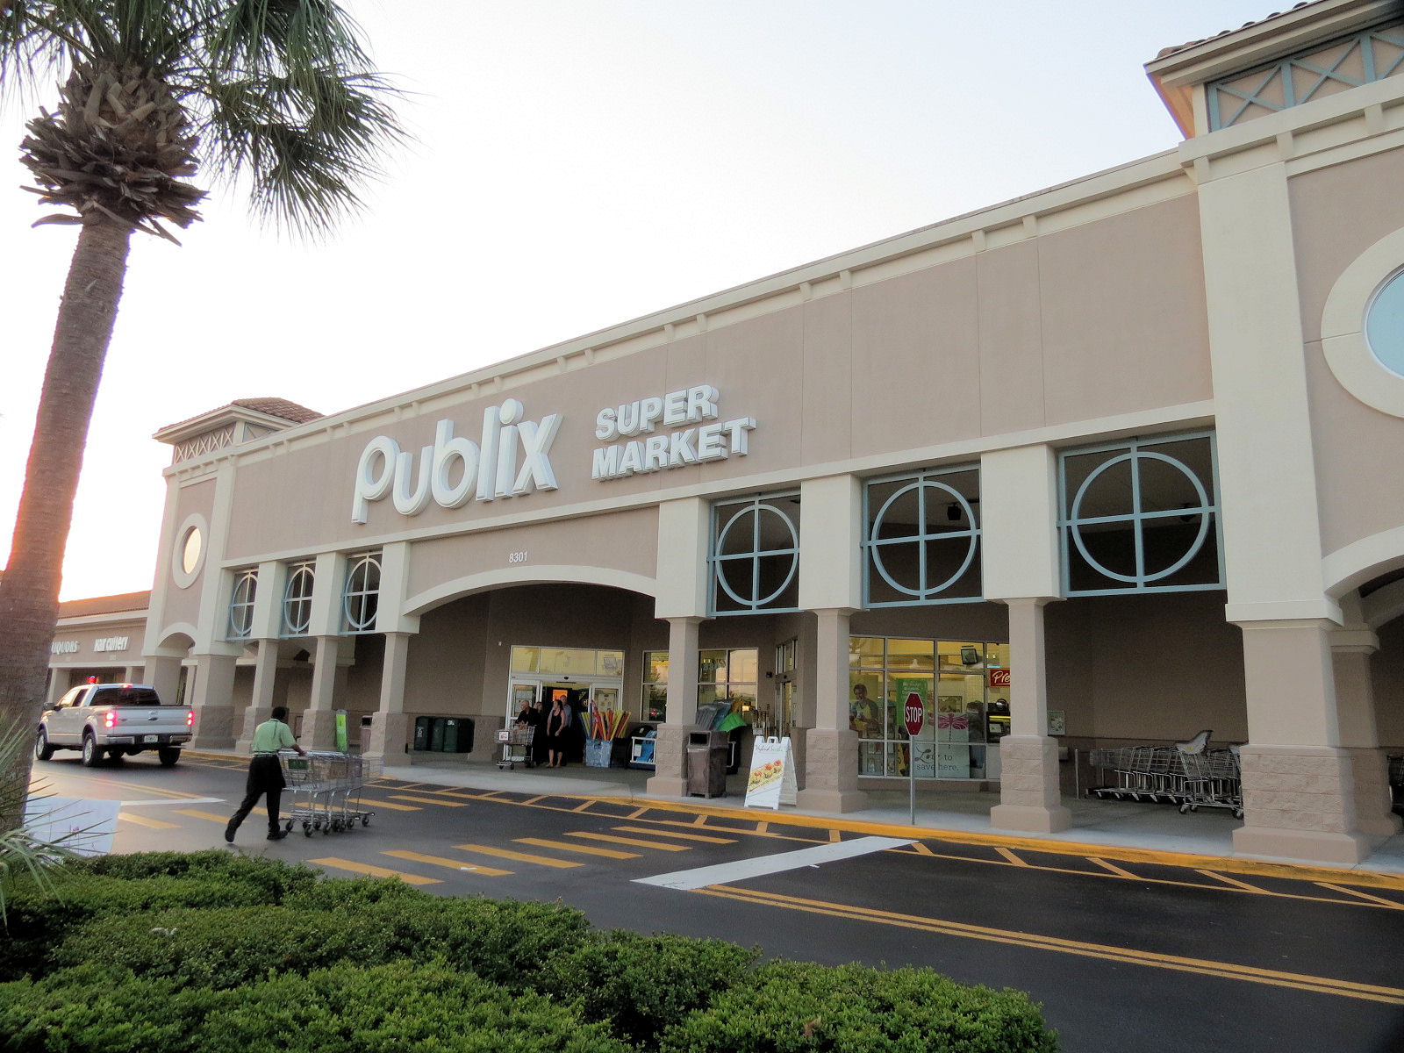

Slide 15


Slide 16

Technological Advances
and Trends

Slide 17

Thank You!

