Slide 1


Innovating responsibly
Bill Breslo
VP SALES & marketing
DIAMONDGAME.COM
Notes:
Right click > Format Background to change background image.

Slide 2


WHAT ARE WE ALL TRYING TO ACHIEVE?

Slide 3
Growth…
Without getting into hot water

Slide 4
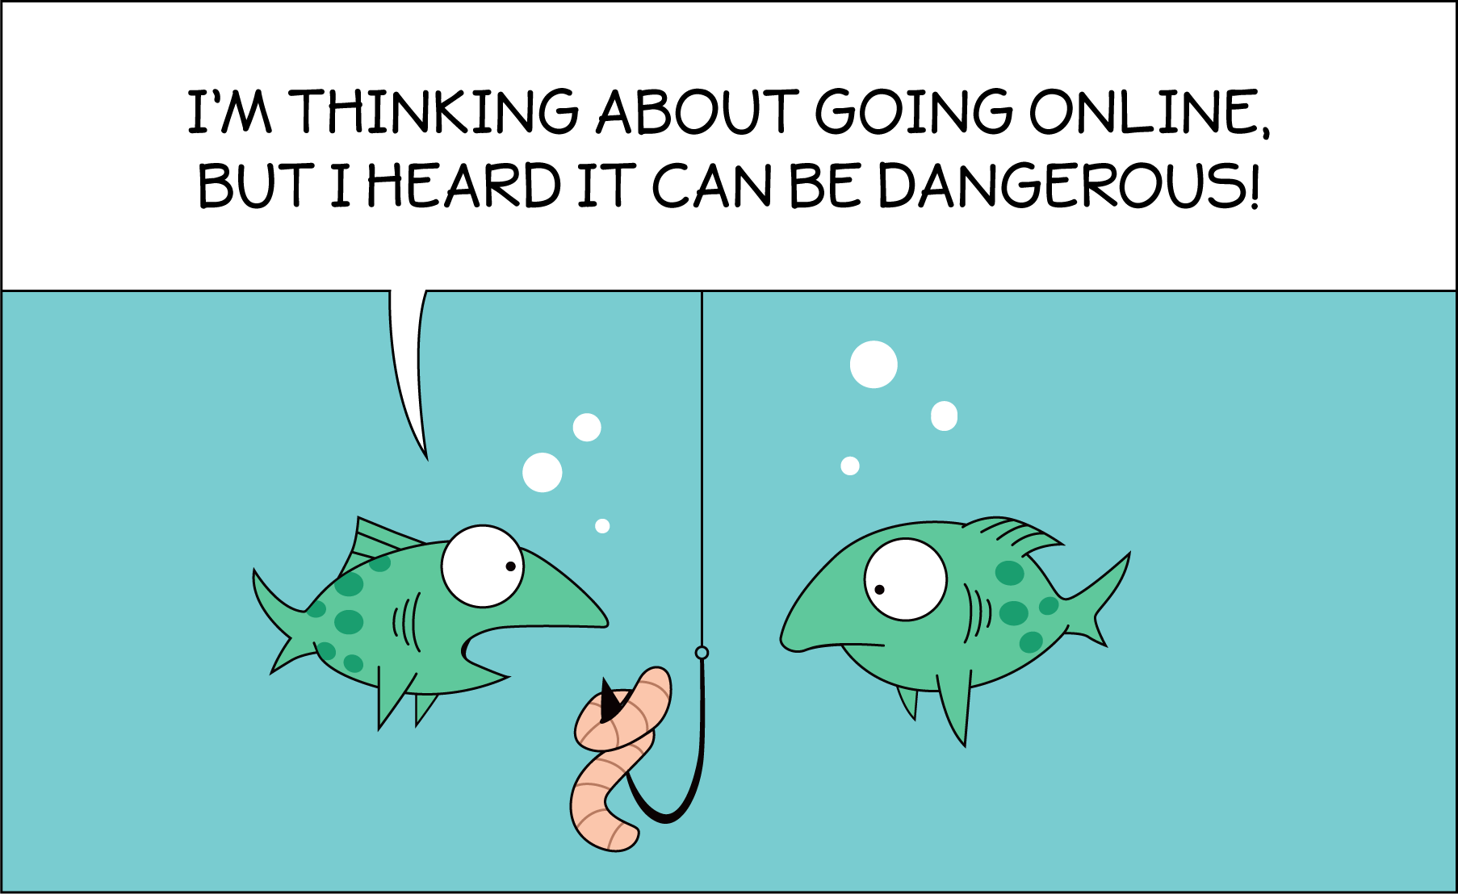

Slide 5
Growth…
Without getting into hot water
Doing right by our players.
RESPONSIBLE Growth

Slide 6

TECHNOLOGY IS OUR FRIEND

Slide 7
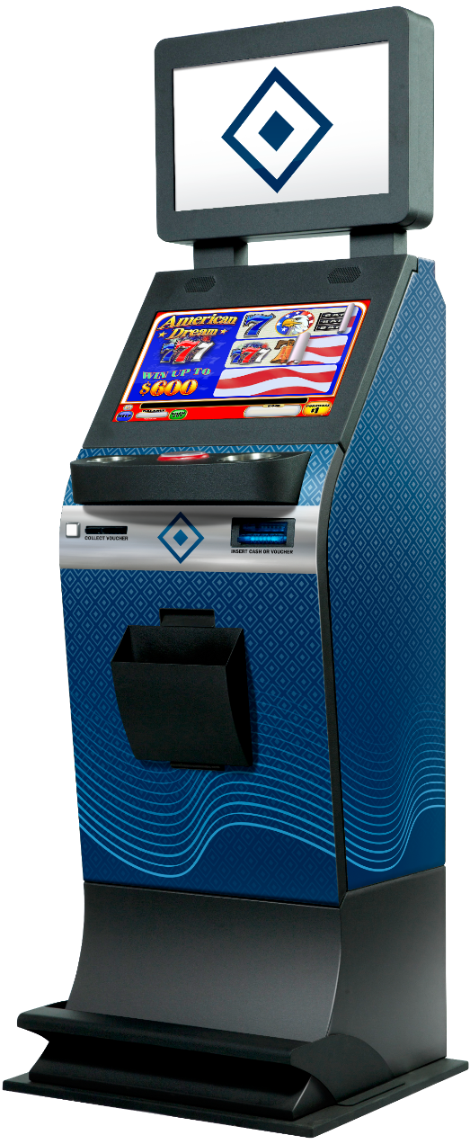



LT-3 ITVM
Applies technology and enhancements to a traditional product
Scans ticket barcode
Captures all data
Displays result in an entertaining fashion

Slide 8

Achieving growth…RESPONSIBLY
EXTENDED-play experience
Reaches new retailers
Broadens player base
More players. Fewer $ per player.
Notes:
Reaches new retailers – where we need to reference social venues

Slide 9

responsibly
Responsible gaming features

Slide 10


AGE VERIFICATION

Slide 11

SELF-EXCLUSION
Notes:
Speak to the difference between doing it with technology and without.
With technology we capture the player BEFORE they’ve spent their money.

Slide 12
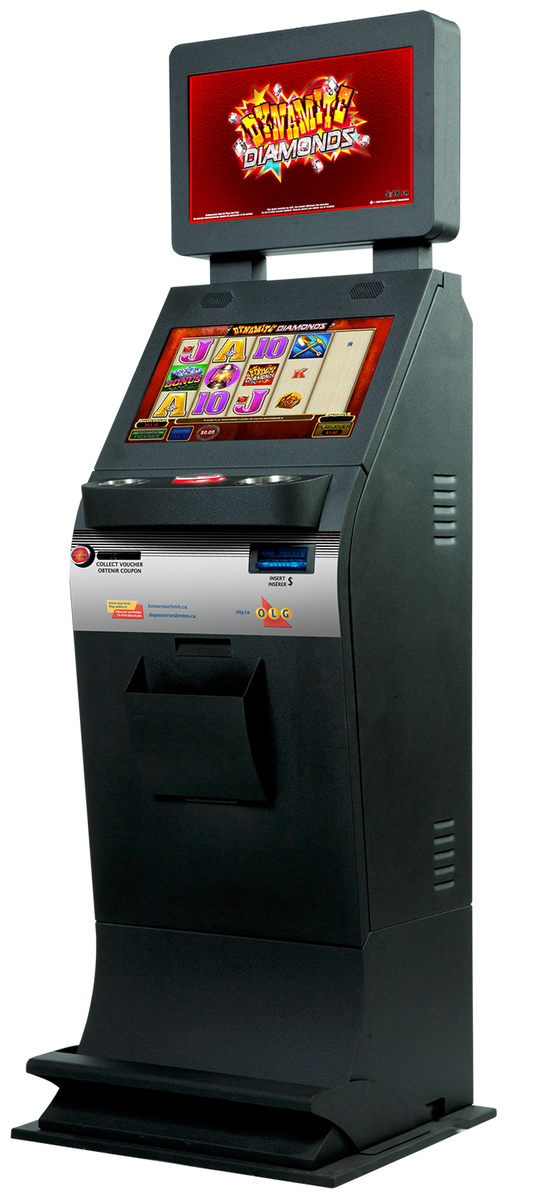

TIMED SESSIONS
Notes:
This could be timed session – picking the time frame you want to play. Or simply having a clock that allows you to keep track of time.

Slide 13

CURRENCY LIMITS
Notes:
Limit total amounts to be inserted or certain dollar bill values.

Slide 14


Rg hotline access

Slide 15
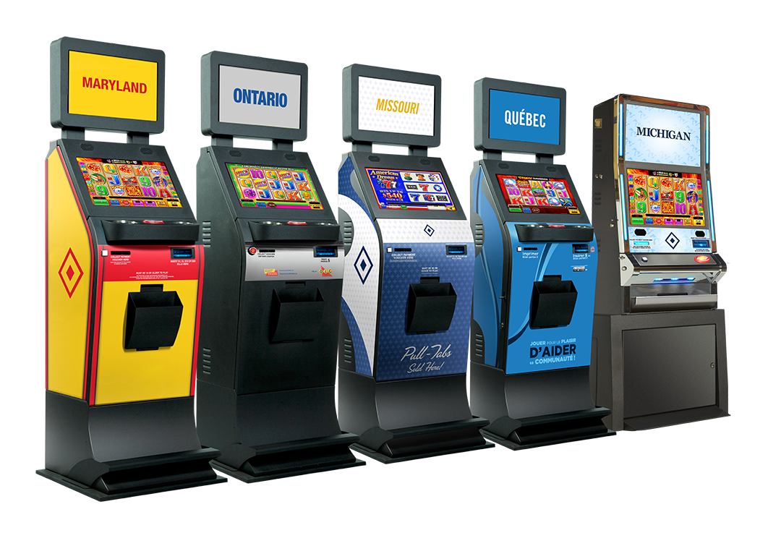
RESPONSIBLY GROWING MARKETS
Notes:
Where we can recap our markets and how we’re helping them grow responsibly.

Slide 16

COME SEE HOW!
Notes:
In addition to RG features, come see our new products and payment solutions.

