Slide 2
A Vision For Lottery Retail
10 Sep 2015
PGRI
Paul Riley
VP Innovation and R&D

Slide 3


NEEDS
Existing Players
Lapsed & Occasional & New Players
Entertainment
How do we make their current experience better?
Focus on Awareness and Accessibility
Player
Convenience
Revenue
Existing Retailers
New Retailers
Foot Traffic
Focus on Simplicity and Conformance to their business rules and processes
How do we enhance sales and reduce labor?
Simplicity
Retailer

Slide 4
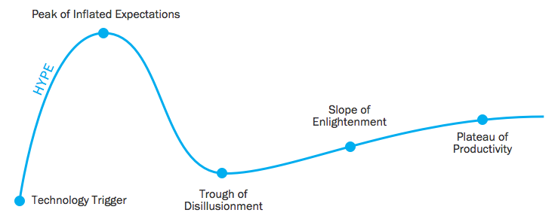

TRENDS
Trailing “Trends”
Emerging “Trends”
Visibility
Smartphones Omnipresent
Cashless Payment
OmniChannel Shopping
Social Media
Personalization
Mobile Payment
Alternative Payment
Concierge Shopping
Time / Maturity
Player
Same As Above ↑
Scan Based Tracking (SBT)
Self Service
Data Automation & Data Mining
POS & Systems Integration
Same As Above ↑
Specialty Stores
Pick Up &/or Delivery Service
Tablet POS Terminals
Scanning Optimization
Proximity Marketing
Biometrics
Retailer

Slide 5
Barriers to Adoption of Lottery
Awareness
Accessibility
Aside from moral objections and game related
Intimidating
Cash only
Player
“Not Cool”
Lack of Integration
Aside from moral objections and licensing hurdles
Lot of training
Inventory intensive (security)
Accounting/Settlement
Retailer
Lot of equipment/footprint
Loitering

Slide 6



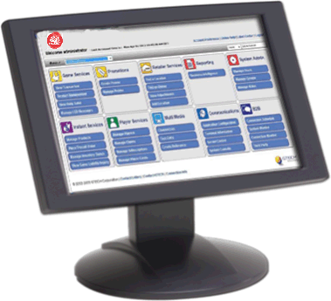
OmniChannel
Consumer centric solutions based on Player Journeys
Today
Target State
Solutions Approach
Consumer Approach
Activities
Channels
Retail Solutions
Awareness
Retail Store
Consideration
Websites
Interactive Solutions
Solutions
Purchase
Mobile
Play
Call Centre
Win/Collect
Social Media
Central System Solutions
Interact
Future

Slide 7
Customer Journey Mapping: Key Task > Buy a Lotto Ticket
Elements of the Customer Journey
AWARENESS
CONSIDERATION
USAGE
POST-USAGE
Aware
Where to buy
Selections
Enter the draw
Pay/Ticket
Check
Win/Prize
Lottery App /Mobile
Lottery Website
Call Centre
Player Touchpoints
Lottery Direct SMS/email
Retail shop
Social Network
Advertising

Slide 8
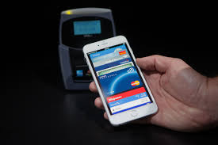
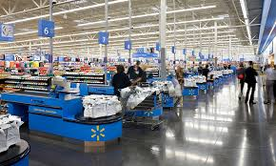
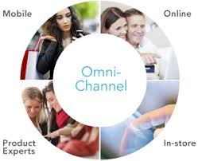
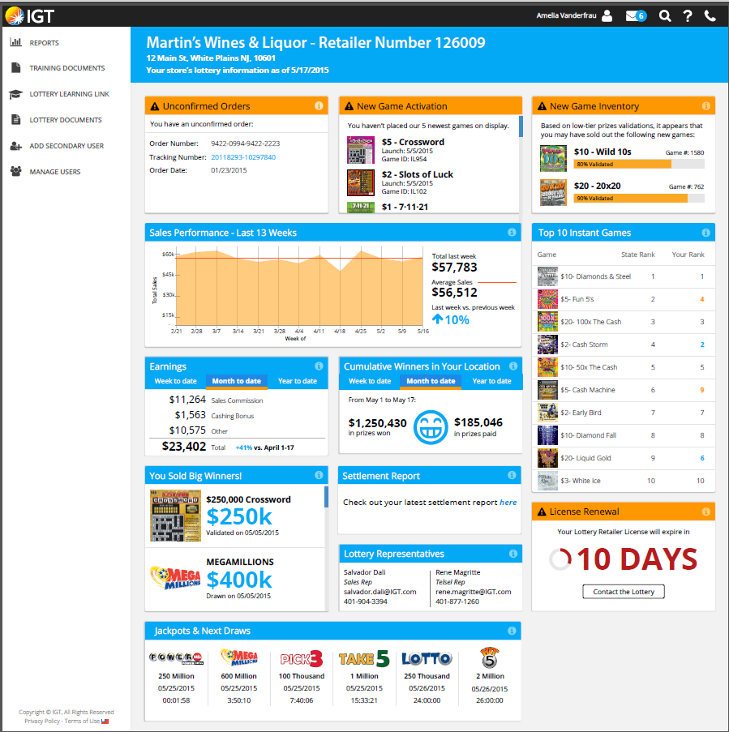
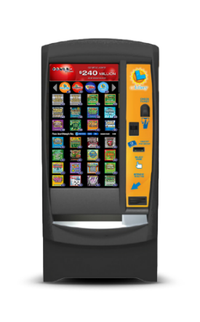
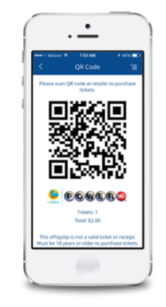
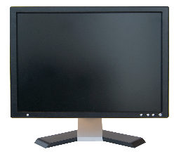
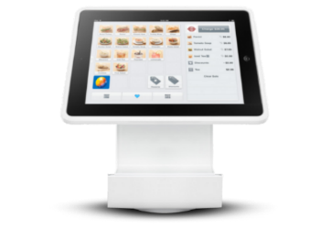
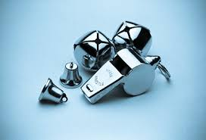

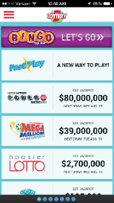
Key Strategies/Initiatives
CASHLESS
MULTILANE
OMNICHANNEL
TOOLS/INTEGRATION
Primary
PR
PR
PR
SMART SIGNAGE
HW AGNOSTIC
SELF SERVICE
BELLS & WHISTLES
Secondary
= Trailing Trend
PR
= Pending Research
= Emerging Trend

Slide 9

CASHLESS
Self Service and Retailer Operated
Card Based
Closed Systems
Evolving Solutions and EcoSystems

Slide 10
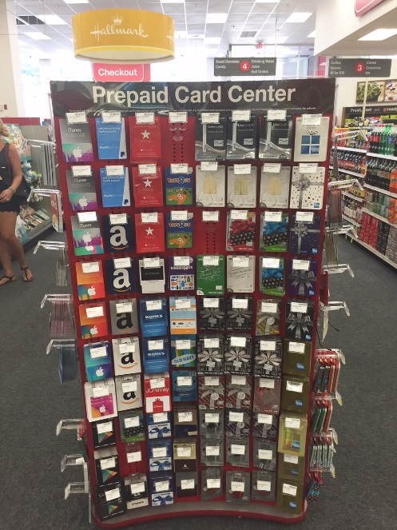
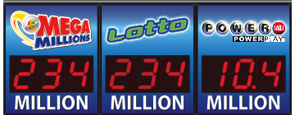
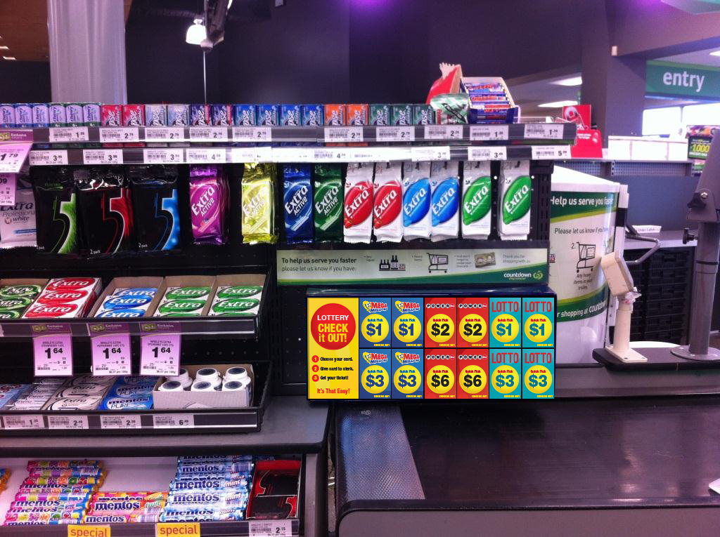
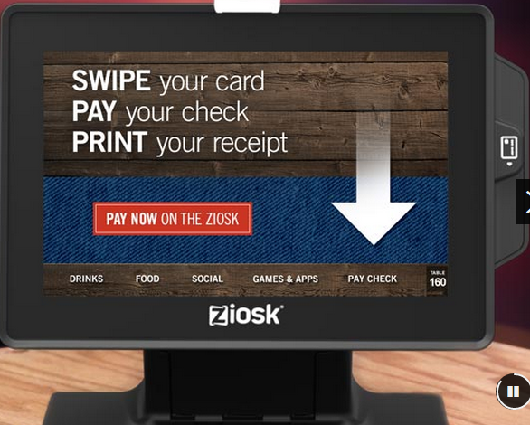
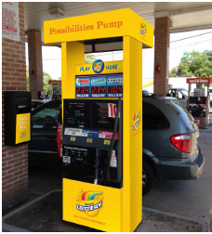
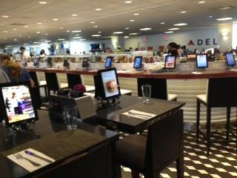
MULTILANE
Non-Traditional
Buy LOTTERY Here!
Ziosk
In Dining Entertainment
Play At The Pump
On The Go
Airport Entertainment
Replicate PrePaid Card Model
Draw Based Games
Scratchers (coupled with Ticket By Ticket)
Possibly Digital Playslip support
Possibly Player ID support

Slide 11
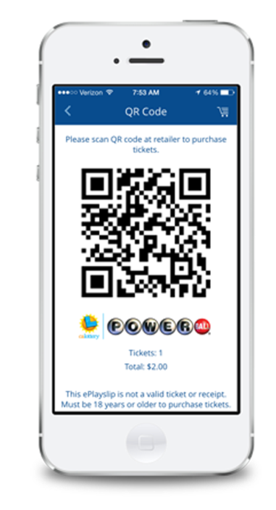
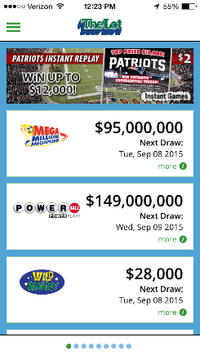
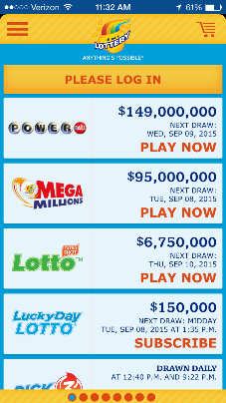


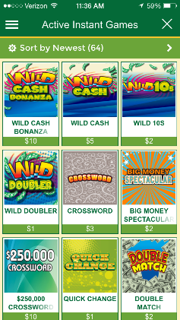
OMNICHANNEL
Check Your Ticket
Retail Locator
Promotions/Notifications
Retail Locator
Instant Ticket Metadata
Player ID
Digital Betslip
Digical
IL
IN
RI
NJ
Baseline

Slide 12
TOOLS &
INTEGRATION

Slide 13
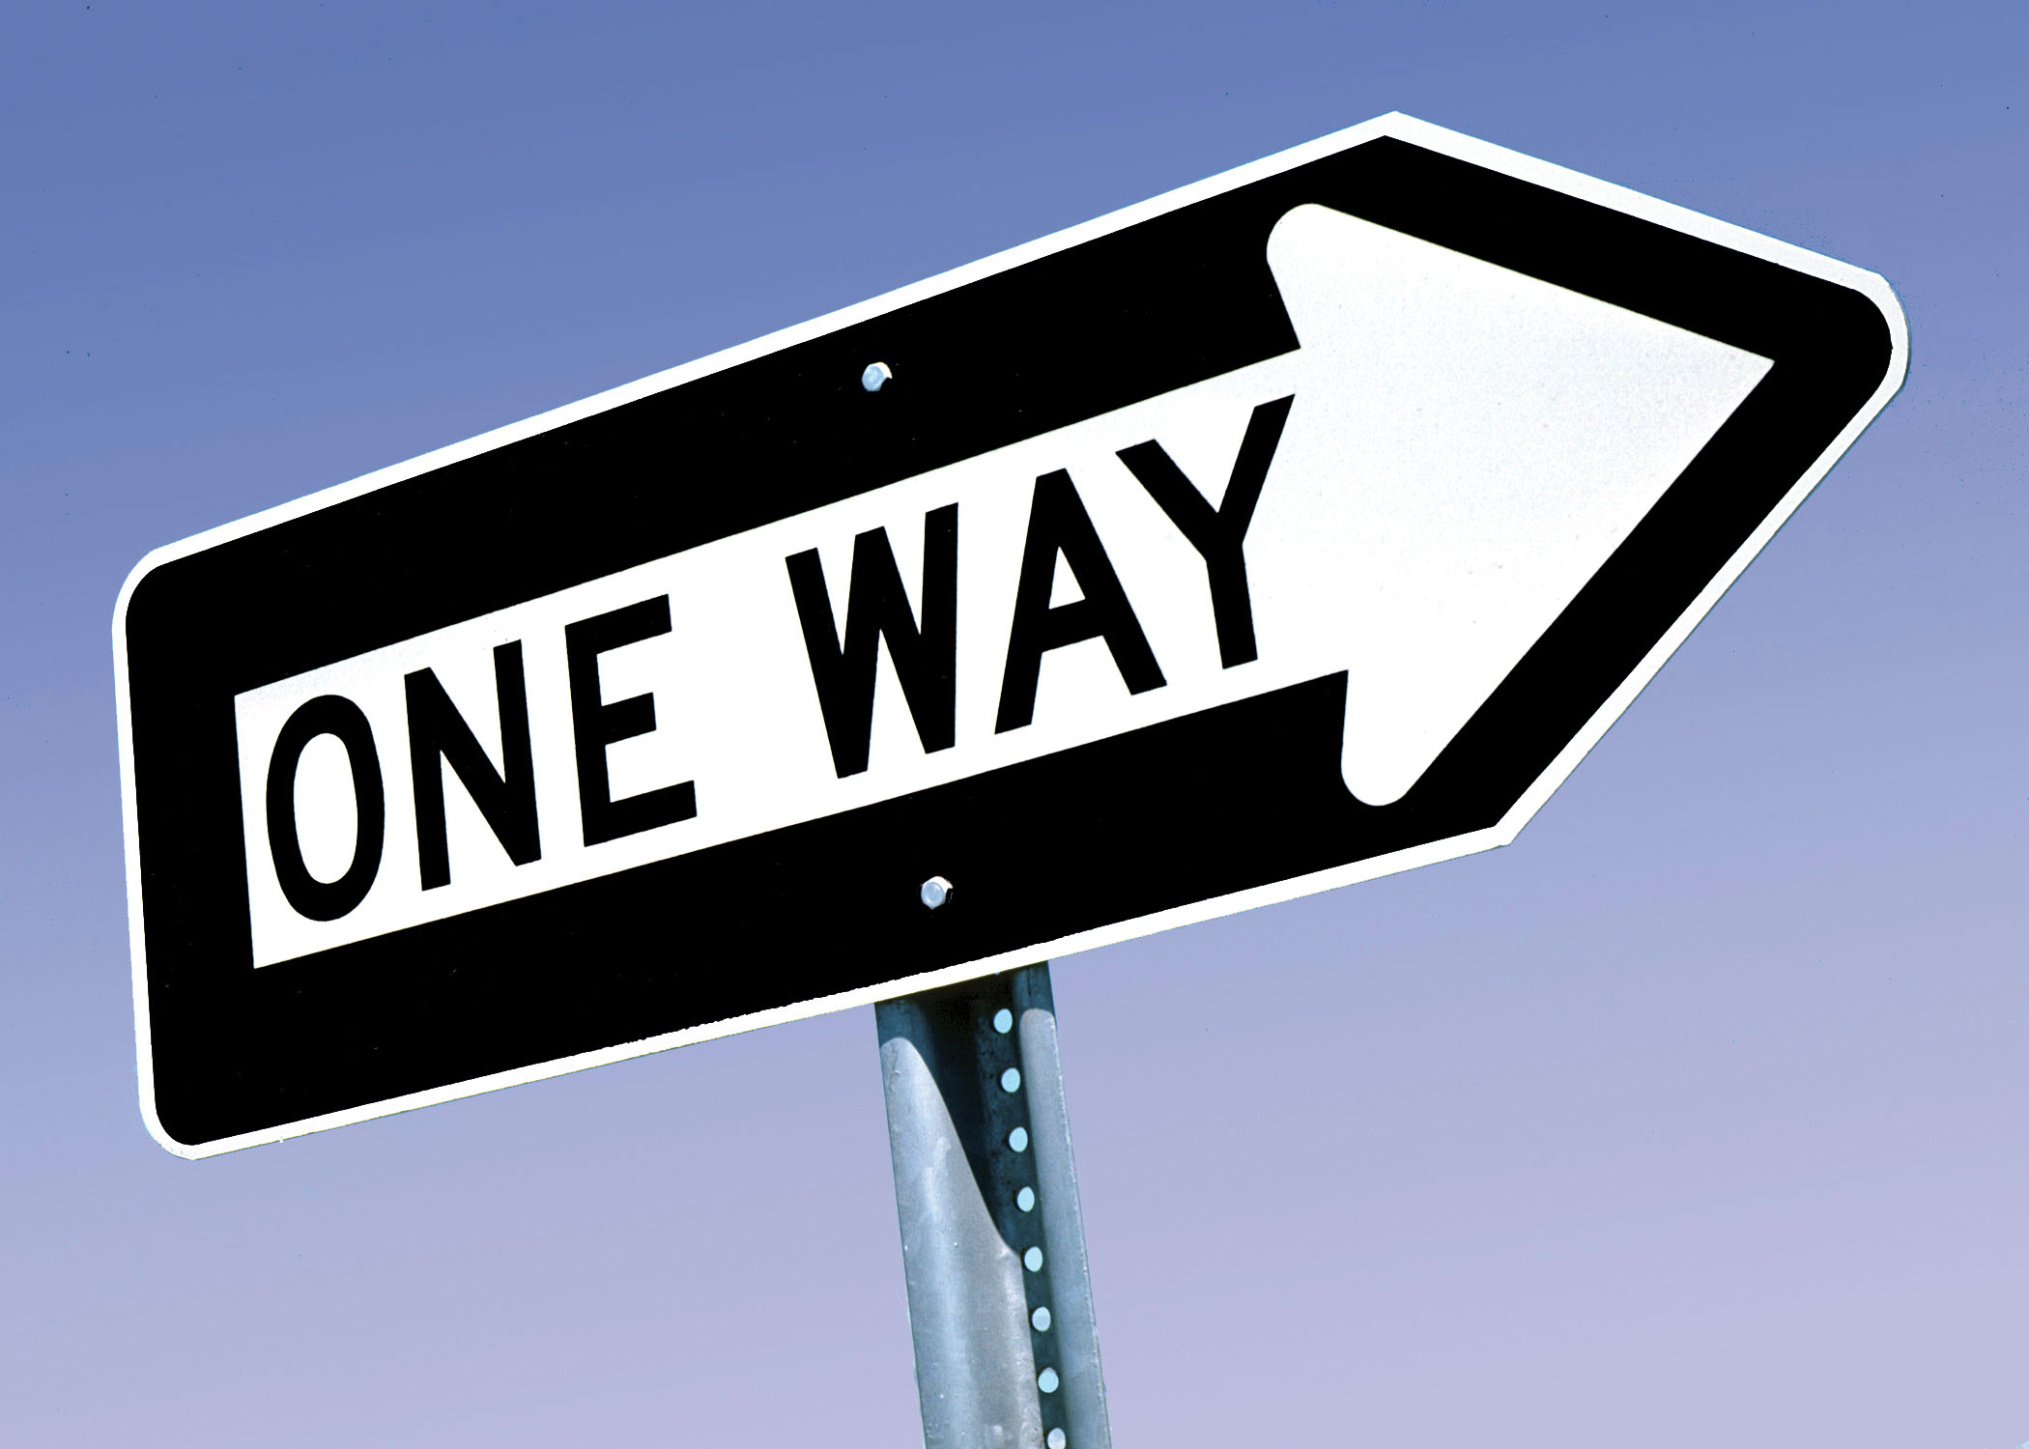
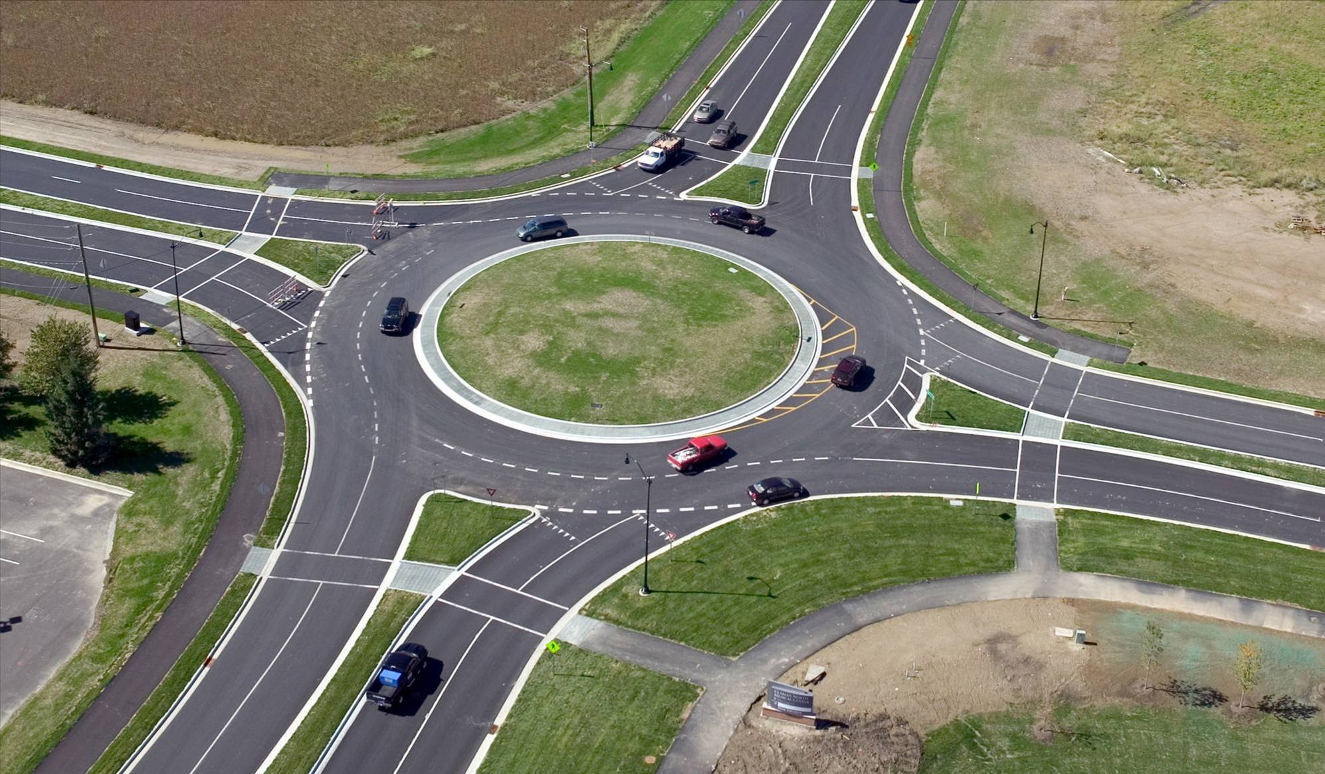
SMART SIGNAGE

Slide 14
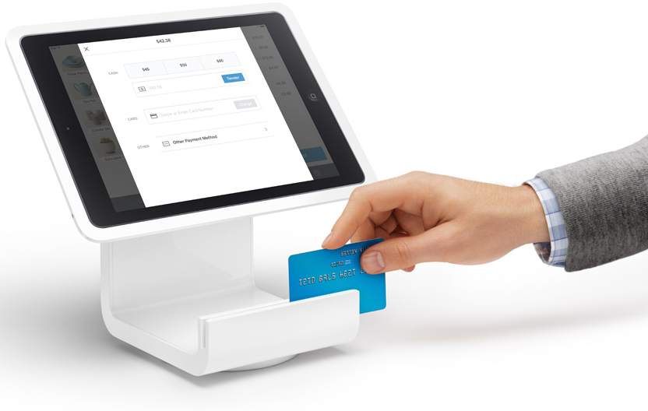
HARDWARE AGNOSTIC

Slide 15
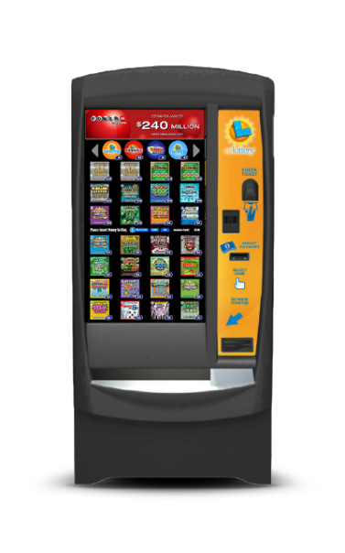
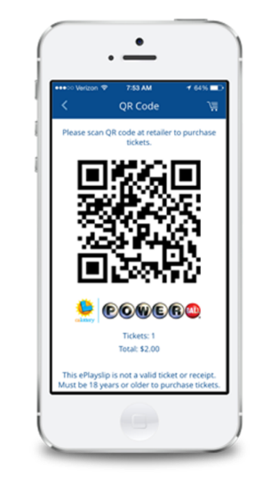
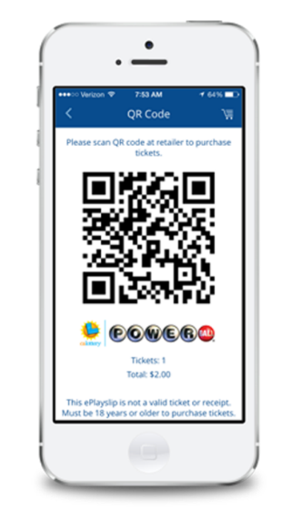

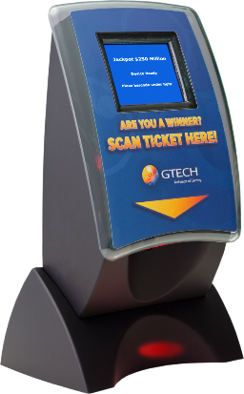
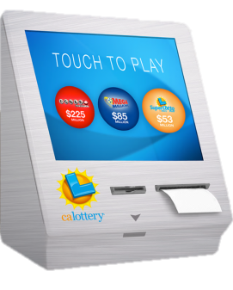
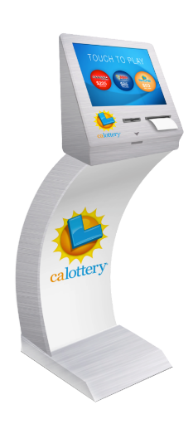
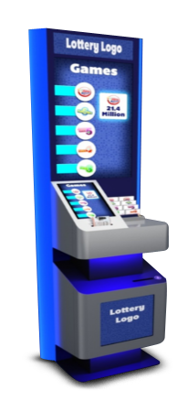

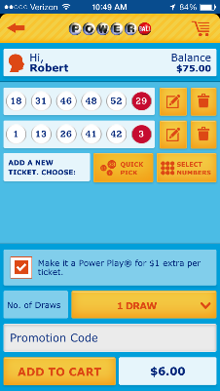
Self Service
Web Portal
Mobile App
Ticket Checker
Kiosk/Playstation
Self Service Terminal
Lottery Vending Machine
Tethered Wagering
Web Portal
Mobile App
Non-Wagering
Wagering
Learn/Explore
Did I Win?
Register
Draw Based Games, Scratchers, eInstants
Cash, Cashless, eWallet
Internet wagering allowed or not allowed

Slide 16
Self Service
Web Portal
Mobile App
Ticket Checker
Kiosk/Playstation
Self Service Terminal
Lottery Vending Machine
Tethered Wagering
Web Portal
Mobile App
Non-Wagering
Wagering
Learn/Explore
Did I Win?
Register
Draw Based Games, Scratchers, eInstants
Cash, Cashless, eWallet
Internet wagering allowed or not allowed
Requires
Research

Slide 17
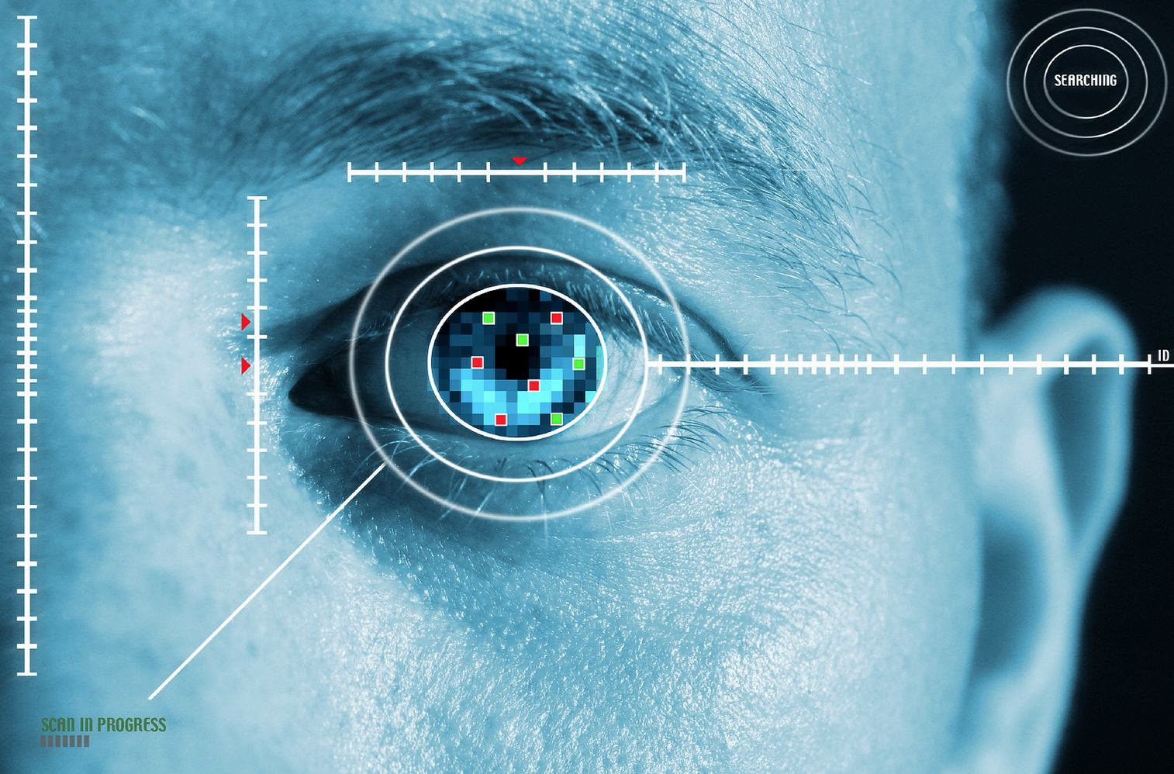
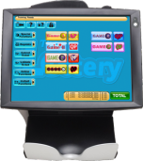
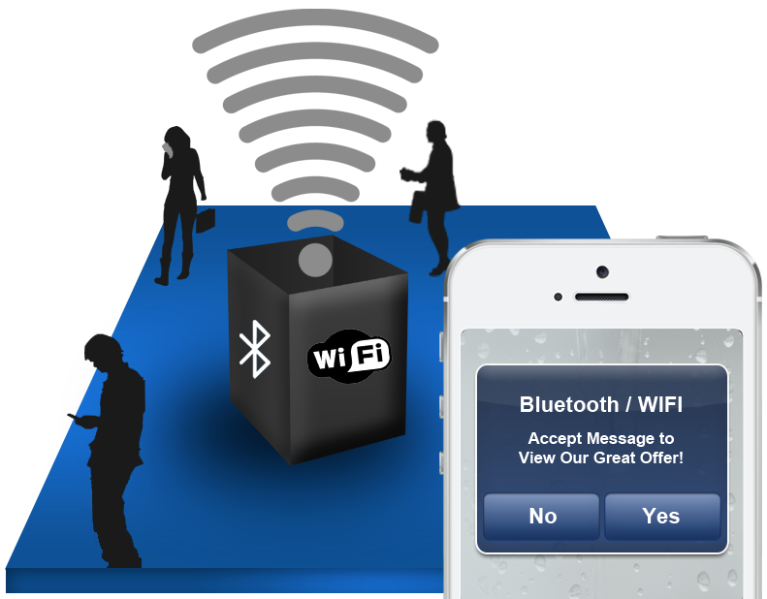

BELLS & WHISTLES
Biometrics
Proximity Marketing

Slide 18
Thank You

Slide 19
Backups Follow

Slide 20

Resulting Strategies/Initiatives
PR
= Pending Research
CASHLESS
MULTILANE
OMNICHANNEL
TOOLS/INTEGRATION
ALL terminals (retailer and self service)
Complete system (end-to-end)
Cards and phones
eWallet
Develop lottery industry API standard
DBGs, then scratchers, then players
Leverage AccuInstants
Player ID recognized at all terminals
Digical support for all terminals
Registration support
Auto Recognition ability
Lottery Services Portal/Retailer Wizard
Reporting/Data (XML) feeds
“Open” architecture and components
Primary
PR
PR
PR
SMART SIGNAGE
HW AGNOSTIC
SELF SERVICE
BELLS & WHISTLES
Retail Driven Content
Content personalization
Player interaction
Engaging experiences
Tablet terminals
Non-betslip reading
Betslip reading
IGT “approved” tablets, followed by BYOD (Bring Your Own Device)
Wagering to Non-wagering
Digical
Scalable configurable solutions
Smart signage leverage
Biometrics
Rapid registration
Remote monitoring
Proximity marketing
Secondary
= Trailing Trend
= Emerging Trend

Slide 21
Digital Delivery Experience
PLAYER
Anonymous
One Way
Not Real Time
Personalized
Two-Way=Interactive
Real Time
RETAILER
No Input
No Results Transparency
No Training Required
Localized Content
Maybe even Retailer loaded content
Augment Lottery Service Portal (LSP) with Digital Signage Analytics
No Training Required
LOTTERY
Slow Time To Market
Show creation
Testing
Network
No Auditable Plays
Minimal Real time
Data Barren
Fast Time To Market
Auditable Plays
Enhanced Real Time Content/Data
Data Feeds into BI (Analyzable)
TODAY
TOMORROW

Slide 22


Player Personalization
A Spectrum
Of Player Identity
Exists
Resulting Digital
Signage (Player) Experience
Recognition at Retail
Manual
Present / Scan a Player ID (Card or Phone)
Say/ Key-In Unique Info (Email or Cell #)
Biometric – finger, palm, voice
NOT
Preferred
Personal “Welcome” message (with or without photo or avatar)
Next Best Offer
For Segments
For Individuals
Account Update
Loyalty
Win Notice
Balance
Sub Renewal
Content added to ticket if bought
Anonymous
Recognized
Male/Female
Young/Old
Light Registered
Email
Phone
Name
Fully Registered
Sally Miller at
10 Main Street, Age 24, Purchases Lotto, etc.
Automatic
Geolocation/ Proximity of cell phone/ wearable
Image (Facial) recognition
(Preferred!)
Requires real time connectivity to CRM solution

Slide 23
Player Interaction (2 Way)
Interactive Channel
Player Experiences
Resulting
Considerations
Touchscreens
Accessibility
Place A Wager
Make Selections
Payment
Pre-Order
Coupon Redemption
Learn
How to Play
Good Causes
Jackpots / Winners
Try a Game (PFF)
Registration
Info Capture
Image Capture
Winner Awareness
Upload Your Info/ Photo
Touch
Phone/
Wearable
Gesture
Voice
Today
Apps
Proximity
Near
Term
Camera
Image Processing
Coming
Microphone
Noise
Accuracy
Digital
Signage
Ticket
Checker
Digital
PlayStation

Slide 24
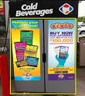


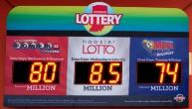



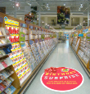

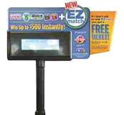



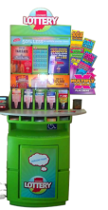
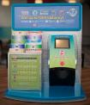



The five zones of the shopper’s experience
Cooler Clings
2
Pole Signs
THRESHOLD ZONE
Objective: Remind potential players that the retailer sells Hoosier Lottery games inside
Window/Door Cling
1
EXTERIOR ZONE
Entry Clings
Objective: Clearly communicate that the retailer sells Hoosier Lottery games inside
Triple Jackpot Sign
Floor Clings
Nozzle Talkers
3
Winner Awareness Banners
SHOPPING ZONE
Objective: Disrupt shoppers and introduce Hoosier Lottery games/ remind them to purchase
5
Pole Signs
COUNTER ZONE
Vending Machine
Hoosier Lottery Game
Objective: Educate players on promotions and variety of Scratch Off and Draw Games
Catalina and iBeacon Couponing
4
LOTTERY ZONE
Objective: Educate players on new games and provide playslips
Counter Mats
Merchandisers
ESMM
Towers
Play Center
Winner Awareness

Slide 25
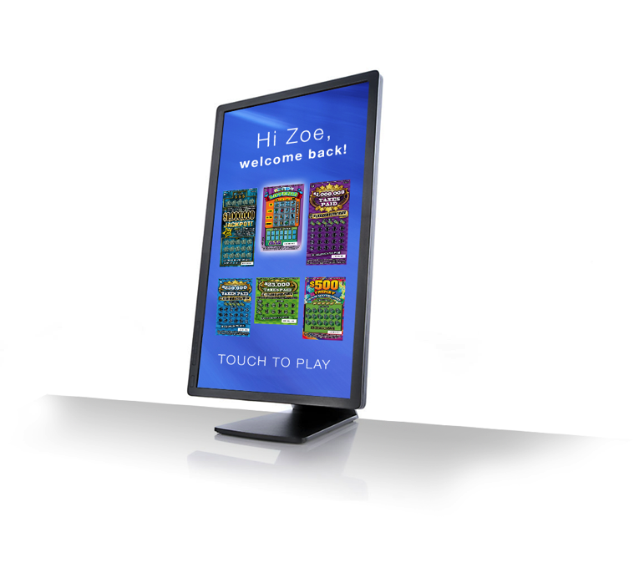
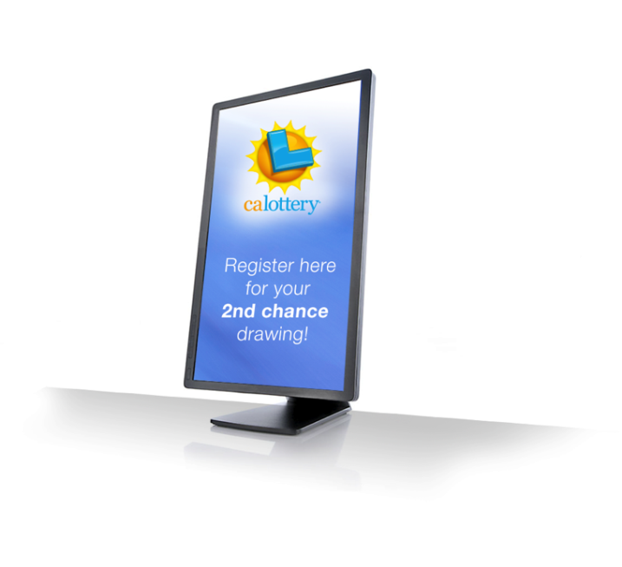
Smart Signage
Modern, powerful player engagement
Player Interactive Touchscreen
Creates excitement in-store
Player Registration
Player Engagement
Register via touchscreen
Manage your account
View account activity
Personalized Messaging
Scan Player ID
Receive personalized messages and offers
Download Lottery APP so that you are recognized when you near a machine in order to receive personalized messages

Slide 26



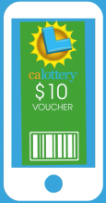


Tethered Wagering – Play on the go
Pay the retailer and play anywhere.
GETTING STARTED
Downloads Lottery APP anywhere
Registers
Email
Password
Date of birth
GAMES
Selects games anywhere
Hot Spot
DBG
eInstants
RETAILER
Scans players virtual ID Barcode
Confirms purchase on terminal
Receives payment from player (cash, debit or eWallet)
Earns commission
PLAYER
Pays retailer (cash, debit or eWallet)
Wagers are loaded into players account and logged to system
Smartphone can reveal the pre-determined results of their eScratchers anywhere
Results of draw games reported directly to phone
WIN
If player wins <$600, they can load directly to account
If they have an eWallet, they use fnds to purchase items in retail location, purchase more lottery tickets or cash out
>$600 normal claim process
Add games to cart
Receives a virtual ID barcode

Slide 27
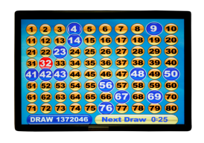
Tethered Wagering – Play at retail
Without aid from clerks or machines
PLAYER
Downloads and launches Lottery APP
Full registration
Loads eWallet-Credit, debit, ACH
CONNECT
Player who sees a lottery hot stop symbol in a retail location, can connect to the hot spot with their smartphone
PLAY ANYWHERE
While connected inside the location or venue, players can purchase and play all games offered straight from their smartphone without any manual aid from a physical retail clerk or lottery machine
Retailer earns commission
WIN
If player wins <$600, they can load winnings directly to their eWallet.
Use funds to purchase items in retail location, purchase more lottery tickets or cash out
>$600 normal claim process

